Slide 1
Day 1

Slide 2
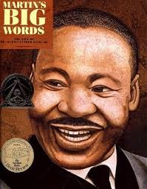
Martin’s Big Words

Slide 3
I can determine the meaning of unknown words.
Notes:
Goal- Students need to engage with the goal- read it, repeat it, write it, etc.

Slide 4
blistering
“They walked in the rain and cold and in blistering heat.”
Notes:
New Information-
Contextualize the word- Find it in the text
“She took raisins, candies, and nuts and gave him two bright eyes, a laughing mouth, and a cowboy vest with fringe.”
Say the word together

Slide 5
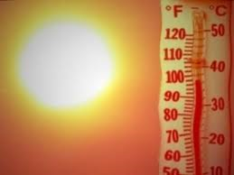
blistering
Very intense heat, hurts like a burn
Synonym: fiery
Notes:
Give student friendly definition
Use the word in other contexts

Slide 6

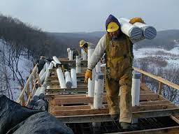
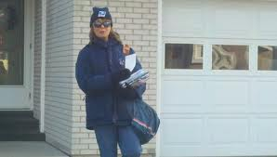
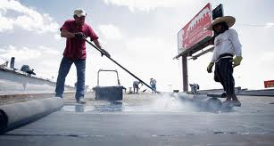
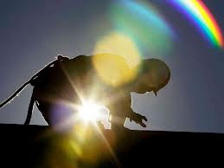
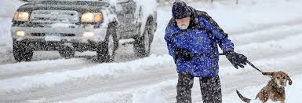
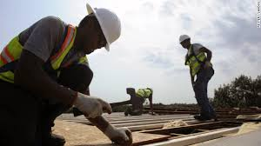
Thumbs up, Thumbs down
Notes:
Engage the students with the word
Thumbs up if this item might have fringe. Thumbs down if not likely.

Slide 7
convinced
“Martin convinced them not to, by reminding them of the power of love.”
Notes:
Contextualize the word- Find it in the text
… “until he met some hungry cowboys riding the range. The cowboys yelled, ‘Stampede!’ They wanted gingerbread too. “
Say the word together

Slide 8
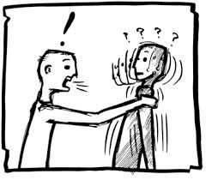
convinced
to make someone agree or believe you
Synonym: persuade
Notes:
Give student friendly definition
Use the word in other contexts

Slide 9
protested
“In the next ten years, black Americans all over the south protested for equal rights.”
Notes:
Contextualize the word- Find it in the text
“He turned down a canyon and raced away as fast as his boots could carry him.”
Say the word together

Slide 10
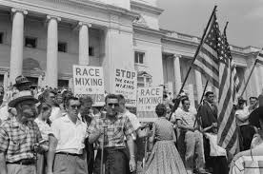
protested
To complain about or object to something that you feel is wrong
Synonym: object
Notes:
Give student friendly definition
Use the word in other contexts

Slide 11
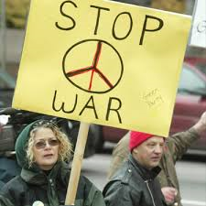
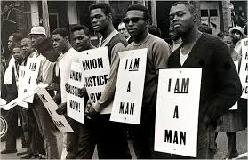
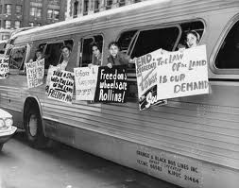
protested

Slide 12
Turn and tell your partner the words and what they mean.
blistering
convinced
protested
Notes:
Read all three words and see if you can use them in one sentence.

Slide 13


Draw a picture or write a sentence to show you know what these words mean.
blistering
convinced
protested
Notes:
Application-
Students need an opportunity to use the words they just learned from the text.

Slide 14
I can determine the meaning of unknown words.
Notes:
Goal-
Revisit the Goal

Slide 15
Day 2

Slide 16
I can determine the meaning of unknown words.
Notes:
Goal- Students need to engage with the goal- read it, repeat it, write it, etc.

Slide 17
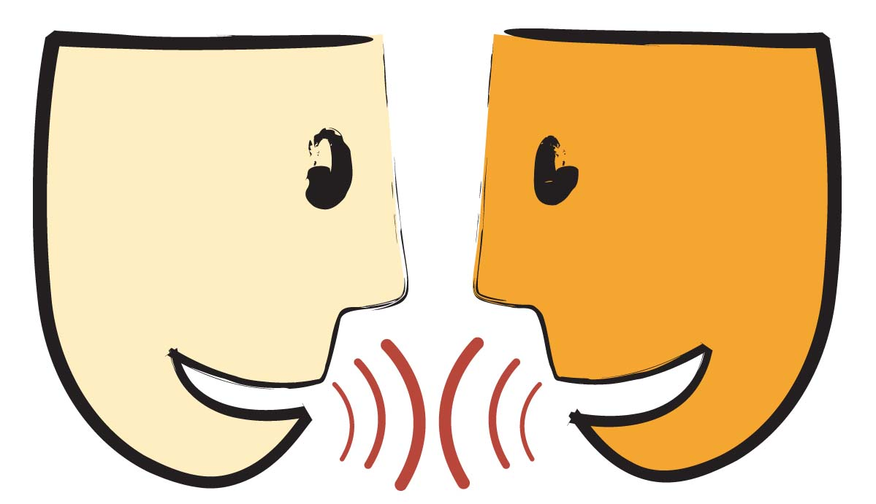
Tell your partner about a new word you learned yesterday.
Notes:
Access Prior Knowledge- (APK)
Turn and Talk
Review 3 words and definitions

Slide 18
Word Association
Which word goes with making others believe you?
Which word is a synonym for fiery?
Which word means to object to something?
blistering
convinced
protested
Notes:
Application
Word Association
Have students explain their thinking

Slide 19
I can determine the meaning of unknown words.
Notes:
Goal- Students need to engage with the goal- read it, repeat it, write it, etc.

Slide 20
Day 3

Slide 21
I can determine the meaning of unknown words.
Notes:
Goal- Students need to engage with the goal- read it, repeat it, write it, etc.

Slide 22
Tell your partner what it means to protest something.
Notes:
Access Prior Knowledge- (APK)
Turn and Talk
Review 3 words and definitions

Slide 23
Describe a time when…
You felt blistering heat
someone might protest (in real life, a book, or a movie)
you had to be convinced of something

Slide 24
I can determine the meaning of unknown words.
Notes:
Goal- Students need to engage with the goal- read it, repeat it, write it, etc.

Slide 25
Day 4

Slide 26
I can determine the meaning of unknown words.
Notes:
Goal- Students need to engage with the goal- read it, repeat it, write it, etc.

Slide 27
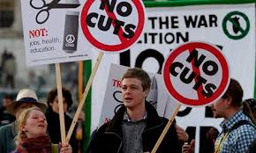
Tell your partner what all of these pictures have in common.
Notes:
Access Prior Knowledge- (APK)
Turn and Talk
Review 3 words and definitions

Slide 28
Turn and Talk
Have you ever had to convince someone of something?

Slide 29
Thumbs up, Thumbs down
Which of these would be blistering heat?
A hot July day
A popsicle
A pot of boiling water
A glass of iced lemonade

Slide 30
I can determine the meaning of unknown words.
Notes:
Goal- Students need to engage with the goal- read it, repeat it, write it, etc.

