Slide 1
Day 1

Slide 2

Henry’s Freedom Box

Slide 3
I can determine the meaning of unknown words.
Notes:
Goal- Students need to engage with the goal- read it, repeat it, write it, etc.

Slide 4
soared
“She was scolding her attendants.”
Notes:
New Information-
Contextualize the word- Find it in the text
“She took raisins, candies, and nuts and gave him two bright eyes, a laughing mouth, and a cowboy vest with fringe.”
Say the word together

Slide 5
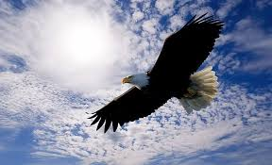
soared
to fly through the air with out difficulty
Synonym: glide
Notes:
Give student friendly definition
Use the word in other contexts

Slide 6

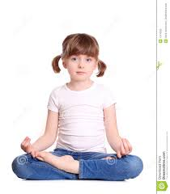
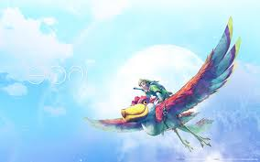
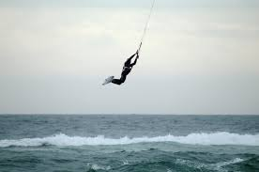
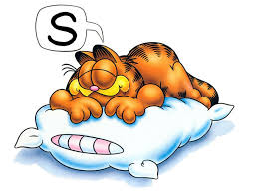
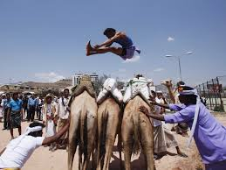
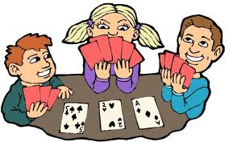
Thumbs up, Thumbs down
Notes:
Engage the students with the word
Thumbs up if this item might have fringe. Thumbs down if not likely.

Slide 7
swirled
“The leaves swirled in the wind. ”
Notes:
Contextualize the word- Find it in the text
… “until he met some hungry cowboys riding the range. The cowboys yelled, ‘Stampede!’ They wanted gingerbread too. “
Say the word together

Slide 8
swirled
To move in a twisting or turning motion
Notes:
Give student friendly definition
Use the word in other contexts

Slide 9
Word Substitution: Use our new vocabulary
word in each sentence below.
The leaves spun around from the gust of wind.
The girls twist quickly at the dance recital.

Slide 10
delivered
“Henry would be delivered to friends in Philadelphia.”
Synonym: to get
Notes:
Contextualize the word- Find it in the text
“He turned down a canyon and raced away as fast as his boots could carry him.”
Say the word together

Slide 11
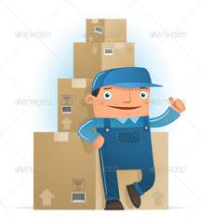
Delivered
to bring or hand over to the proper recipient or address
Notes:
Give student friendly definition
Use the word in other contexts

Slide 12
Turn and tell your partner the words and what they mean.
Soared
Swirled
delivered
Notes:
Read all three words and see if you can use them in one sentence.

Slide 13


Draw a picture or write a sentence to show you know what these words mean.
Soared
swirled
delivered
Notes:
Application-
Students need an opportunity to use the words they just learned from the text.

Slide 14
I can determine the meaning of unknown words.
Notes:
Goal-
Revisit the Goal

Slide 15
Day 2

Slide 16
I can determine the meaning of unknown words.
Notes:
Goal- Students need to engage with the goal- read it, repeat it, write it, etc.

Slide 17
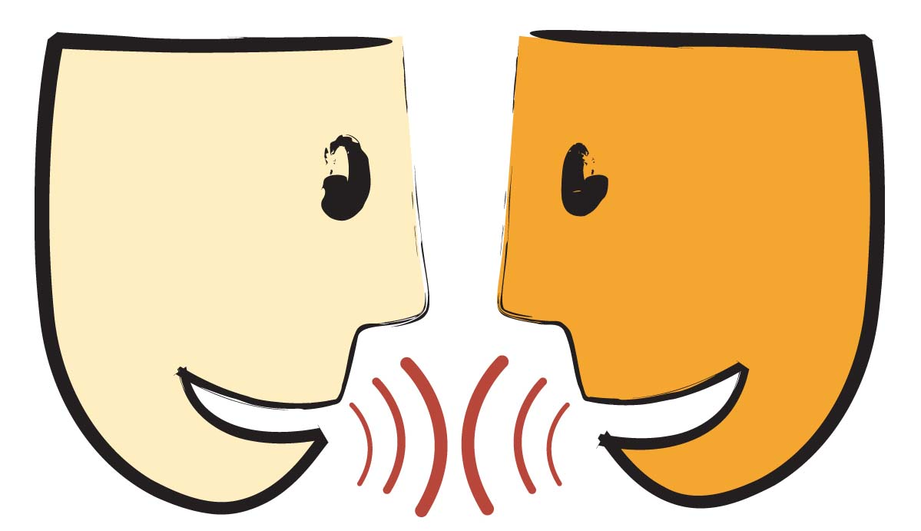
Tell your partner about a new word you learned yesterday.
Notes:
Access Prior Knowledge- (APK)
Turn and Talk
Review 3 words and definitions

Slide 18
Word Association
Which word goes with transport?
Which word is a synonym for glide?
Which word means to move in a twisting motion?
delivered
soared
swirled
Notes:
Application
Word Association
Have students explain their thinking

Slide 19
I can determine the meaning of unknown words.
Notes:
Goal- Students need to engage with the goal- read it, repeat it, write it, etc.

Slide 20
Day 3

Slide 21
I can determine the meaning of unknown words.
Notes:
Goal- Students need to engage with the goal- read it, repeat it, write it, etc.

Slide 22
Tell your partner what it means to be a nuisance.
Notes:
Access Prior Knowledge- (APK)
Turn and Talk
Review 3 words and definitions

Slide 23
Describe a time when…
you delivered something
Someone swirled (in real life, a book, or a movie)
you saw something soar (in real life, a book, or a movie)

Slide 24
I can determine the meaning of unknown words.
Notes:
Goal- Students need to engage with the goal- read it, repeat it, write it, etc.

Slide 25
Day 4

Slide 26
I can determine the meaning of unknown words.
Notes:
Goal- Students need to engage with the goal- read it, repeat it, write it, etc.

Slide 27
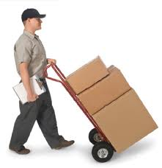
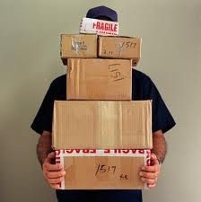
Tell your partner what all of these pictures have in common.
Notes:
Access Prior Knowledge- (APK)
Turn and Talk
Review 3 words and definitions

Slide 28
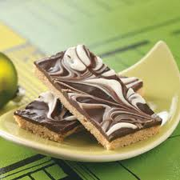
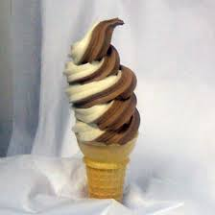
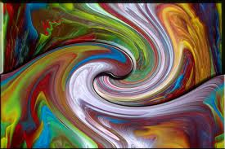
Tell your partner what all of these pictures have in common.

Slide 29
Have you ever had to deal with a nuisance?

Slide 30
I can determine the meaning of unknown words.
Notes:
Goal- Students need to engage with the goal- read it, repeat it, write it, etc.

