Slide 1

2nd Grade
Context Clues
Unit 4

Slide 2
I can words and pictures to find the meaning of a word.
L.2.4.a
Notes:
Goal-
Students need to engage with the goal- read it, repeat it, write it, etc.

Slide 3
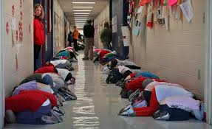
Talk to your partner about what is going on in this picture.
Notes:
Access Prior Knowledge- (APK)
Turn and Talk

Slide 4
What does the word haven mean?
In a clearing: the safe haven.
Harriet knows that most strangers would turn her in, not help her. But the farmer’s wife feeds Harriet, then tells her to sweep the yard.
Notes:
Contextualize the word- Find it in the text
Say the word together

Slide 5
Use the picture and words to find the meaning of the word woes.
But freedom brings new woes. Lord, I am a stranger here; All my kin are down south.
Notes:
Contextualize the word- Find it in the text
Say the word together

Slide 6
Use pictures and words to find out the meaning of shun.
Notes:
Copy the page of the book that contains the word shun for each student. The students will write the meaning of the word shun on the page.

Slide 7
I can words and pictures to find the meaning of a word.
Notes:
Goal-
Revisit the Goal

