Slide 1
Literary Analysis
Prose Constructed Response
2nd Grade, Unit 4
5th Grade, Unit 4
Modeled after PARCC Practice Test Items and Information from the Test Specs.

Slide 2
Note to 2nd Grade Teachers:
The following writing prompt is modeled after the Literary Analysis Task from the PARCC Performance Based Assessment. The suggestion is to give students about 20 minutes to write to the prompt. This is under the understanding that students have previously read and discussed both texts. Giving them about 20 minutes to write to the prompt was the suggestion from a PARCC presenter. She estimated that this is about how long they should have left when they reach this point in the assessment.
Teachers could use this prompt to assess the following standards:
RL.2.3 Describe how characters in a story respond to major events and challenges.
RL.2.7 Use information gained from the illustrations and words in a print or digital text to demonstrate understanding of its characters, setting, or plot.
W.2.1 Write opinion pieces in which they introduce the topic or book they are writing about, state an opinion, supply reasons that support the opinion, use linking words (e.g., because, and, also) to connect opinion and reasons, and provide a concluding statement or section

Slide 3
Note to 5th Grade Teachers:
The following writing prompt is modeled after the Literary Analysis Task from the PARCC Performance Based Assessment. The suggestion is to give students about 20 minutes to write to the prompt. This is under the understanding that students have previously read and discussed both texts. Giving them about 30-45 minutes to write to the prompt was the suggestion from a PARCC presenter. She estimated that this is about how long they should have left when they reach this point in the assessment.
Teachers could use this prompt to assess the following standards:
RL.5.3 Compare and contrast two or more characters, settings, or events in a story or drama, drawing on specific details in the text (e.g., how characters interact).
RL.5.7 Analyze how visual and multimedia elements contribute to the meaning, tone, or beauty of a text (e.g., graphic novel, multimedia presentation of fiction, folktale, myth, poem).
W.5.1 Write opinion pieces on topics or texts, supporting a point of view with reasons and information.
W.5.9 Draw evidence from literary or informational texts to support analysis, reflection, and research.

Slide 4
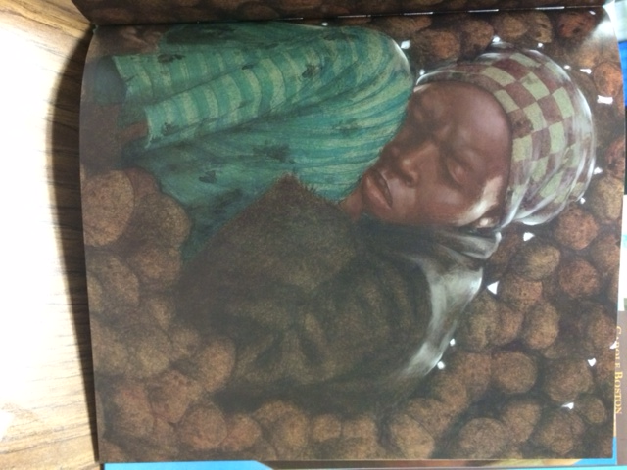
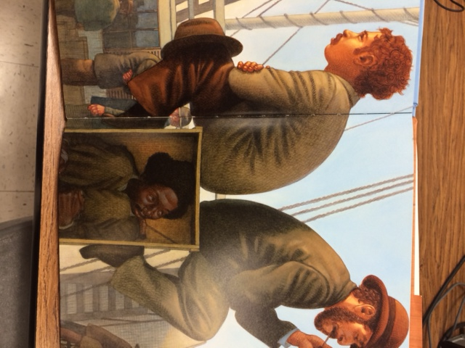
Write an essay telling how Kadir Nelson used the illustrations to show how Harriet Tubman and Henry “Box” Brown faced challenges. Use evidence from the illustrations to support your response.

