Slide 1

2nd Grade Text Talk
Unit 3

Slide 2
I can make real-life connections to new words.
L.2.5.a
Notes:
Goal-
Students need to engage with the goal- read it, repeat it, write it, etc.

Slide 3

Tell your partner about a new word you learned last week.
Notes:
Access Prior Knowledge- (APK)
Turn and Talk

Slide 4
fragrant
Notes:
Contextualize the word- Find it in the text
Say the word together

Slide 5
Can you use context clues to figure out the meaning of fragrant?
She ducked into shaded, cobbled alleyways and pranced through sunlit courtyards fragrant with the sweet smell of rosemary.

Slide 6
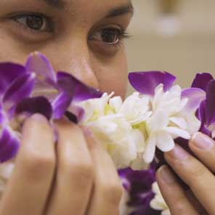
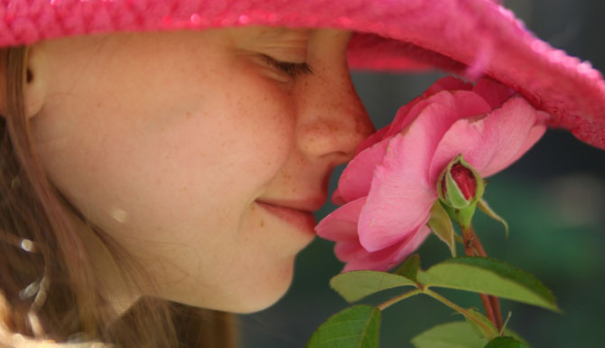
fragrant
Having a pleasant or sweet smell.
Notes:
Give student friendly definition
Use the word in other contexts

Slide 7

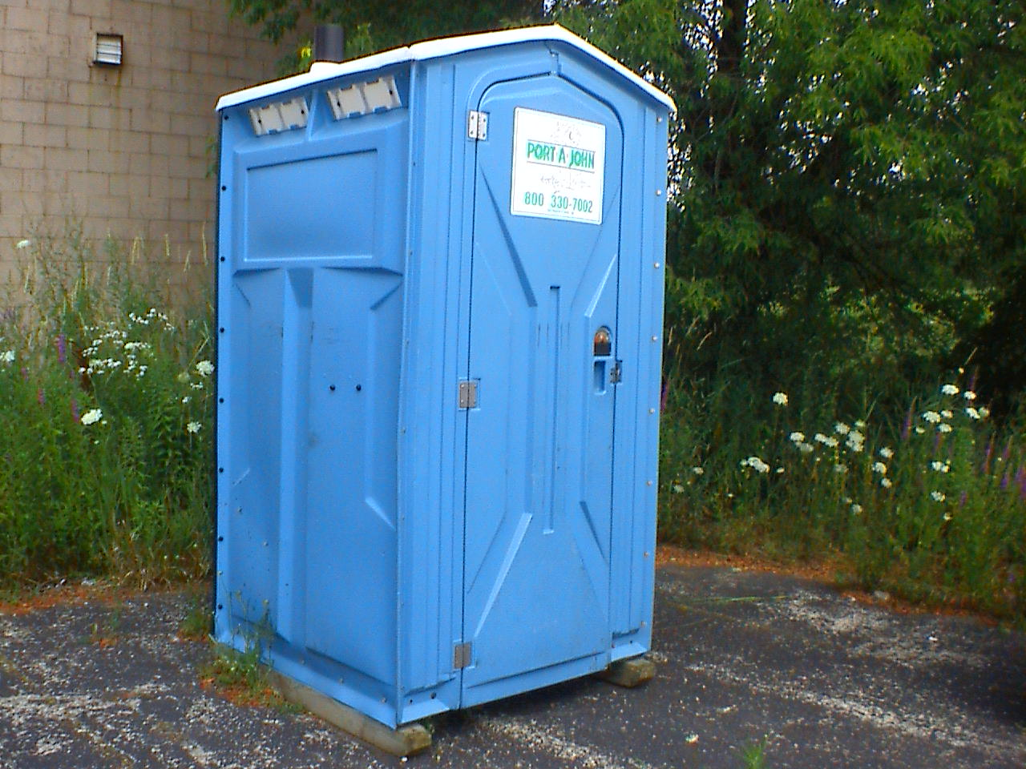

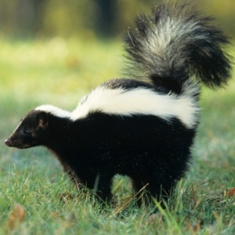
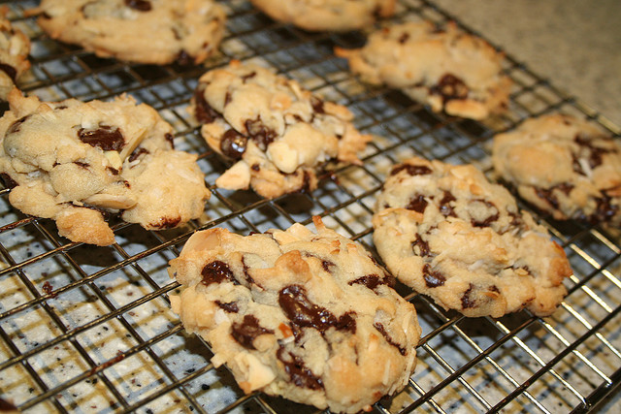
Thumbs up, Thumbs down
Is this fragrant? (click for pictures)
Notes:
Engage the students with the word

Slide 8
hustle and bustle
Notes:
Contextualize the word- Find it in the text
Say the word together

Slide 9

hustle and bustle
Busy and noisy activity
Click on the picture to see the hustle and bustle of Grand Central Station in New York.
Notes:
Give student friendly definition
Use the word in other contexts

Slide 10

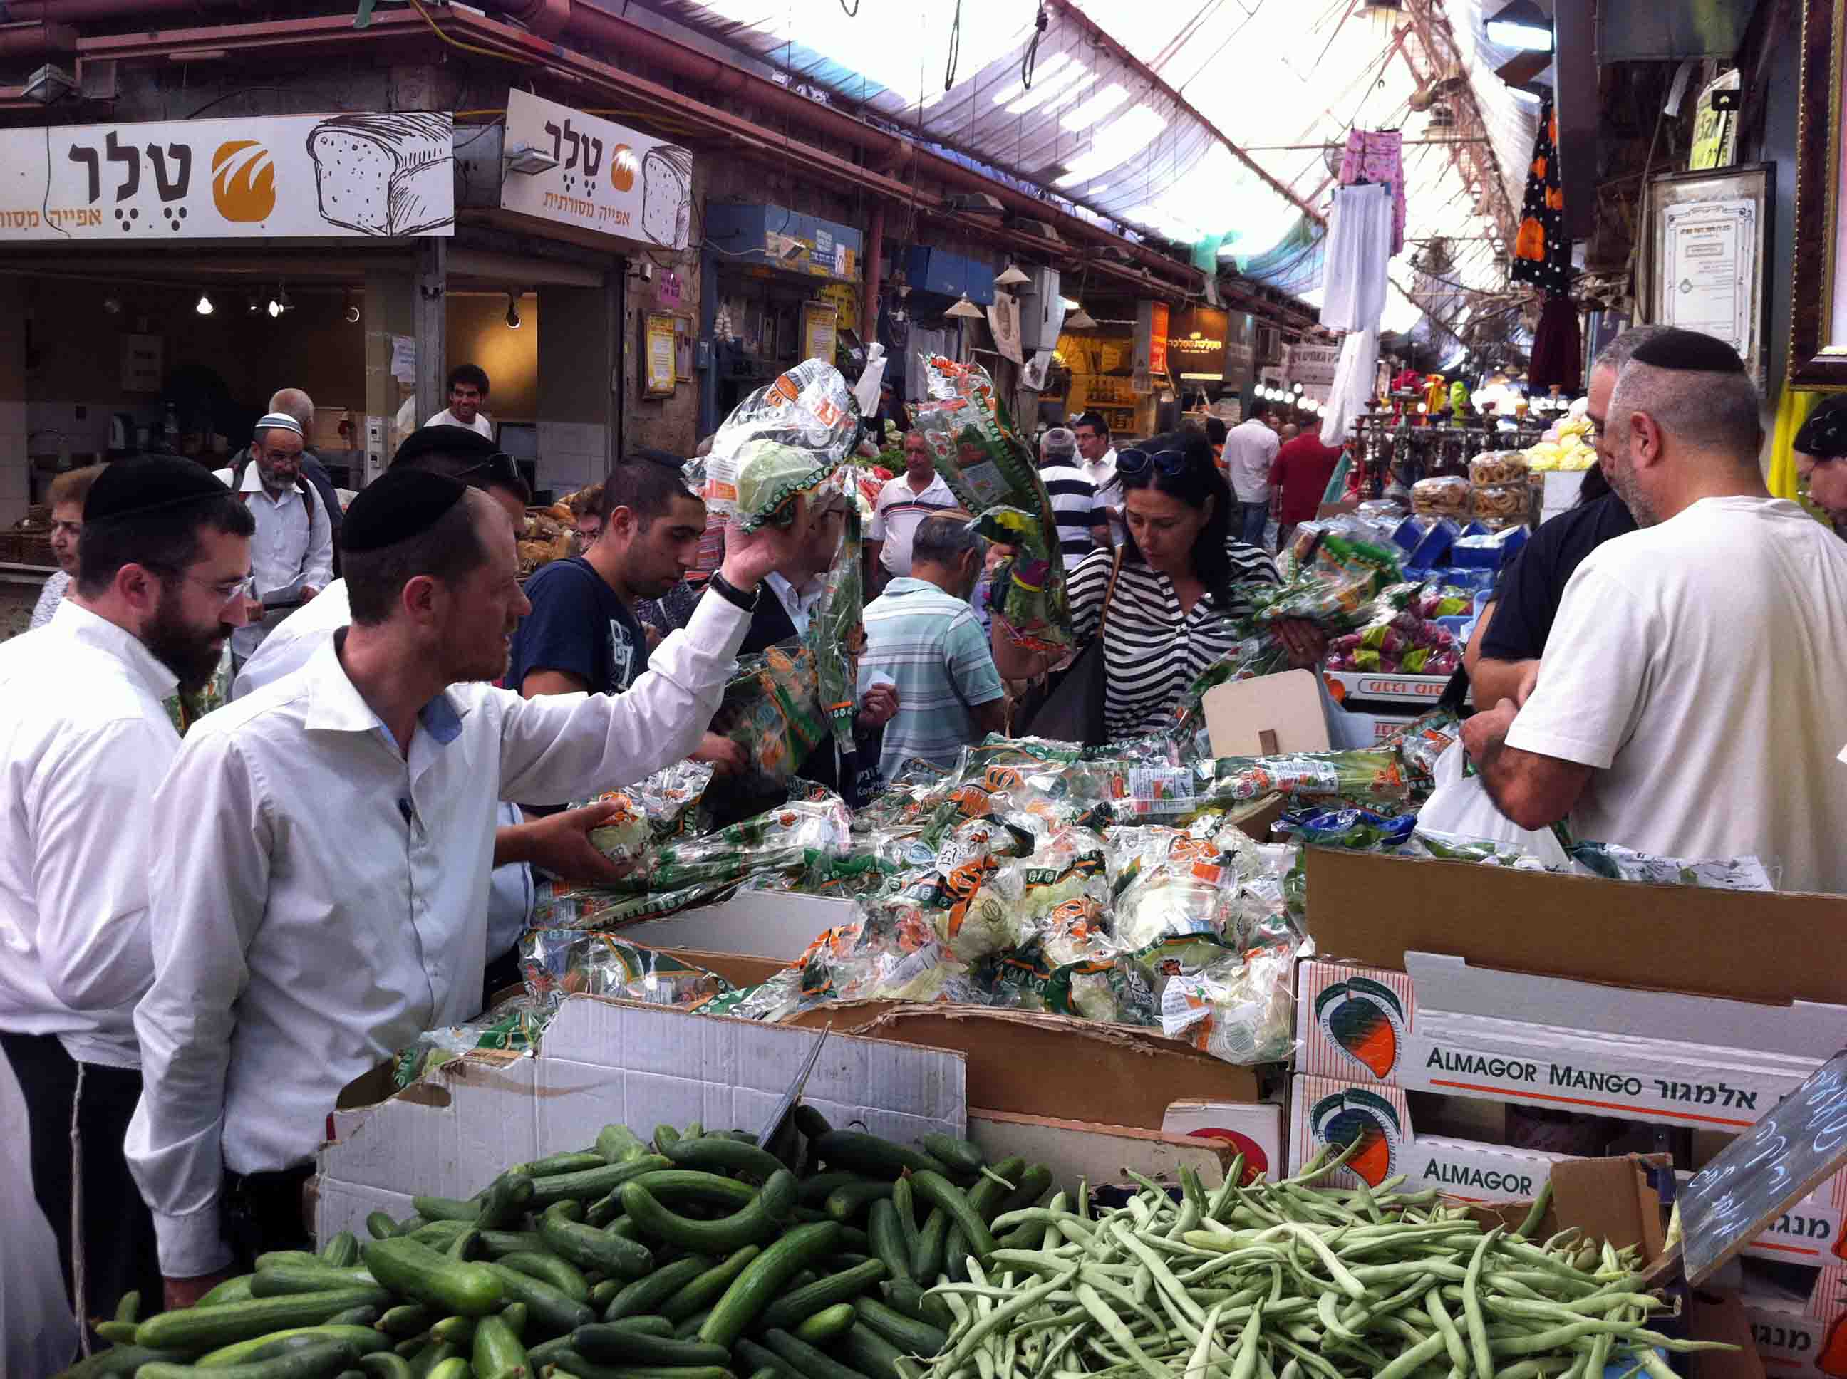
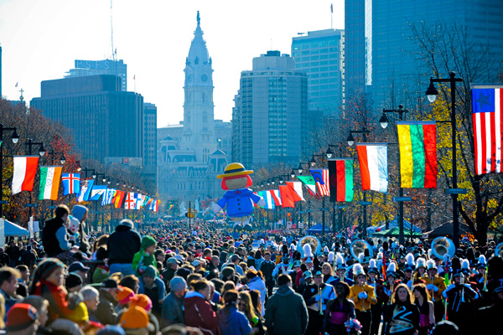
Which places would you experience
hustle and bustle?
Notes:
Engage the students with the word

Slide 11
accused
Notes:
Contextualize the word- Find it in the text
Say the word together

Slide 12

accuse
(accused)
to charge someone with wrong doing
Notes:
Contextualize the word- Find it in the text
Say the word together

Slide 13
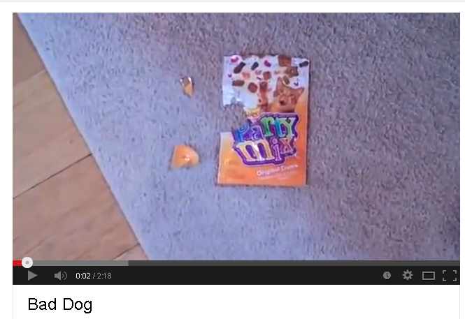
Who would you accuse?
(Click to the photo to see the video)
Notes:
Engage the students with the word

Slide 14
Who can use all 3 words/phrases in a sentence?
fragrant
hustle & bustle
accused
Notes:
Read all three words and see if you can use them in one sentence.

Slide 15
I can make real-life connections to new words.
Notes:
Goal-
Revisit the Goal

