Slide 1
Galloping Gertie
Using adverbs to describe actions

Slide 2
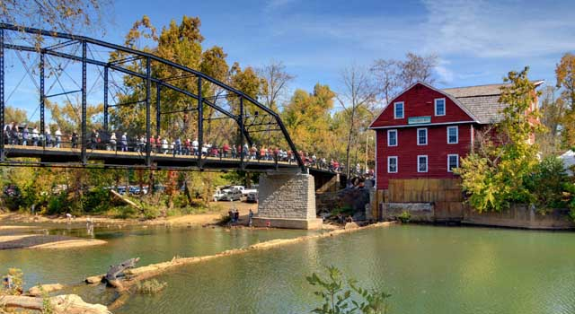
Have you ever walked across a bridge?
when
how
where
Notes:
APK
Turn and talk- Have you ever walked across a bridge?
How did you walk across? When? Where?

Slide 3
Goal:
I can use adverbs to tell more about actions.
Notes:
Goal

Slide 4
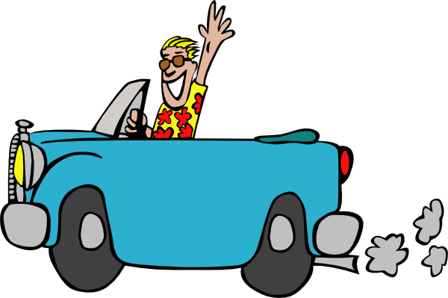
Adverb
A word that tells more about an action
Notes:
New information:
An adverb is a word that describes an action.

Slide 5
The car drove slowly.
Notes:
Click and the car drives.

Slide 6
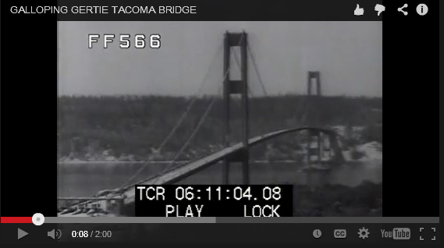
Galloping Gertie Tacoma Bridge
(Click to view the video)

Slide 7
Adverbs describe actions.
They tell…
when
how
where

Slide 8
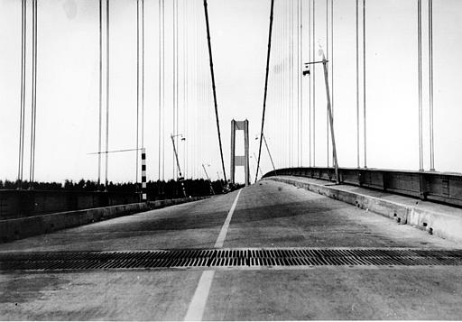
Fill in the blank with an adverb to describe how the bridge swayed.
Adverbs
dangerously
noisily
quickly
quietly
slowly
violently
The bridge swayed _________________ in the wind.

Slide 9
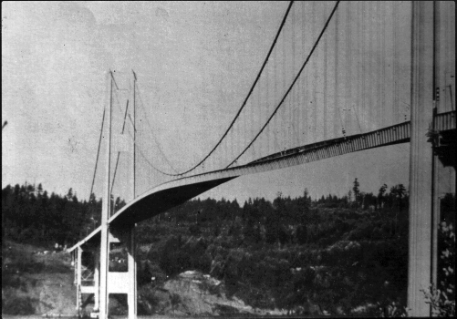
Fill in the blank with an adverb to describe when the bridge swayed.
Adverbs
frequently
often
rarely
suddenly
sometimes
today
yesterday
The bridge swayed _________________.

Slide 10
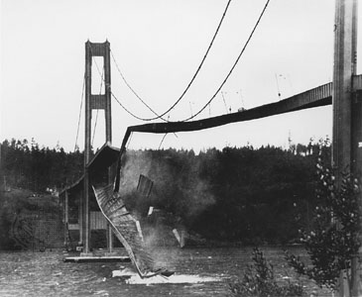
Fill in the blank with an adverb to describe where the bridge fell.
Adverbs
away
below
down
here
nearby
off
there
The bridge fell _________________.

Slide 11
What do you think it felt like to walk across Galloping Gertie?
Imagine you lived in Tacoma in 1940. Write a paragraph describing your walk across the bridge. Make sure to use adverbs to describe your actions.
when
how
where
Notes:
Application

Slide 12
Goal:
I can use adverbs to tell more about actions.
Notes:
Goal

