Slide 1
Describing Bridges
Using Adjectives
2nd Grade Unit 3

Slide 2
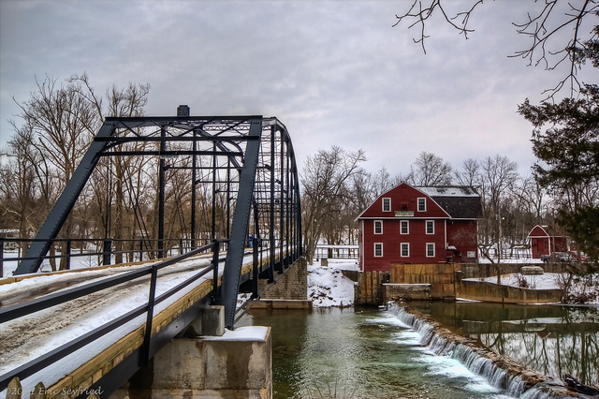

Turn and talk about this bridge in Arkansas.
Click the photograph to see a video clip
Notes:
APK

Slide 3
Goal:
I can use adjectives to tell more about a noun.

Slide 4
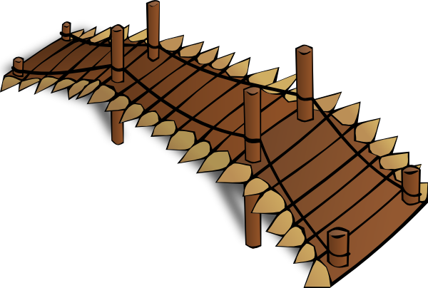
Adjective
An adjective is a word that tells us more about a noun.
short
wooden
brown
Notes:
New Information-
An adjective is a word that tells us more about a noun.

Slide 5
War Eagle Mill Bridge, Arkansas
The _____________ bridge led to the mill.
Notes:
Application
Practice using nouns to tell more about these bridges.

Slide 6
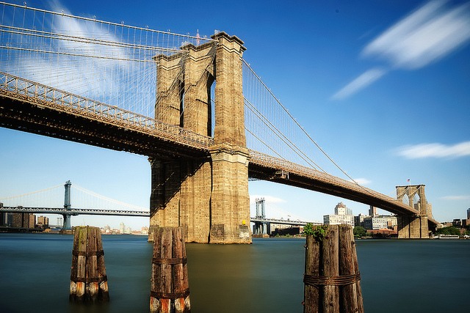
Brooklyn Bridge, New York
The _____________ bridge stretched across the river.

Slide 7
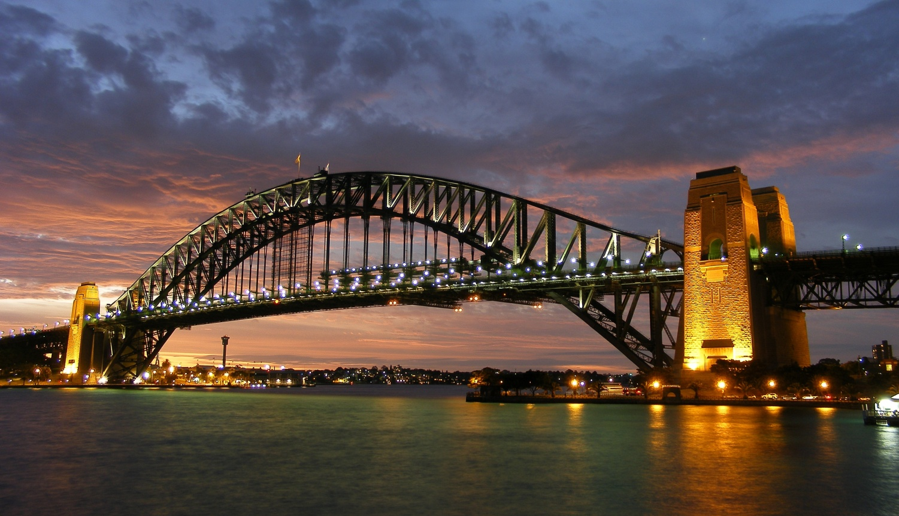
Sydney Harbor Bridge, Australia
The bridge is ______________________.

Slide 8
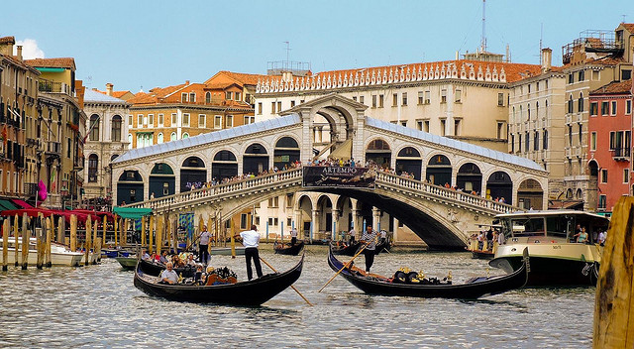
Rialto Bridge, Italy
_____________ bridges help people cross the canals.

Slide 9
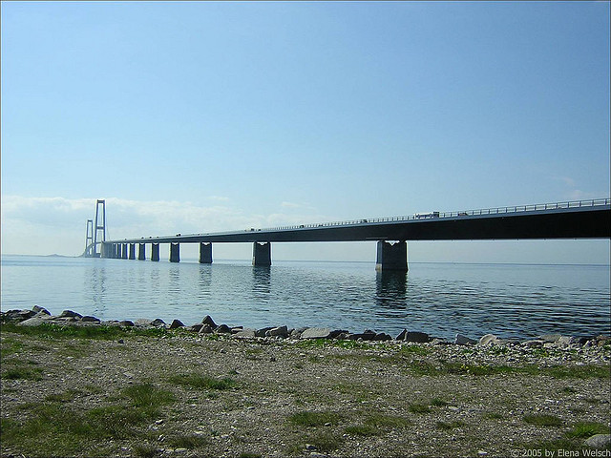
Great Belt Bridge, Denmark
The bridge was _____________________.

Slide 10
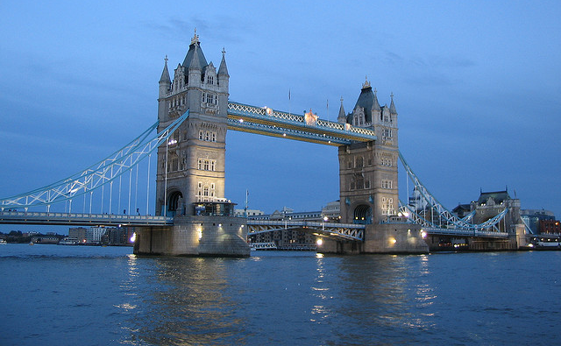
Tower Bridge, London
The lights made the _________________ bridge glow.

Slide 11
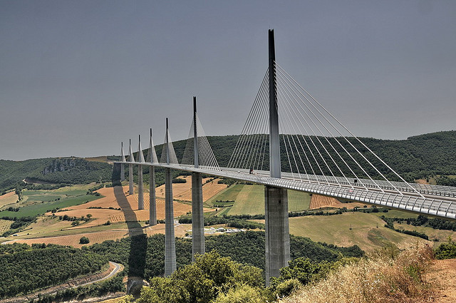
Millau Bridge, France
The people of France built a _____________ bridge.

Slide 12
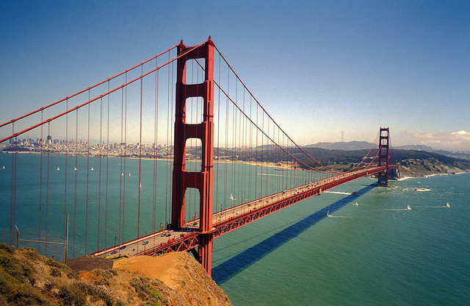
Golden Gate Bridge, San Francisco
I want to visit the ________________ bridge.

Slide 13
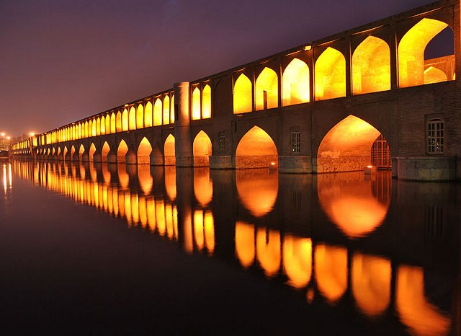
Si-o-se Pol, Iran
The _____________ bridge is 295 meters long.

Slide 14
Choose a photograph of one of the bridges. Write a paragraph that describes the bridge. Use adjectives in your description.
Notes:
Application:
Write a paragraph describing one of the bridges.

Slide 15
Goal:
I can use adjectives to tell more about a noun.
Notes:
Revisit the goal

