Slide 1
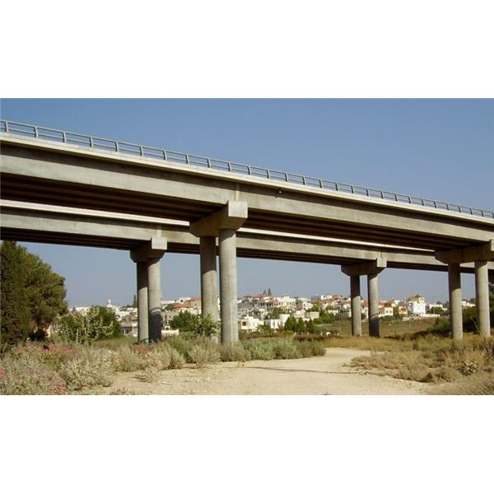
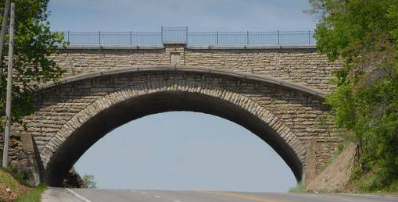
Bridges
Picture yourself on the side of a river. In the middle of the river are mean, ugly crocodiles. You need to get to the other side. What can you do to help get you to the other side? You can build a bridge! A bridge is a structure made by men that connects pieces of land. Bridges can come in many shapes and sizes. They can be made out of wood, stone, steel, or other kinds of metal. Their goal is simple: to help people get from one place to another safely.
beam
One of the 3 main kinds of bridge is a beam bridge. A beam bridge is made by having a long beam lay across a space to connect two places. The beam is a flat piece of wood, metal, or concrete that gives people a way to walk or ride across. Under the beams are tall poles or posts, called piers, that help to hold up the beams. Beam bridges are the most simple kind of
posts
bridge to create, and they are also the least expensive. Beam bridges are best if you don’t have to cross a huge distance.
Keystone- top of the arch
Another type of bridge is the
arch bridge. The arch bridge is special
because it can hold a lot of weight. The curve shape helps the weight to push out not down. The abutments, which are the ends of the bridge, are super strong and carry all of the weight that is pushed to them from the middle. Abutments
abutments

Slide 2
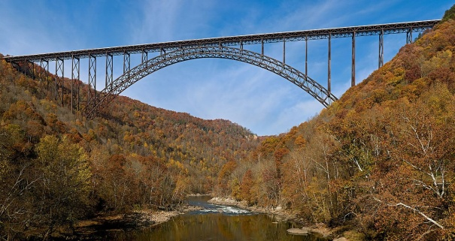
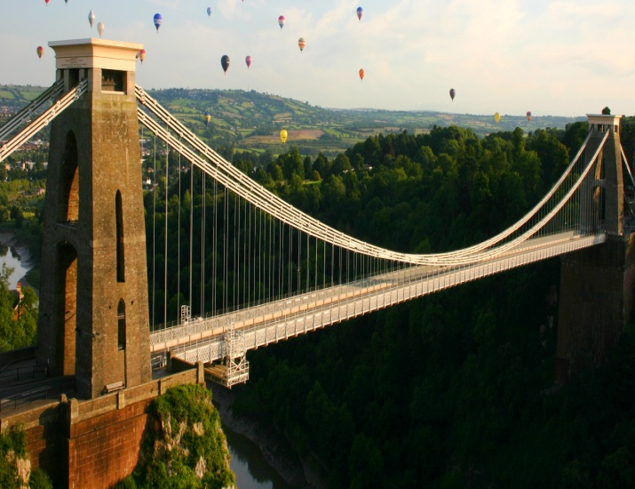
are the superheroes of the arch bridge. An arch bridge is also special because it can be built much higher than a beam bridge can. This helps ships to pass underneath the bridge. The arch bridge is the most beautiful of all of the bridges. Many famous arch bridges are still in our world today.
The New River Gorge bridge is an arch bridge in Fayetteville, West Virginia.
The last type of bridge is called a suspension bridge. They are the most expensive kind of bridge. They are also very difficult to create. A suspension bridge is made by building several towers. These towers let cables hang down and hold the deck in the air. The deck is the part you walk or drive on. Underneath the deck are truss systems. These truss systems are groups of triangles hooked together to let wind pass through, but they also support the deck. This keeps the bridge from swaying on a windy day or in a storm. Suspension bridges are much longer than any other type of bridge. They are amazing to both the people that use them and the people that are able to create them.
cables
deck
deck
tower
tress system
Would you like to be a bridge builder? It is not an easy job. You have to be able to use all of the seven habits, especially synergize. It takes many people to accomplish such a huge task. How cool would it be to see a picture in a magazine one day and know you were a part of creating such a beautiful, useful, and strong structure!

Slide 3
Name: _______________________ Date: ___________
What are two types of materials that can be used to make a bridge?
____________________________________________________________
____________________________________________________________
2. Which bridge is the most simple kind to make?
____________________________________________________________
____________________________________________________________
3. Which bridge is the most expensive to make?
____________________________________________________________
____________________________________________________________
4. What do you learn by using the labels?
____________________________________________________________
____________________________________________________________
What do you learn by reading the caption under the photograph?
_________________________________________________
_________________________________________________

