Slide 1
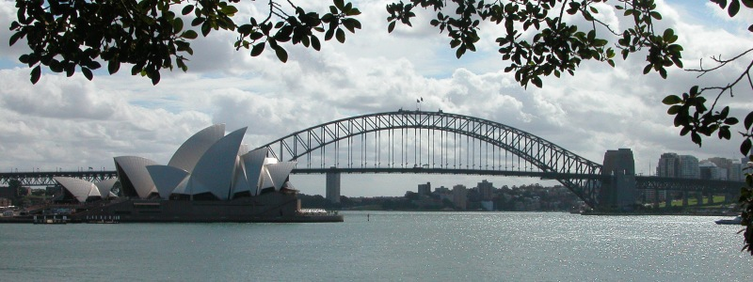
Name: ___________________________________ Date:_________________
The Sydney Harbour Bridge
Can you believe it took 42 years to plan and build one bridge? Well that is just what happened with the Sydney Harbour Bridge in Sydney, Australia. In 1890 the people in Australia had a problem. There were so many people having to ride a ferry, which is a boat that carries people and cars across a body of water. It took a long time for people to ride the ferry. They decided they needed to build a bridge. While they were trying to plan the bridge, World War 1 broke out. They had to stop. After the war, they started to build again. The bridge was finished and opened in 1932.
The bridge is very pretty and very big. It weighs 39,000 tons, which is equal to the weight of about 1,200 garbage trucks. That is one heavy bridge! Cars, trucks, bicycles, and walkers can go across the bridge.
For many years the Sydney Harbour Bridge has been a special place in Australia. People from all over the word come to see it. Visitors pay money to go across the bridge. In 2000, the Olympic games were in Sydney. The bridge was the special place where they hung the rings. It was a beautiful sight. This bridge is very special to the people of Australia and recognized by people all over world.

Slide 2
How long did it take to build the Sydney Harbour Bridge?
_______________________________________________________________________
_______________________________________________________________________
2. When were the Olympic Games in Sydney, Australia?
_______________________________________________________________________
_______________________________________________________________________
3. Why did the people in Sydney need a bridge?
_______________________________________________________________________
_______________________________________________________________________
4. Why did they have to stop planning and building the bridge for a little while?
_______________________________________________________________________
_______________________________________________________________________

