Slide 1
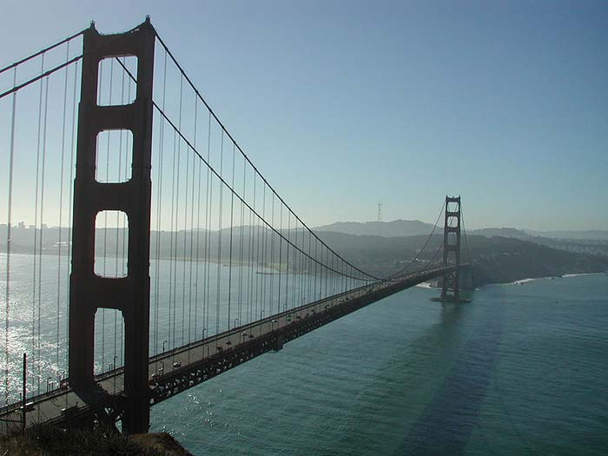
The Golden Gate Bridge
The Golden Gate Bridge in San Francisco, California is a suspension bridge. A suspension bridge is a bridge that is held by cable wires. The wires are hung between large tall towers. Many people thought the bridge was impossible to build. After many years of planning, the bridge was started on January 5, 1933. It was completed in April 1937 and opened to pedestrians, or walkers, that year. It was soon opened to cars too.
Before the bridge was built, the only way across the bay was by boat. It would take about 25 minutes to cross the Bay. After the bridge was built, it only took 10 minutes to cross the bridge. The speed limit on the bridge is only 45 miles per hour to help keep people safe.
The Golden Gate Bridge is huge and is said to be the most beautiful bridge in the world. It is definitely the most photographed bridge in the world. It is 1.22 miles long. The distance between the tall towers that help to hold it up is is 4200 ft, which is the length of 14 football fields. The towers are 750 feet tall above the water, which would be about 125 people stacked on top of each other. WOW!
The bridge has six lanes of vehicle traffic. It also has
walkways on both sides of the bridge. The middle barrier, or wall,
between the lanes can be moved to allow more or less traffic to
move across. One lane is always for walkers and another lane is for
people riding bicycles. However, this can change when construction
is taking place. No one can walk on the bridge at night for safety reasons.
More than 1.9 billion cars have used the Golden Gate Bridge to
cross the San Francisco Bay since it was first built. Since September 2002,
it costs vehicles $5.00 per car to drive across the bridge going one way.
It does not cost anything to ride a bike or walk across. You also do not have
to pay to drive back across if you pay $5.00 to go across one way.
The Golden Gate Bridge is known as one of the most
amazing man made creations of all time!

Slide 2
What is a suspension bridge?
_______________________________________________________________________
_______________________________________________________________________
2. When was the Golden Gate Bridge completed?
_______________________________________________________________________
_______________________________________________________________________
3. Where is the Golden Gate Bridge located?
_______________________________________________________________________
_______________________________________________________________________
4. Why can people NOT walk on the bridge at night?
_______________________________________________________________________
_______________________________________________________________________
5. How can people travel across the bridge? Make sure to list all 3 ways.
_______________________________________________________________________
_______________________________________________________________________

Slide 3
The Golden Gate Bridge
Have you ever seen this bridge in a picture?
I bet you have! This is the Golden Gate bridge and it
is one of the most famous bridges in the world. It is
in San Francisco, California. It is made by wires that
are hung between large, tall towers. That kind of
bridge is called a suspension (sus-pen-shun) bridge.
It took four years to build this bridge.
Before the bridge was built, people had to take a boat across the Bay. It took 25 minutes to ride across on the boat. After the bridge was built, it only takes 10 minutes to drive across it. That is much faster! Cars can drive on the bridge. People can walk and ride bicycles across the bridge too. At night, people can not walk on the bridge. It would not be safe for them.
The bridge is very, very tall. It is as tall as 125 people stacked on top of each other. It is also very long. It takes a little more than a mile to go from one side to the other. Lots of cars and trucks drive across this bridge every day. The Golden Gate Bridge one of the most
amazing man made bridges of all time!

Slide 4
How long did it take to build the Golden Gate Bridge?
_______________________________________________________________________
_______________________________________________________________________
2. When are people not allowed to walk on the bridge?
_______________________________________________________________________
_______________________________________________________________________
3. Where is the Golden Gate Bridge located?
_______________________________________________________________________
_______________________________________________________________________
4. Why can people NOT walk on the bridge at night?
_______________________________________________________________________
_______________________________________________________________________

