Slide 1
Building Bridges With Unlikely Friends
2nd Grade, Common Core Unit 3
Mrs. Maribeth Williams – 2nd Grade teacher
Mrs. Deborah Goff - Literacy Facilitator
The Students in Room 508
Old Wire Road Elementary

Slide 2
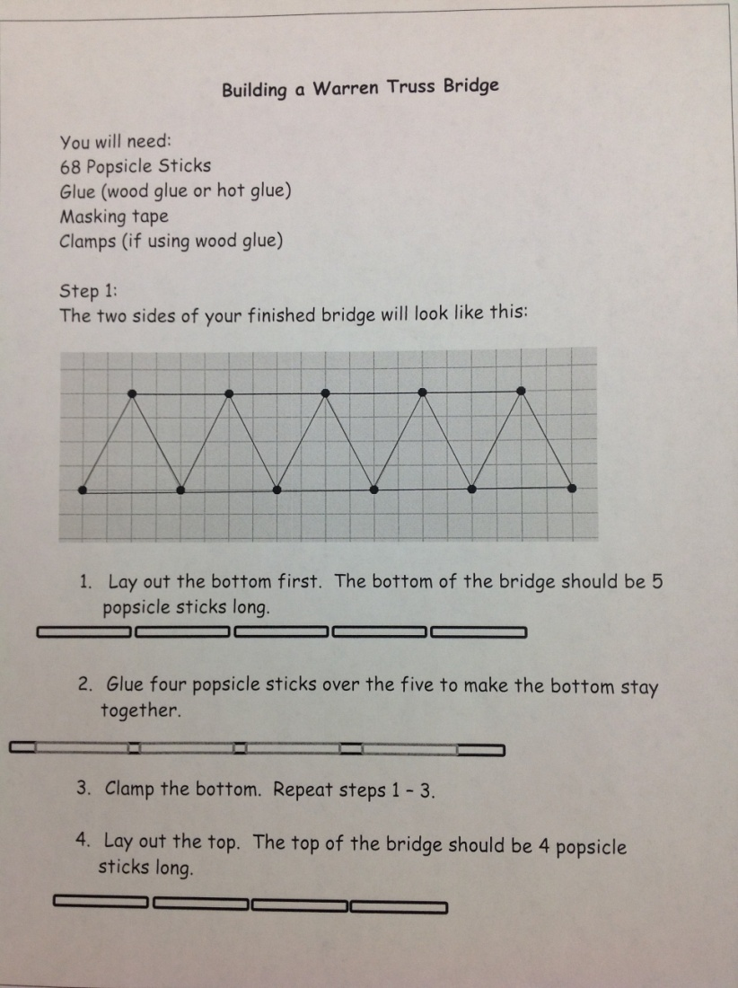
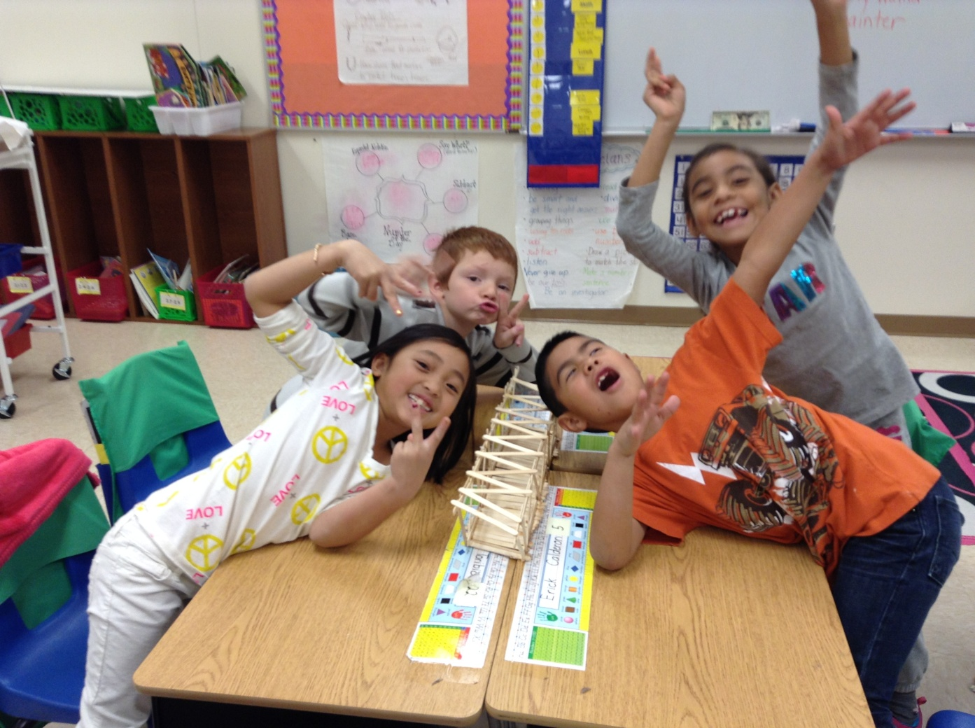
We began by building a model bridge together.
Notes:
In the push to meet the standard of the new CCSS, we often forget that connections made through projects help students to grasp difficult concepts. (RI.2.7 is used in reading the directions in that both print and images help to clarify the instructions.)
We started in Mrs. Williams’ class by building a model bridge with popsicle sticks. We used step-by-step instructions and worked together in groups. (These step-by-step instructions would give students real-world experience from which to write a “how-to.”) (Activity 1, W.2.2; SL.2.6; RI.2.3; RI.2.7: Also, W.2.7 – shared writing projects.)
How do authors use the phrase “building a bridge” to explain how we connect with each other? (RL.2.4)

Slide 3
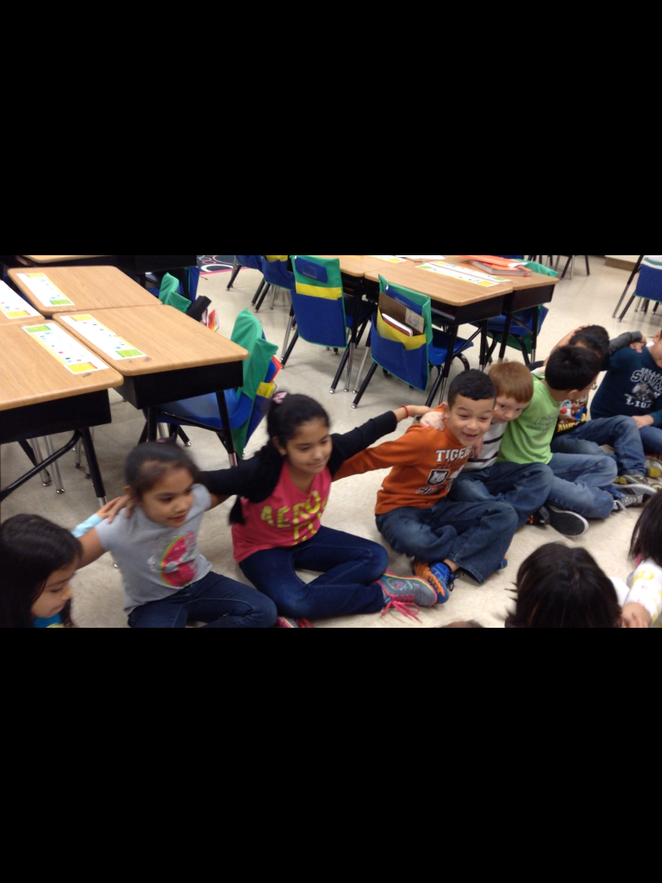
We built partnerships
Notes:
Throughout the process we talked about how each of the groups had to build a bridge between the partners in order to work together to build the model bridge. This was a constant theme as we worked. We learned the song “Love Can Build a Bridge” by the Judds. (S.L.2.1)

Slide 4
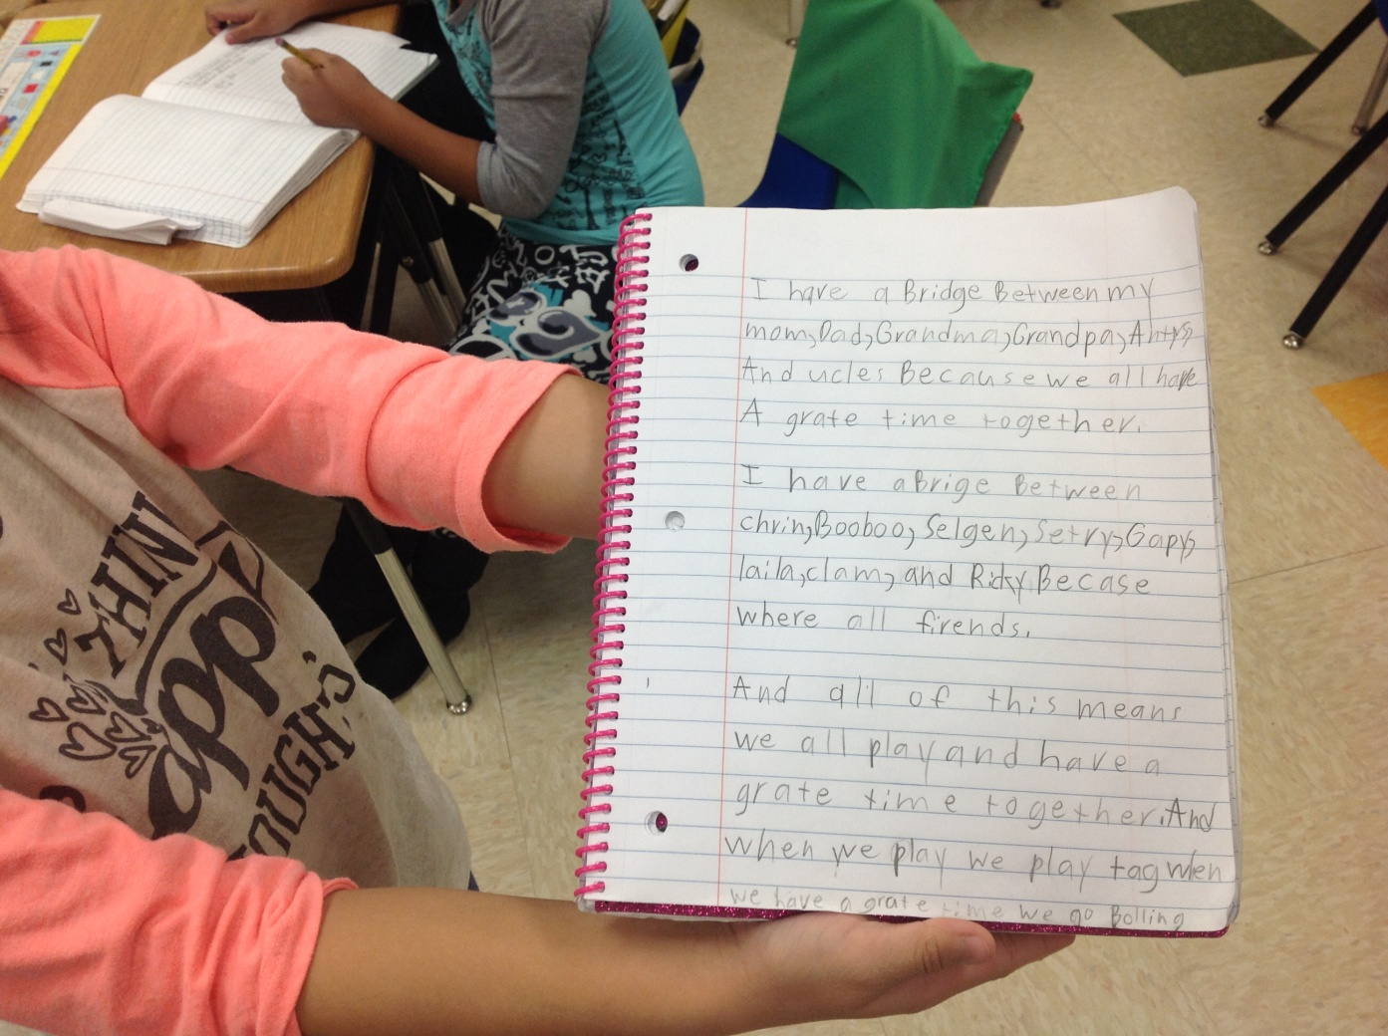
We wrote about building bridges
Notes:
Students wrote about the bridges they have built between family members and friends. (W.2.3; W.2.5;

Slide 5
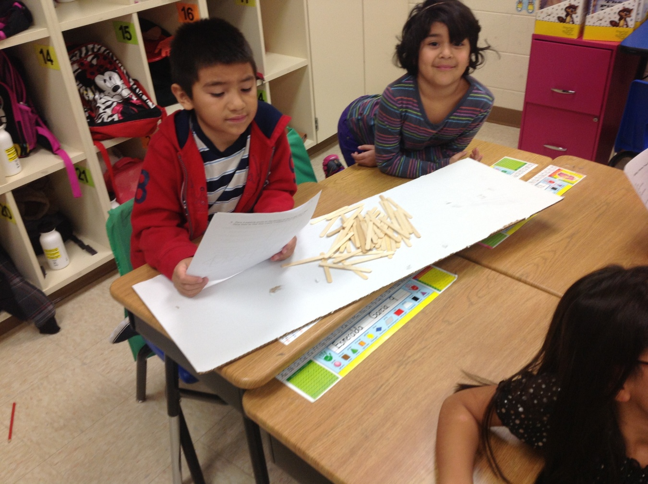
We chronicled our journey
Please click the picture to see the “trailer”

Slide 6
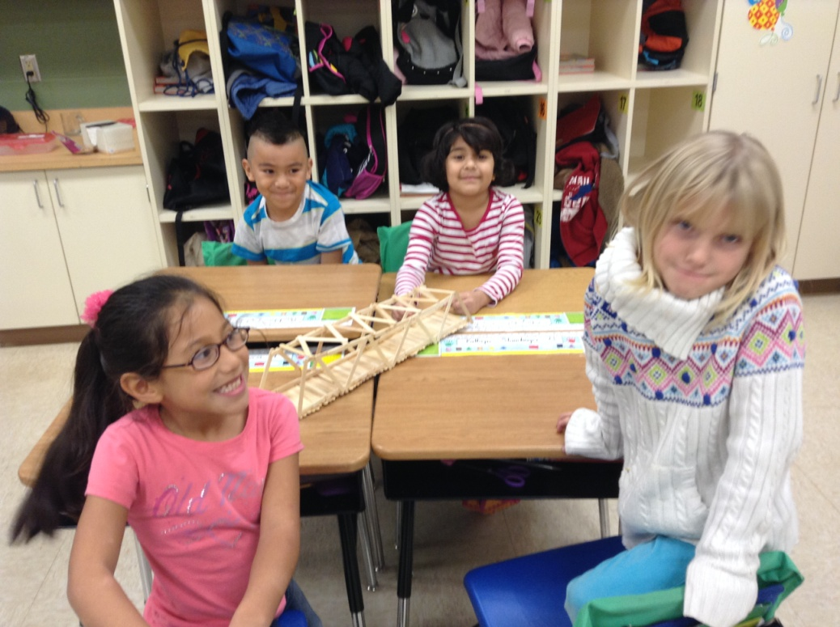
We know what it means to build bridges with wood….and in our hearts!
Please click the picture to see the full length documentary of our journey….

