Slide 1
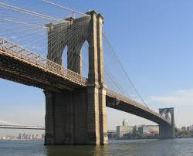
The Brooklyn Bridge
Did you know we have a huge and famous bridge right here in the United States? It is in Brooklyn, New York. This bridge took 14 years and around $15 million to build. Wow, that’s longer than a second grader has been alive. Twenty seven people died while building the bridge.
The Brooklyn Bridge opened to the community on May 24, 1883. It made a way for people to travel from Manhattan to Brooklyn for the first time. Those two cities in New York are only 10 miles away from each other. People in the community were so surprised at how tall the towers were. They were 270 feet tall. Can you believe that is longer than an airplane is? The people were also surprised at how the cables were able to hold the bridge up. Another interesting fact about the Brooklyn Bridge is it was built to be over 1,595 feet long. When it was built it was by far the longest suspension bridge in the world.
Even today the Brooklyn Bridge is one of the United States’ most famous bridges. Students that live in New York get to take field trips to see the bridge to learn all about it. People that live in New York travel on the Brooklyn Bridge everyday.

Slide 2
Name: __________________________ Date:__________________________
Where is the Brooklyn Bridge located?
___________________________________________________________________
How long did it take to make the Brooklyn Bridge?
___________________________________________________________________
What was one thing that people were surprised about when the bridge was built?
___________________________________________________________________
How much money did it cost to build the Brooklyn Bridge?
___________________________________________________________________

