Slide 1
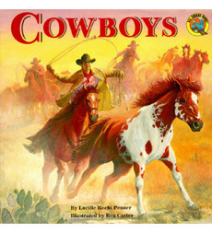
2nd Grade Text Talk
Unit 2

Slide 2
Part 1
Read ½ of the book- stop after reading about the cowboy’s clothes.

Slide 3
I can make real-life connections to new words.
L.2.5.a
Notes:
Goal-
Students need to engage with the goal- read it, repeat it, write it, etc.

Slide 4
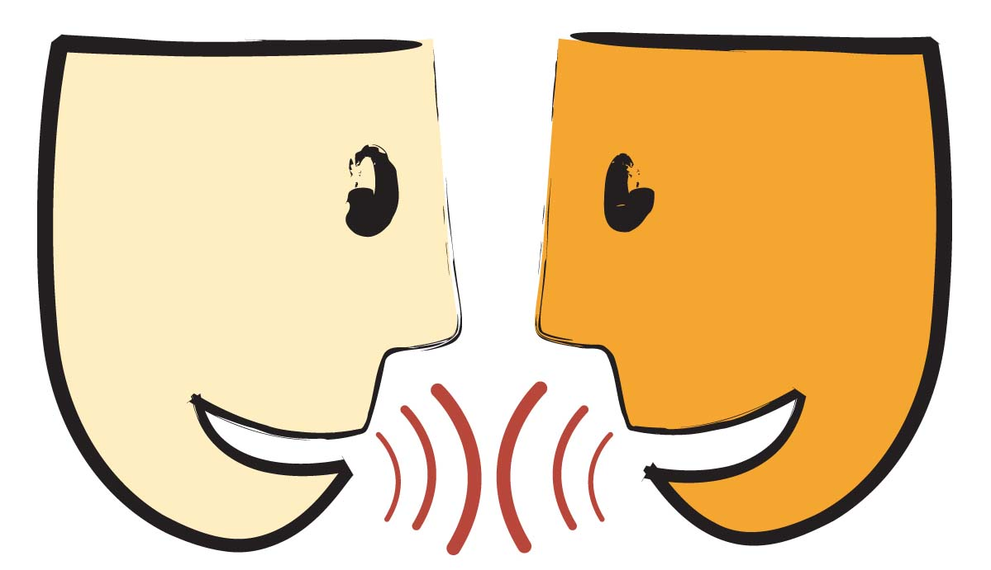
Tell your partner about a new word you learned last week.
Notes:
Access Prior Knowledge- (APK)
Turn and Talk

Slide 5
Notes:
New Information-
Read the book- provide a brief explanation of any words that may be new or unfamiliar to the students.

Slide 6
plains
Notes:
Contextualize the word- Find it in the text
Say the word together

Slide 7
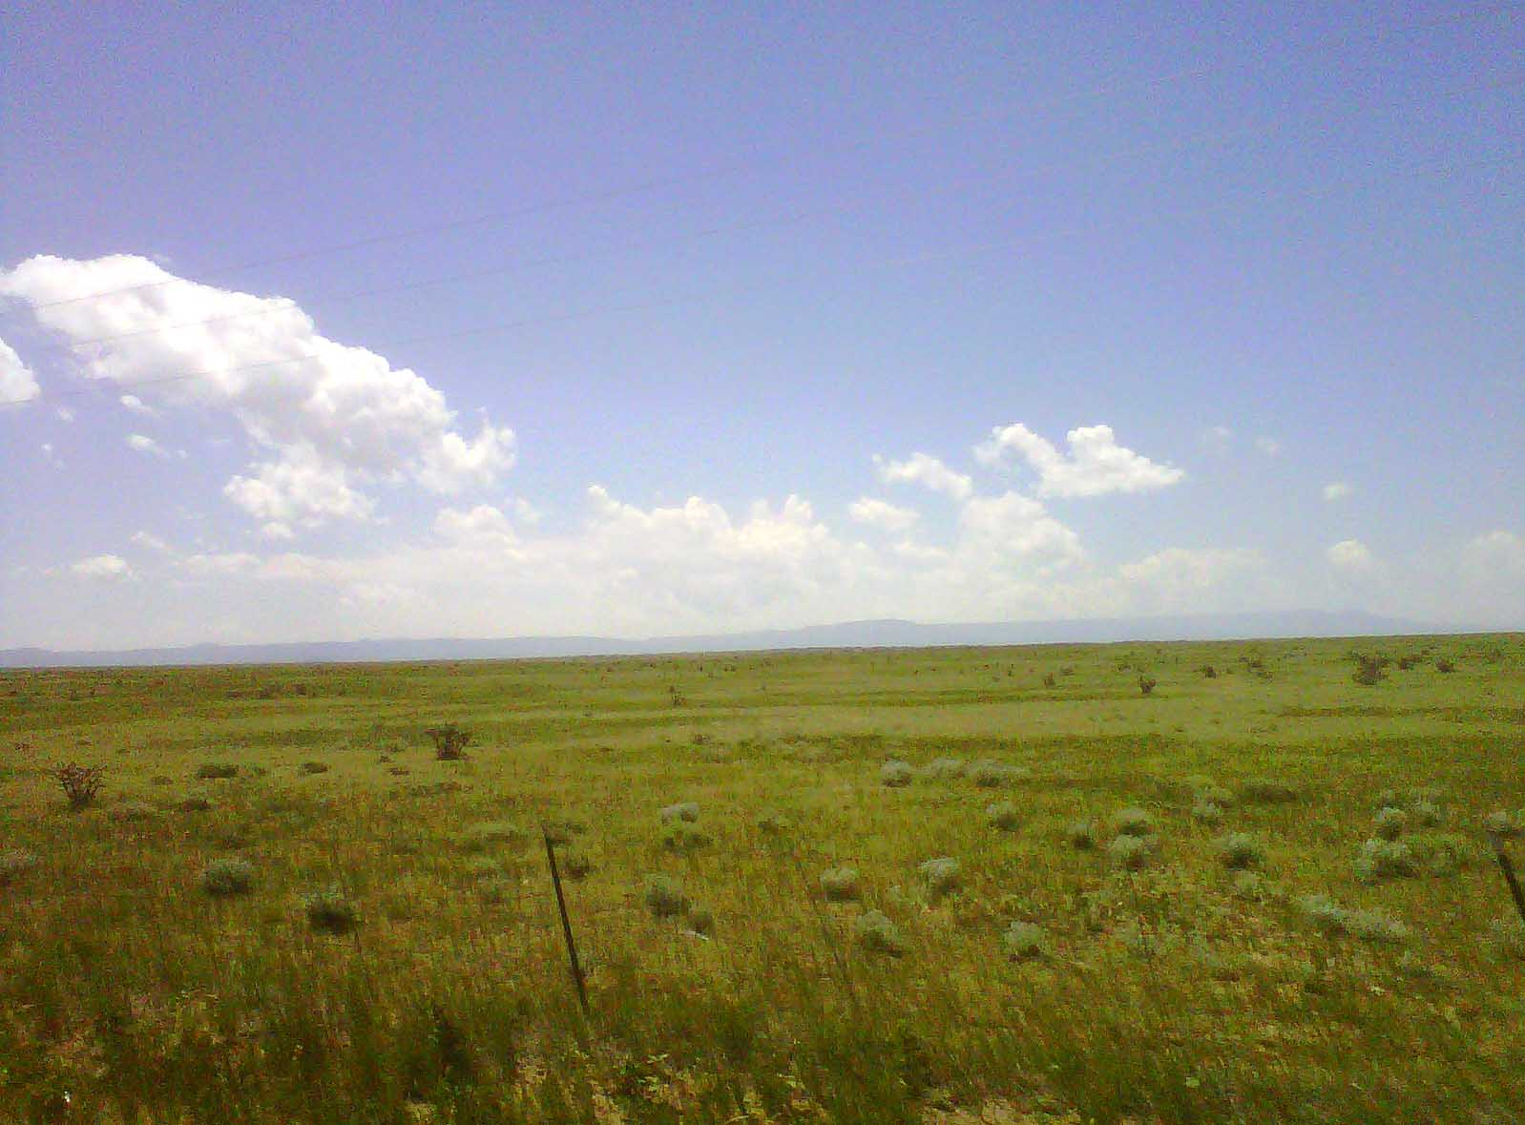
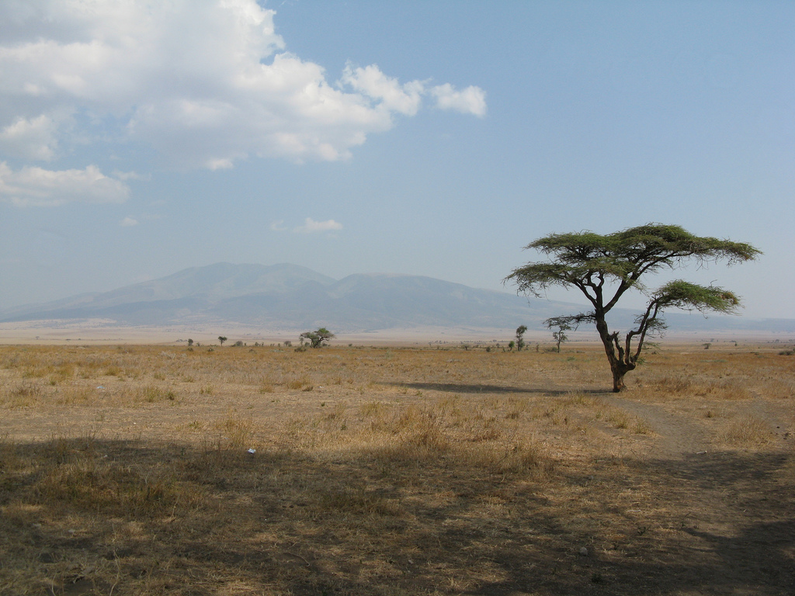
plains
large open area of land
Notes:
Give student friendly definition
Use the word in other contexts

Slide 8

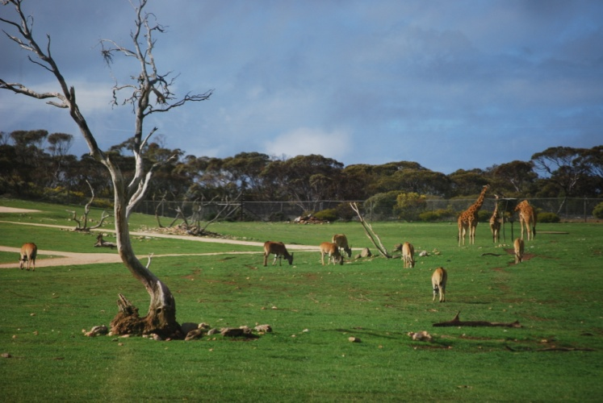
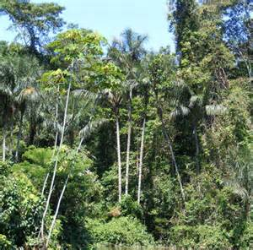
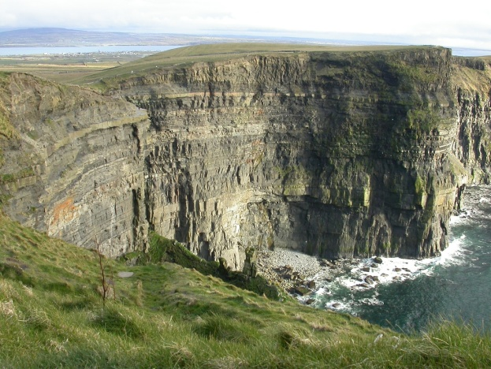
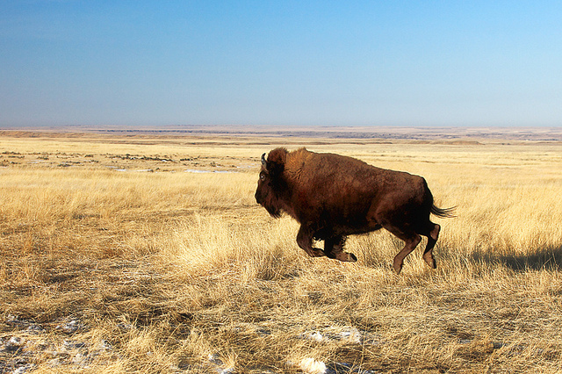
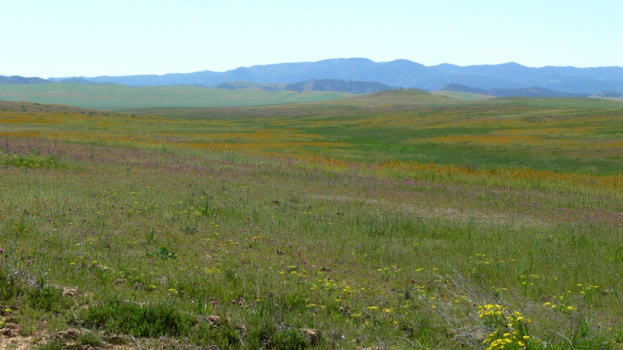
Thumbs up, Thumbs down
Is this a plain? (click for pictures)
Notes:
Engage the students with the word

Slide 9
charge
Notes:
Contextualize the word- Find it in the text
Say the word together

Slide 10
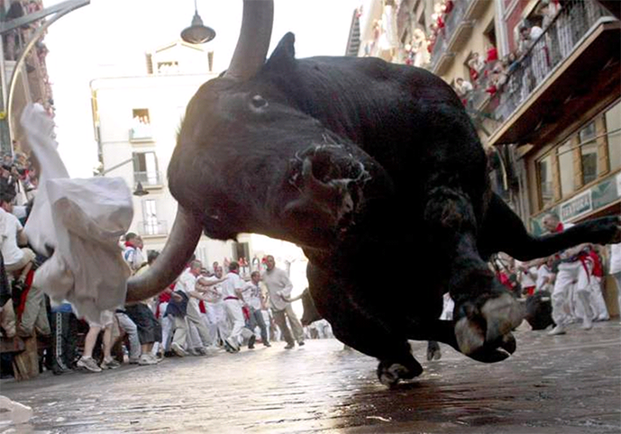
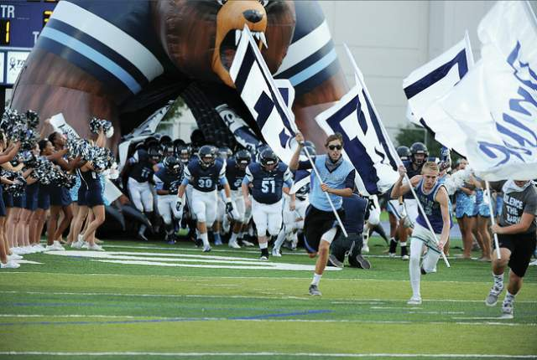
charge
to move forward really fast
Notes:
Give student friendly definition
Use the word in other contexts

Slide 11
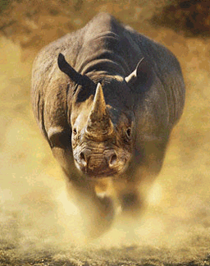
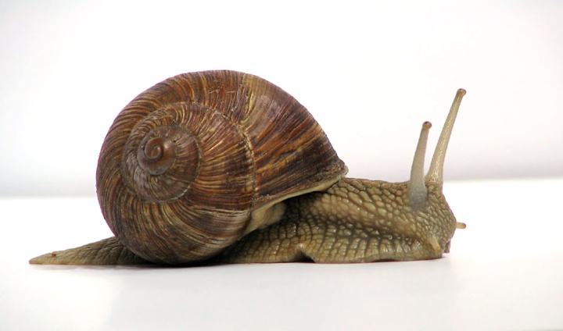
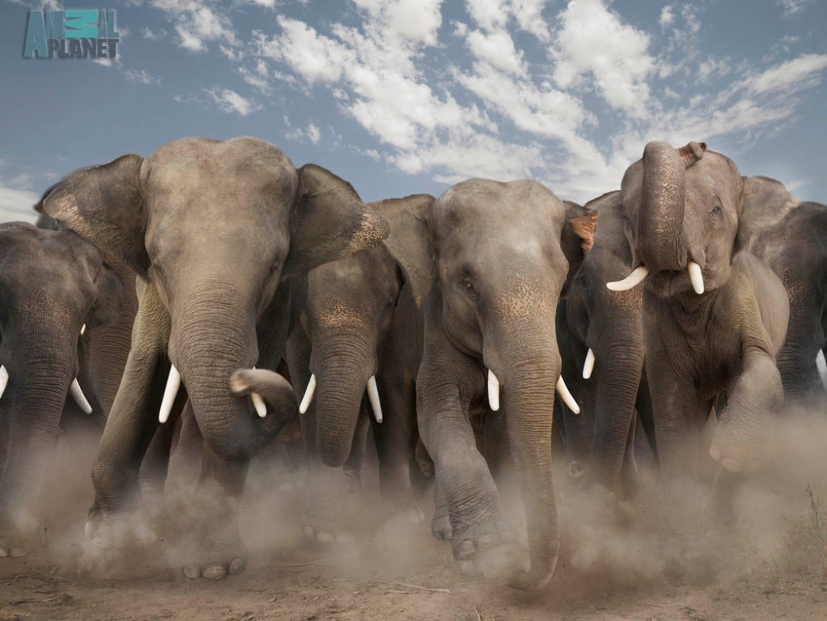
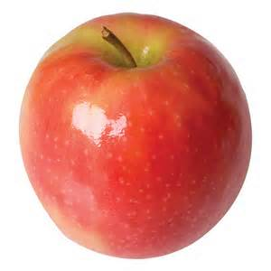
Which items could charge?
Notes:
Engage the students with the word

Slide 12
bellowed
Notes:
Contextualize the word- Find it in the text
Say the word together

Slide 13
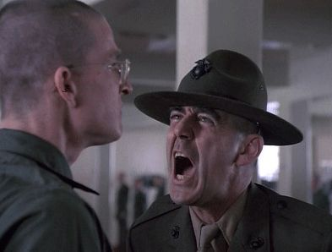
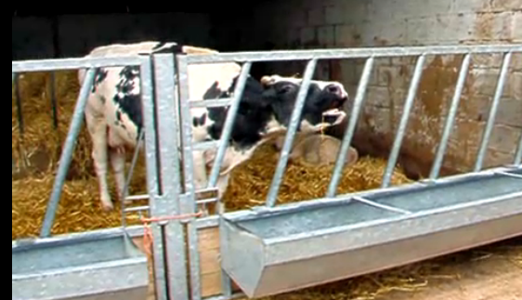
bellow
(bellowed)
(click to hear a cow bellow)
to shout or make a loud noise
Notes:
Contextualize the word- Find it in the text
Say the word together

Slide 14
Can you think of something that could bellow?
Notes:
Engage the students with the word

Slide 15
Who can use all 3 words in a sentence?
plains
charge
bellowed
Notes:
Read all three words and see if you can use them in one sentence.

Slide 16
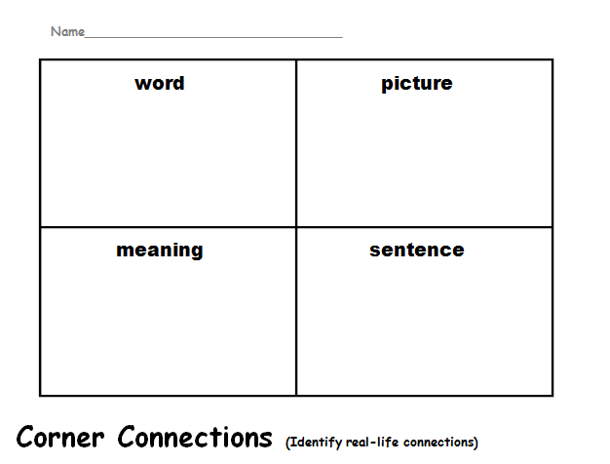
Choose one word and complete a Corner Connection sheet.
plains
charge
bellowed
Notes:
Application-
Students need an opportunity to use the words they just learned from the text.

Slide 17
I can make real-life connections to new words.
Notes:
Goal-
Revisit the Goal

Slide 18
Part 2

Slide 19
Tell your partner about a new word you learned in part 1.
Notes:
Access Prior Knowledge- (APK)
Turn and Talk

Slide 20
Notes:
New Information-
Read the book- provide a brief explanation of any words that may be new or unfamiliar to the students.

Slide 21
I can make real-life connections to new words.
Notes:
Goal-
Students need to engage with the goal- read it, repeat it, write it, etc.

Slide 22
tramped
Notes:
Contextualize the word- Find it in the text
Say the word together

Slide 23
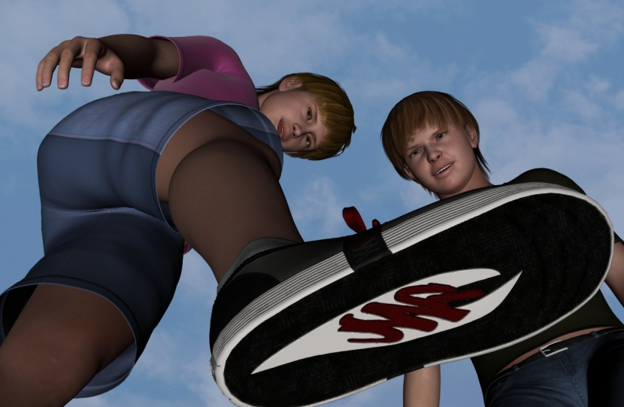
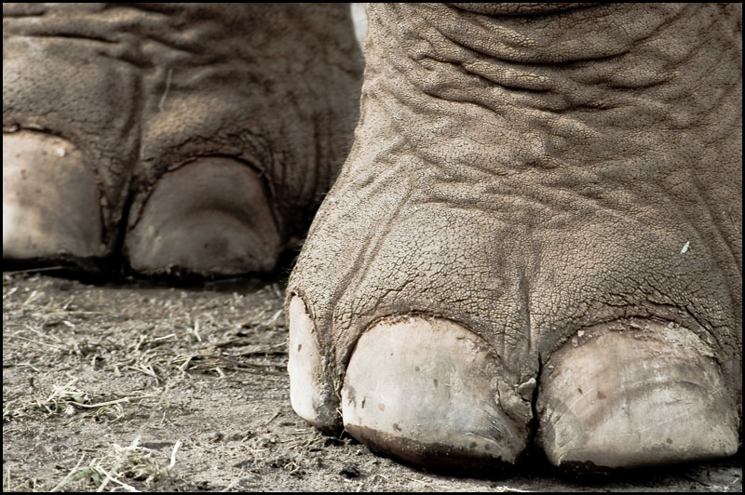
tramped
walking with heavy feet
Notes:
Give student friendly definition
Use the word in other contexts

Slide 24
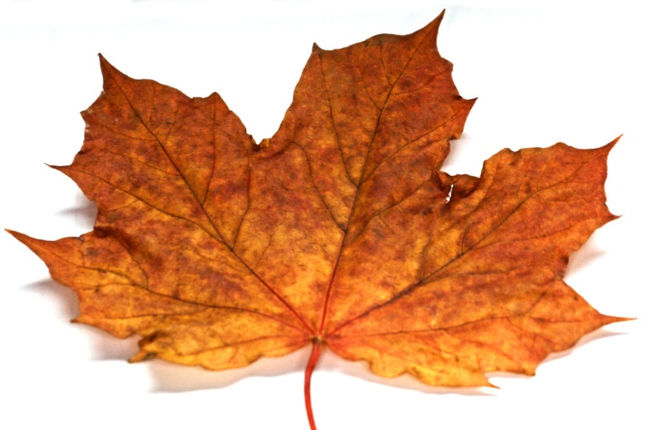
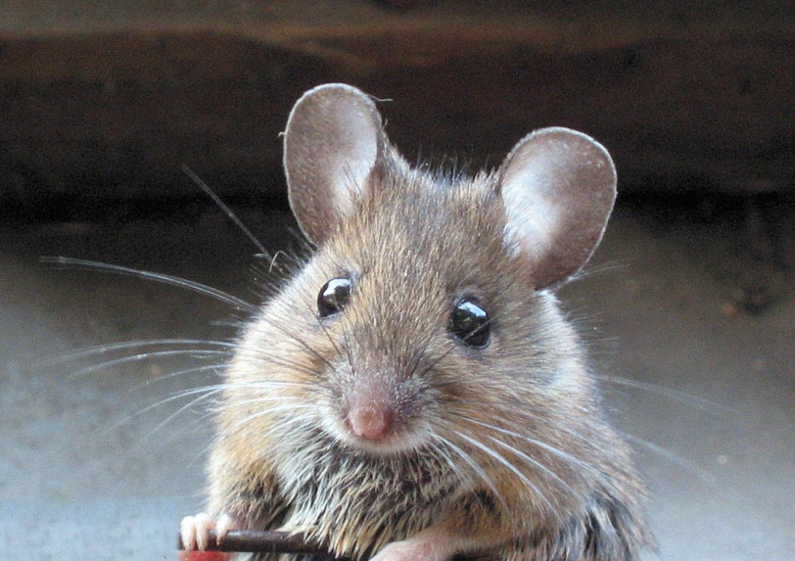
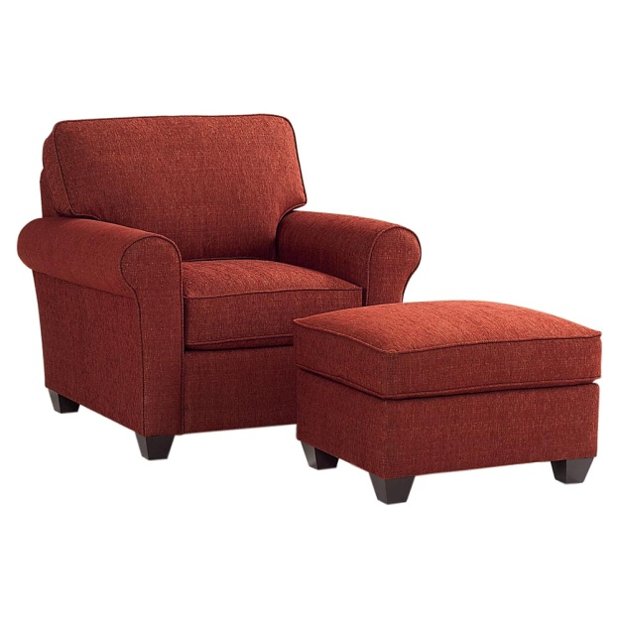
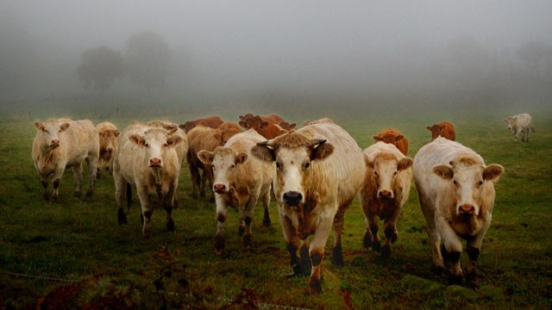
Thumbs up, Thumbs down
Could this tramp? (click for pictures)
Notes:
Engage the students with the word

Slide 25
galloped
Notes:
Contextualize the word- Find it in the text
Say the word together

Slide 26
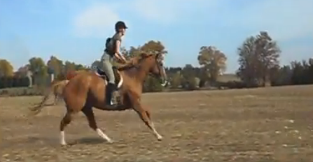
galloped
the fastest way a four-legged animal can run
(click on the picture to see a horse gallop)
Notes:
Give student friendly definition
Use the word in other contexts

Slide 27
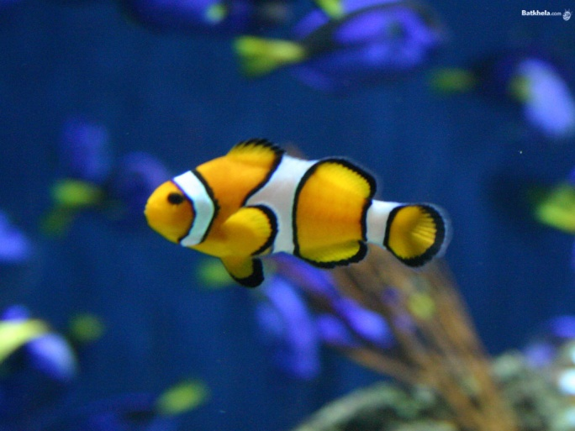
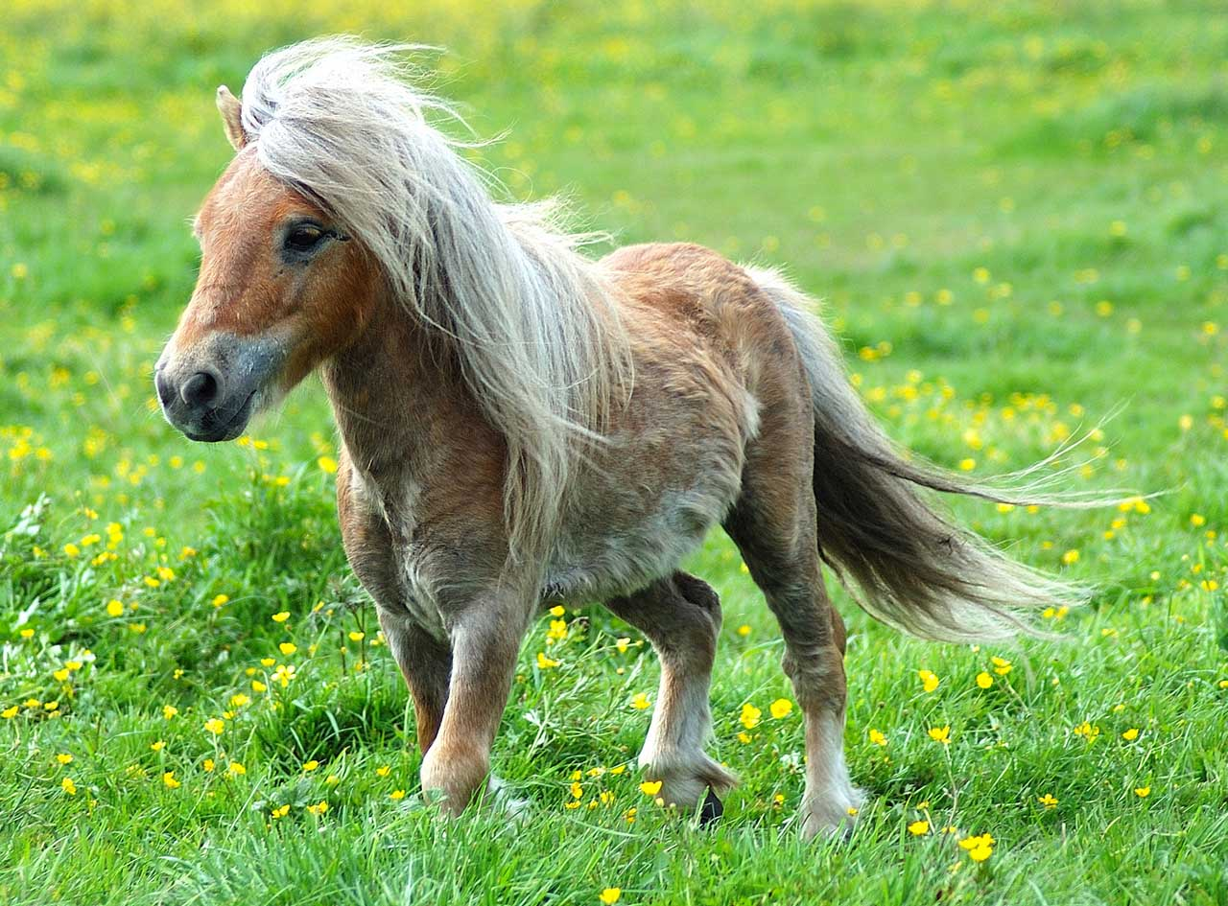
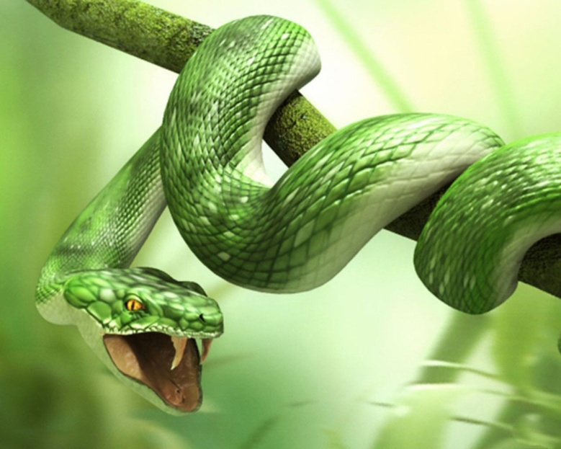
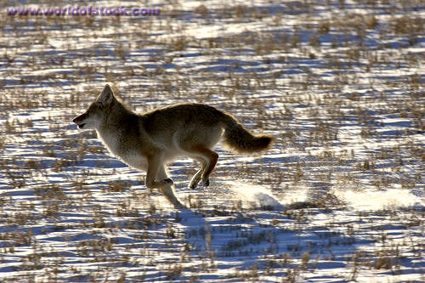
Thumbs up, Thumbs down
Can this animal gallop? (click for pictures)
Notes:
Engage the students with the word

Slide 28
plunged
Notes:
Contextualize the word- Find it in the text
Say the word together

Slide 29
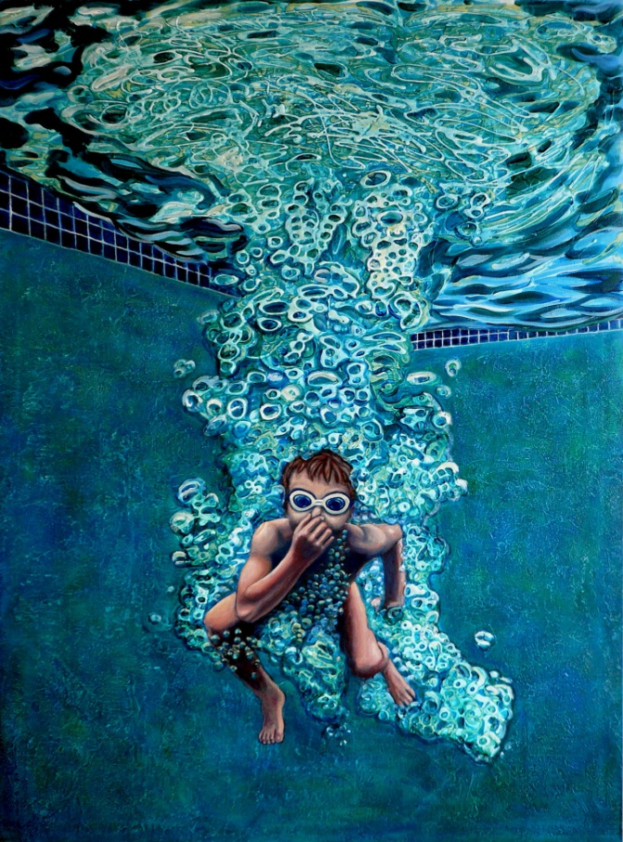
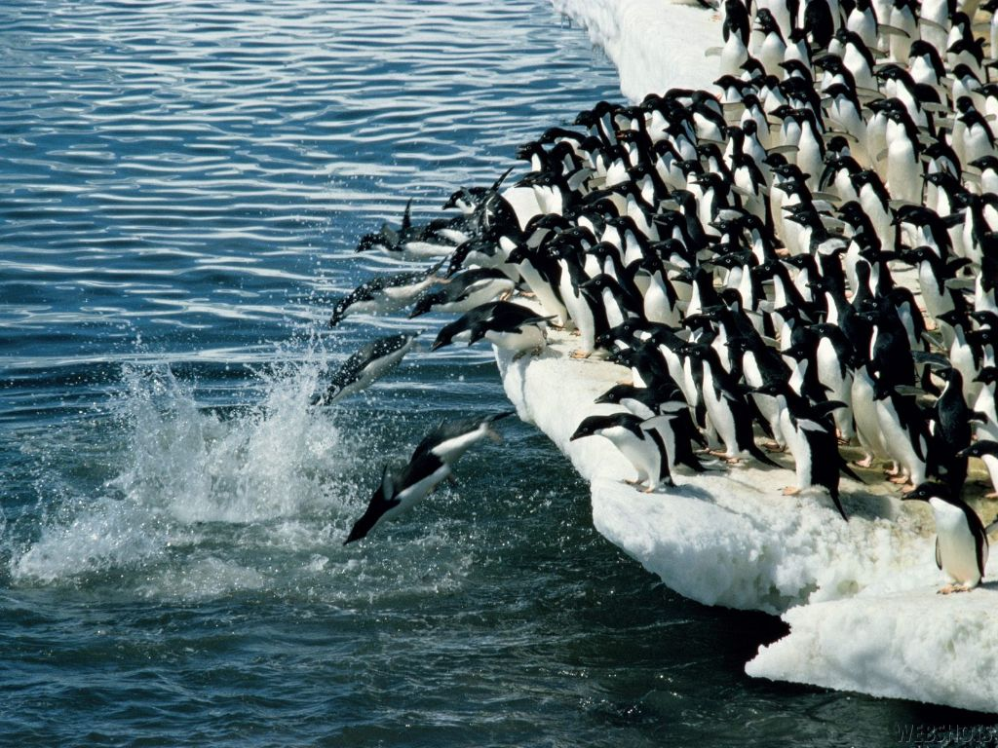
plunge (plunged)
dive or fall fast into the water or something soft
Notes:
Give student friendly definition
Use the word in other contexts

Slide 30
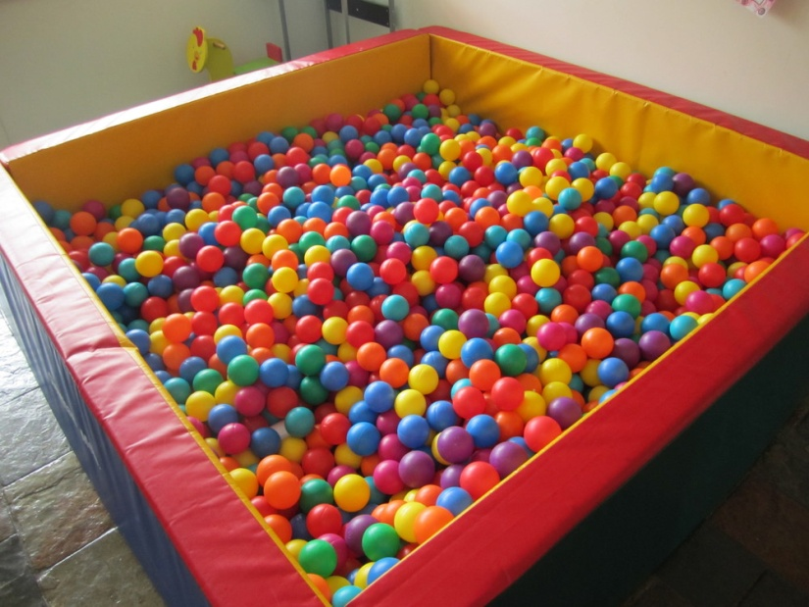
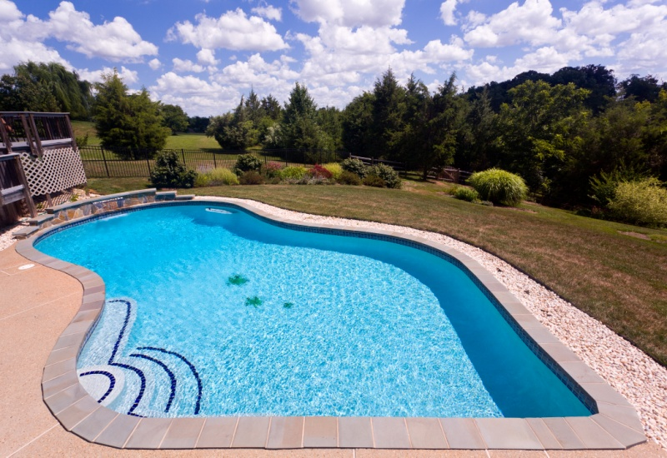
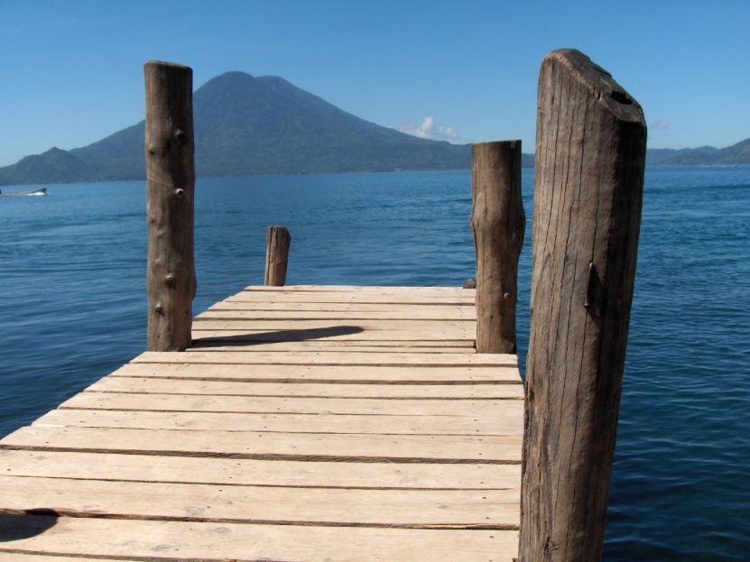
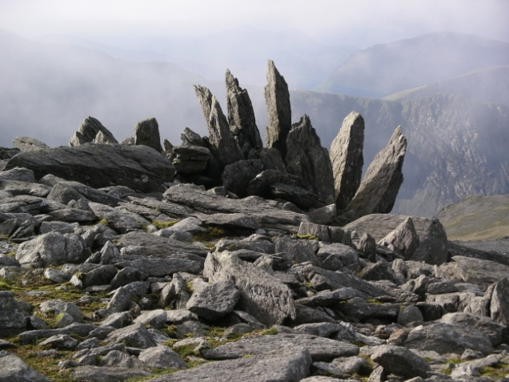
Which of these things would you like to
plunge into?
Notes:
Read all three words and see if you can use them in one sentence.

Slide 31
Who can use all 3 words in a sentence?
tramped
galloped
plunged
Notes:
Read all three words and see if you can use them in one sentence.

Slide 32
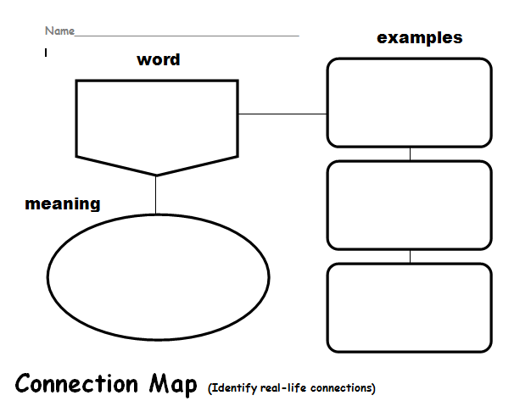
Choose one word and complete a Connection Map.
tramped
galloped
plunged
Notes:
Application-
Students need an opportunity to use the words they just learned from the text.

Slide 33
I can make real-life connections to new words.
Notes:
Goal-
Revisit the goal

