Slide 1

2nd Grade Text Talk
Unit 2

Slide 2
I can use words I learn from a text.
Notes:
Goal-
Students need to engage with the goal- read it, repeat it, write it, etc.

Slide 3

Tell your partner about a new word you learned last week.
Notes:
Access Prior Knowledge- (APK)
Turn and Talk

Slide 4
Notes:
New Information-
Read the book- provide a brief explanation of any words that may be new or unfamiliar to the students.

Slide 5
urge
Notes:
Contextualize the word- Find it in the text
Say the word together

Slide 6
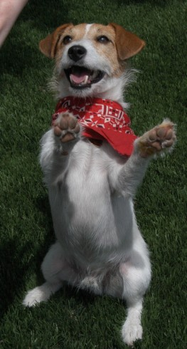
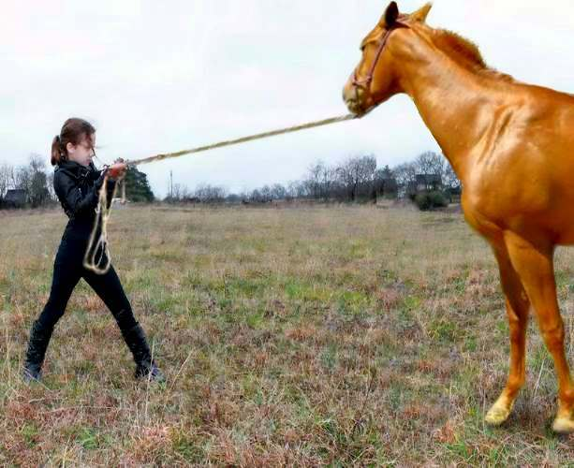

urge
to encourage someone to do something
Notes:
Give student friendly definition
Use the word in other contexts

Slide 7

Thumbs up, Thumbs down
Would you urge your teacher for extra homework?
You want to eat at McDonalds. Would you urge someone to take you?
There are sharks in the water. Would you urge your parents to let you swim?
Notes:
Engage the students with the word

Slide 8
thunderous
Notes:
Contextualize the word- Find it in the text
Say the word together

Slide 9
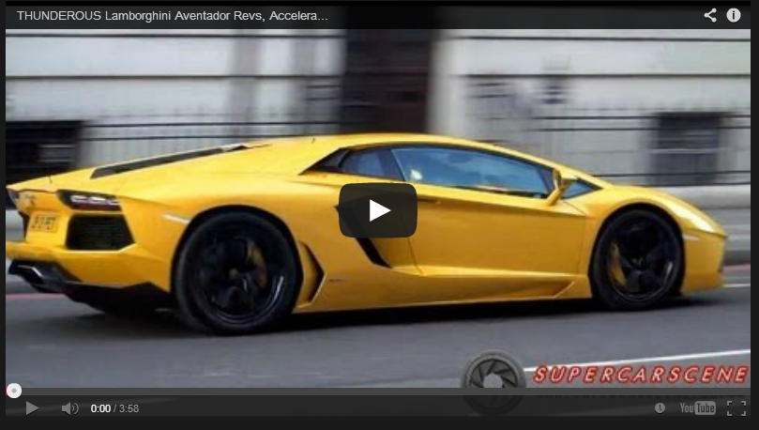
thunderous
to make a noise like thunder
(Click on the picture to hear a thunderous car)
Notes:
Give student friendly definition
Use the word in other contexts

Slide 10
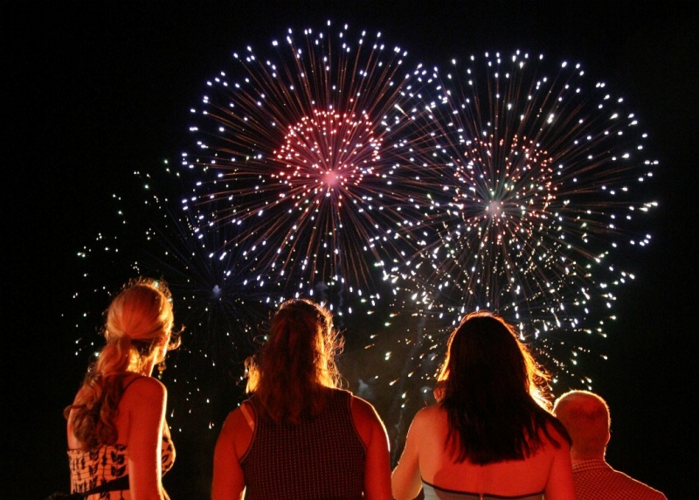
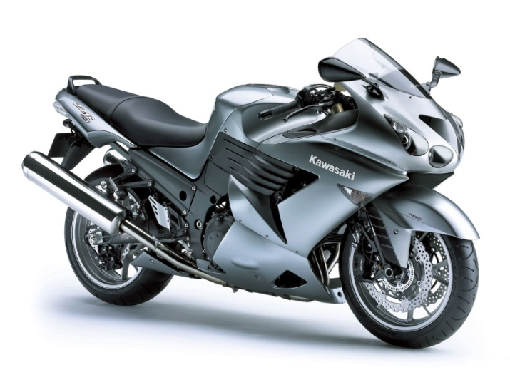
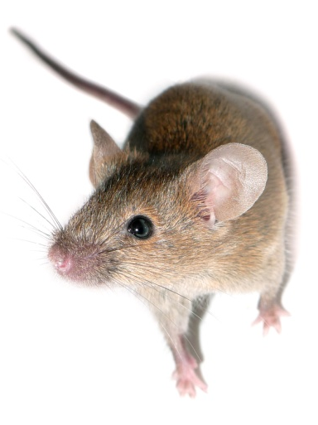

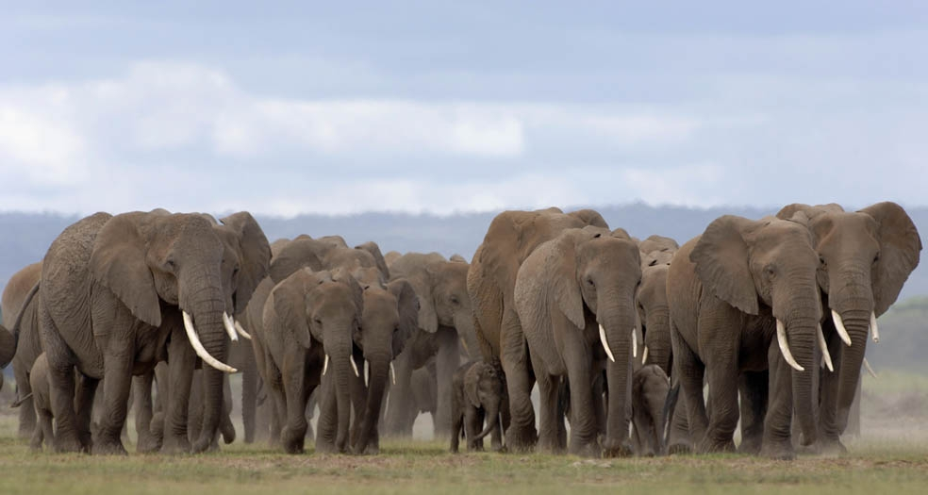
Which items are thunderous?
Notes:
Engage the students with the word

Slide 11
longingly
Notes:
Contextualize the word- Find it in the text
Say the word together

Slide 12
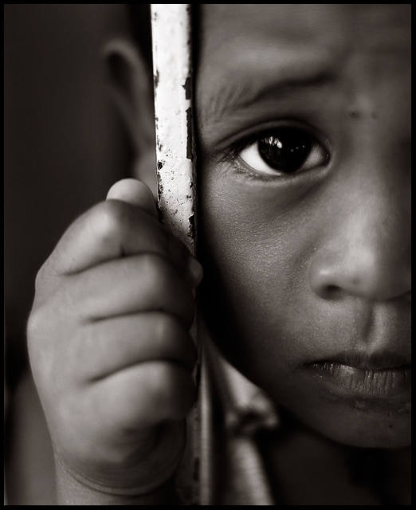

longing
(longingly)
a strong wish for something
Notes:
Contextualize the word- Find it in the text
Say the word together

Slide 13
What is something that you have longed for?
Notes:
Engage the students with the word

Slide 14
Who can use all 3 words in a sentence?
urge
thunderous
longingly
Notes:
Read all three words and see if you can use them in one sentence.

Slide 15


Draw a picture or write a sentence to show you know what these words mean.
urge
thunderous
longingly
Notes:
Application-
Students need an opportunity to use the words they just learned from the text.

Slide 16
I can use words I learn from a text.
Notes:
Goal-
Revisit the Goal

