Slide 1
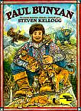
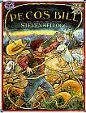
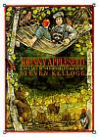
Mentor Sentences for:
  L 2.1.f Produce and expand simple sentences using adjectives and adverbs.
Page 1
Paul Bunyan was the largest, smartest, and strongest baby ever born in the state of Maine.
Page 15
A wild, rough-and-tumble rumpus began inside the den.
Page 18
But no matter what you call him, he’s the fastest most beautiful horse in the world.
Page 5
He often escaped from boisterous household to the tranquil woods.

