Slide 1





READ ALL ABOUT IT
Where was your person’s place of birth?
What was their birthday?
Who is the person you are researching?
(First and last name; Nickname)
How easy or hard was their childhood?
(Ex. parents, siblings, jobs, etc.)
Do you know at least one interesting fact about the person you researched?
What were their major accomplishments?

Slide 2
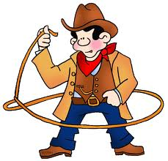
Name:_________________________
Topic Sentence:_____________________________________
First,
Next,
Last,
Conclusion:_________________________________________

Slide 3


