Slide 1
Day 1

Slide 2
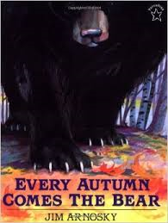
Every Autumn Comes the Bear

Slide 3
I can determine the meaning of unknown words.
Notes:
Goal- Students need to engage with the goal- read it, repeat it, write it, etc.

Slide 4
Notes:
Access Prior Knowledge (APK)-
Read the book again- provide a brief explanation of any words that may be new or unfamiliar to the students.

Slide 5
rugged
“It is a wild and rugged place with as many rocks and trees.”
Notes:
New Information-
Contextualize the word- Find it in the text
“She took raisins, candies, and nuts and gave him two bright eyes, a laughing mouth, and a cowboy vest with fringe.”
Say the word together

Slide 6
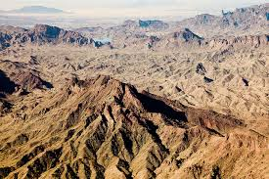
rugged
a rocky, hilly or jagged area.
Notes:
Give student friendly definition
Use the word in other contexts

Slide 7

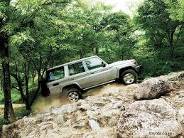
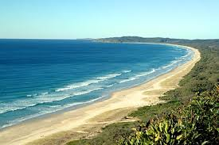
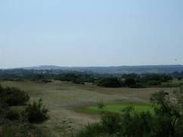
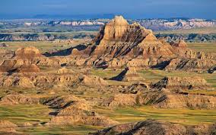
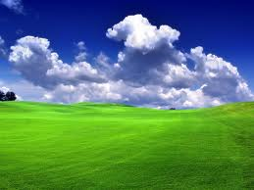
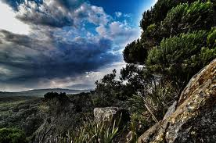
Thumbs up, Thumbs down
Notes:
Engage the students with the word
Thumbs up if this item might have fringe. Thumbs down if not likely.

Slide 8
perch
“He walks out on the cliff where the ravens perch. “
Notes:
Contextualize the word- Find it in the text
… “until he met some hungry cowboys riding the range. The cowboys yelled, ‘Stampede!’ They wanted gingerbread too. “
Say the word together

Slide 9
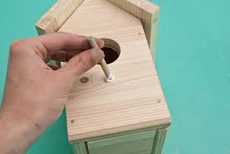
perch
Any place for a bird to rest on
Notes:
Give student friendly definition
Use the word in other contexts

Slide 10
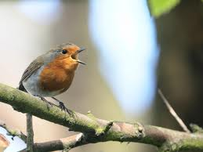
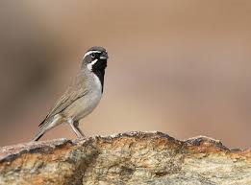
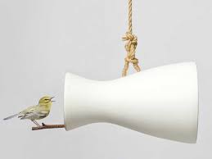
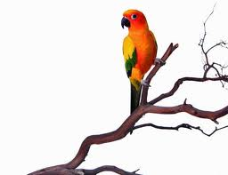
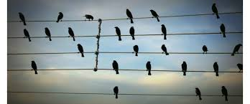
Examples of a perch
Notes:
Engage the students with the word

Slide 11
nestled
“Nestled there against cold rock, with only fat and fur to keep him warm.”
Notes:
Contextualize the word- Find it in the text
“He turned down a canyon and raced away as fast as his boots could carry him.”
Say the word together

Slide 12
nestled
Click the word nestled to see a video
To lay comfortably in or against something
Notes:
Give student friendly definition
Use the word in other contexts

Slide 13
Turn and tell your shoulder partner one word we talked about today and what that word means.
Notes:
Engage the students with the word

Slide 14


Write the word in each box, write your definition of the word, draw a picture of what the word means, write a sentence using the word.
rugged
perch
nestled
Notes:
Application-
Students need an opportunity to use the words they just learned from the text.

Slide 15
I can determine the meaning of unknown words.
Notes:
Goal-
Revisit the Goal

Slide 16
Day 2

Slide 17
I can determine the meaning of unknown words.
Notes:
Goal- Students need to engage with the goal- read it, repeat it, write it, etc.

Slide 18
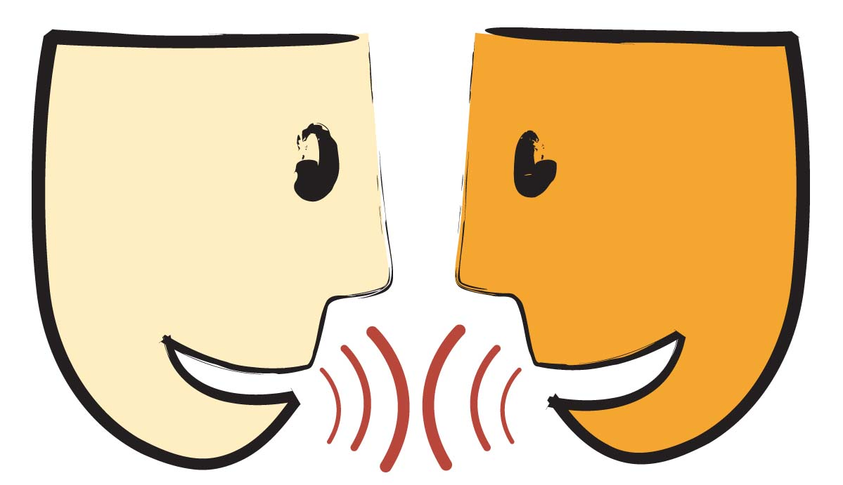
Tell your partner about a new word you learned yesterday.
Notes:
Access Prior Knowledge- (APK)
Turn and Talk
Review 3 words and definitions

Slide 19
Word Association
Which word goes with resting animals?
Which word goes with rocky or hilly?
Which word goes with being comfortable?
rugged
perch
nestled
Notes:
Application
Word Association
Have students explain their thinking

Slide 20
I can determine the meaning of unknown words.
Notes:
Goal- Students need to engage with the goal- read it, repeat it, write it, etc.

Slide 21
Day 3

Slide 22
I can determine the meaning of unknown words.
Notes:
Goal- Students need to engage with the goal- read it, repeat it, write it, etc.

Slide 23
Turn and Talk
Tell your partner your favorite word this week.
Notes:
Access Prior Knowledge- (APK)
Turn and Talk
Review 3 words and definitions

Slide 24
Describe a time when…
you saw a rugged area(in real life, a book, or a picture)
where you might find a perch
you nestled against something

Slide 25
I can determine the meaning of unknown words.
Notes:
Goal- Students need to engage with the goal- read it, repeat it, write it, etc.

Slide 26
Day 4

Slide 27
I can determine the meaning of unknown words.
Notes:
Goal- Students need to engage with the goal- read it, repeat it, write it, etc.

Slide 28
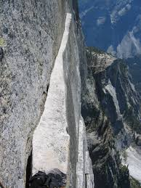
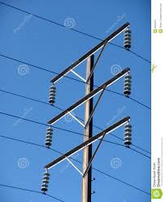
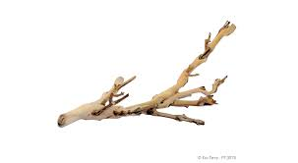
Tell your partner what all of these pictures have in common.
Notes:
Access Prior Knowledge- (APK)
Turn and Talk
Review 3 words and definitions

Slide 29
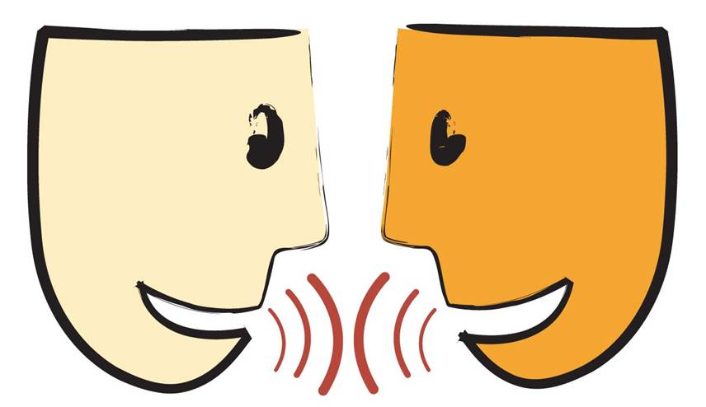
Turn and Talk
Say the word Nestled tell your partner what that word means
Say the word rugged tell your partner what that word means.

Slide 30
I can determine the meaning of unknown words.
Notes:
Goal- Students need to engage with the goal- read it, repeat it, write it, etc.

