Slide 1
Snowflake Bentley
Morning Work

Slide 2
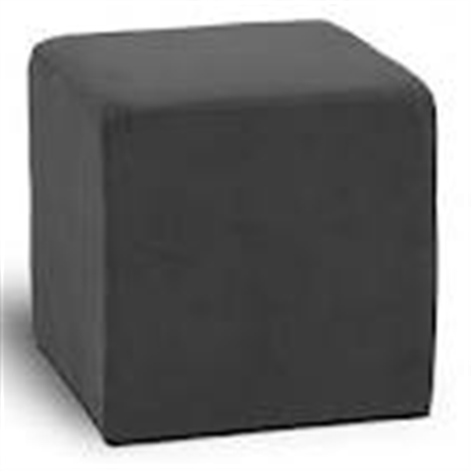
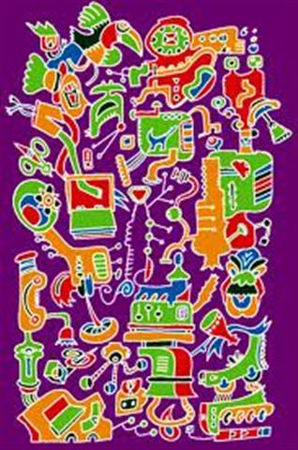
Willie decided he must find a way to save snowflakes so others could see their intricate designs. Intricate means made with or done with a lot of detail.
    Which picture is intricate? List 2 reasons why it is intricate.
    A. B.

Slide 3
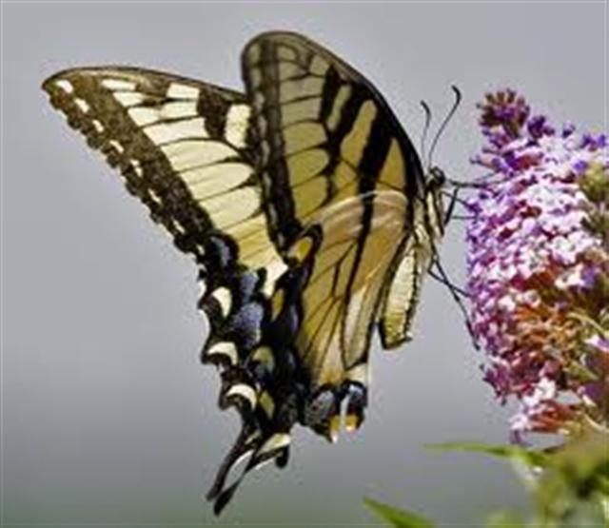
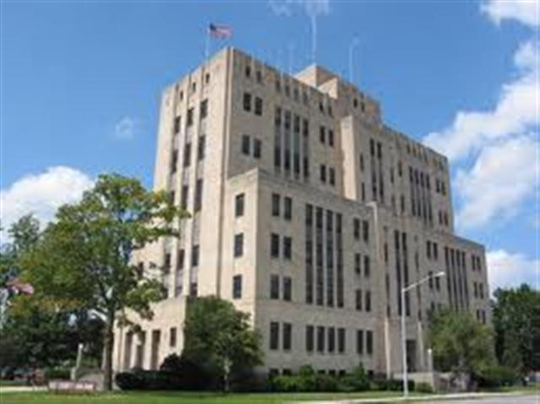
Willie said there were delicate treasures in the snow. Delicate means easy to tear or break.
Which picture shows something delicate? List two reasons the object in the picture is delicate.
A. B.

Slide 4
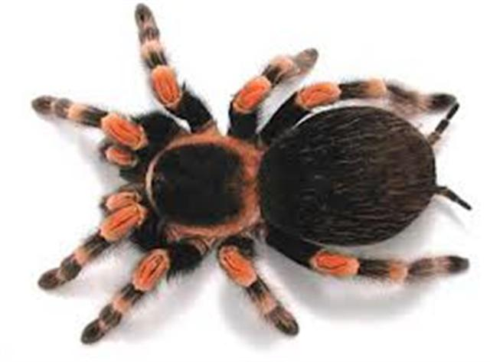
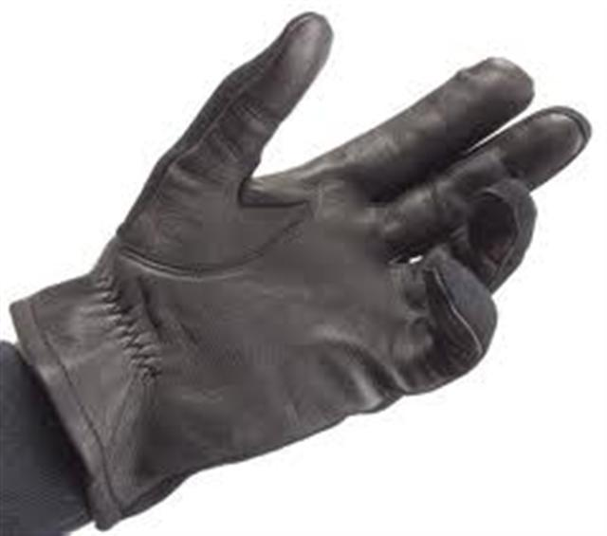
If the shed were warm the snow would melt. If he twitched a muscle as he held the snow crystal on a long wooden pick, the snowflake would melt. Twitched means made a jerky movement.
Which thing below would make you twitch if it was on your hand? List two reasons why you would twitch.
A. B.

