Slide 1
GANAG
Revising Writing Featuring
Scarecrow by Cynthia Rylant
Second Grade
Old Wire Elementary School
Belinda Ward, Teacher
Deborah Goff, Literacy Facilitator

Slide 2
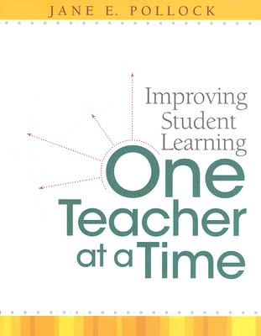
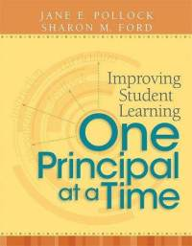
GANAG is a lesson structure that allows teachers to plan for student use of research based instructional strategies.
G= goal
A= access prior knowledge
N= new information
A= application
G= generalize the goal

Slide 3
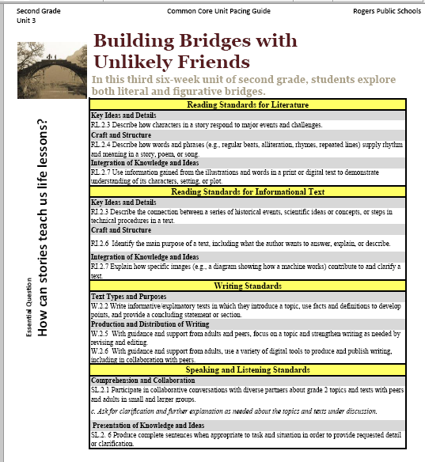
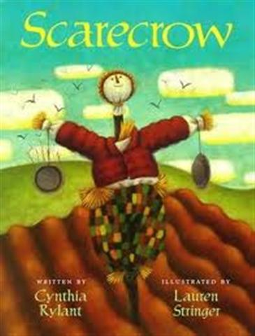
Mrs. Ward began her planning with the pacing guide.
She selected the standard.
W.2.5
With guidance and support from adults and peers, focus on a topic and strengthen writing as needed by revising and editing.
She selected a text from exemplar author Cynthia Rylant to use as a mentor text.

Slide 4
Purpose of the GANAG Structure
To give students the opportunity to actively use the nine high-yield strategies:
(2) Identifying Similarities and Differences
(7) Cooperative Learning
(8) Setting Objectives and Providing Feedback
(3) Summarizing and Note Taking
(4) Reinforcing Effort and Providing Recognition
(9) Generating and Testing Hypotheses
(5) Homework and Practice
(10) Cues, Questions and Advance Organizers
(6) Nonlinguistic Representations

Slide 5
G W.2.5 –With guidance and support from adults and peers, focus on a topic and strengthen writing as needed by revising and editing.
Students will revise previously written drafts about a person, place, or thing by crafting an opening sentence that creates a vivid word picture in the mind of the reader using a repeated word or phrase to describe their topic.
(8) Setting Objectives and Providing Feedback

Slide 6
A Students Access prior knowledge through rereading a familiar text.
Students re-read the opening page of the book Scarecrow by Cynthia Rylant.

Slide 7
N – Students notice Cynthia Rylant’s use of a repeated word to describe the Scarecrow.
His hat is borrowed, his suit is borrowed, his hands are borrowed, even his head is borrowed. And his eyes probably came out of someone’s drawer.
(10) Cues, Questions and Advance Organizers

Slide 8
N- Students discuss how, as authors, they might be able to use a repeated word or phrase to paint a vivid word picture.
Students discuss the use of a repeated word or idea, and how it grabs the reader’s attention, creating a vivid mental image.
Teacher models an example.
Her hands are wrinkly, her face is wrinkly, her clothes are wrinkly, even her hair is wrinkly, and her shoes wrinkle at the toes when she walks.
(10) Cues, Questions and Advance Organizers

Slide 9
N
Students choose a subject from their journals – person, place, or thing. Students list three words or phrases that describe that person, place or thing. They will use these words/phrases to write a attention-grabbing topic sentence to revise a previously drafted paragraph about their chosen subject.
Teacher models:
My friend Jenny –
  Sparkly
  Funny
  Artistic
Her eyes are sparkly, her shirt is sparkly, her earrings are sparkly, even her shoes are sparkly, and her smile lights up a room.

Slide 10
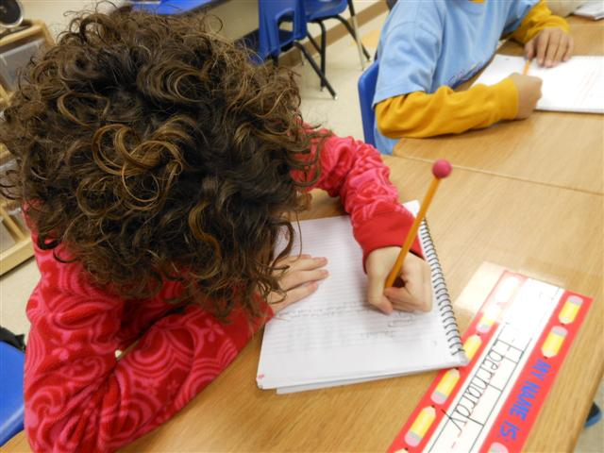
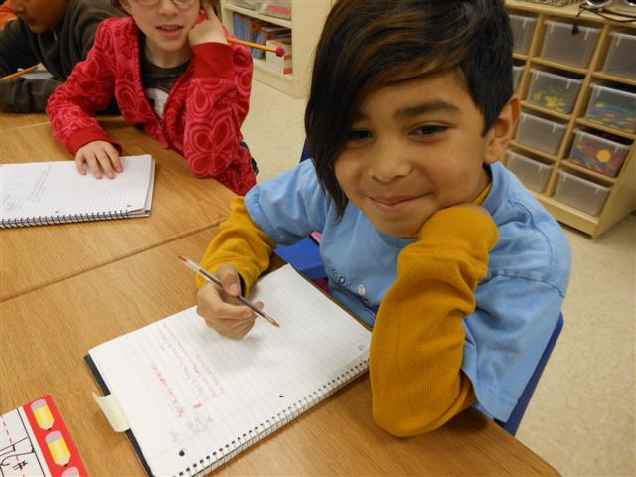
A - Students choose a subject from their journals and three words or phrases that describe that person, place or thing.

Slide 11
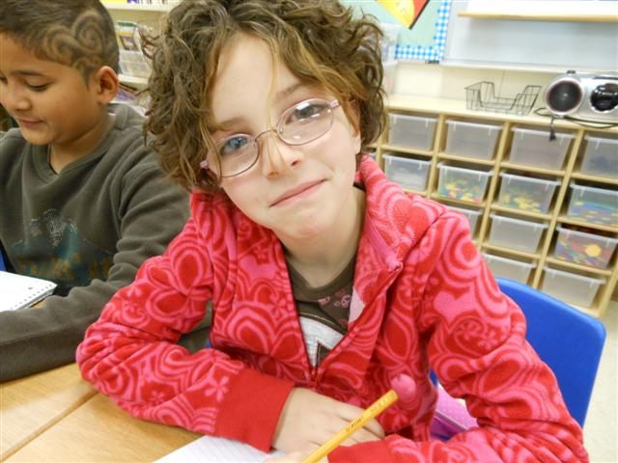
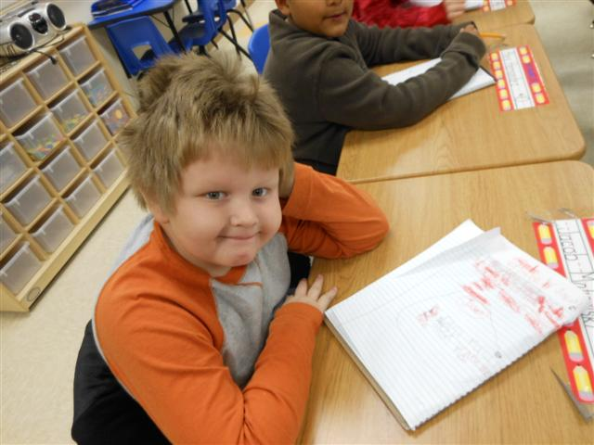
A
Students choose one of these words or phrases to revise their writing.

Slide 12
A
Students revise previous writing by crafting an introductory sentence that creates a vivid mental picture for the reader using a repeated word or phrase.
My Friend Jaden
His shirt is orange, his jacket is orange, his pants are orange, even his socks are orange, and his tongue is orange from eating candy.
~Jacob
Jasmine
Her hands are small, her feet are small, her mouth is small, even her backpack is small, and she has a tiny red bow in her hair.
~Melanie
(4) Homework and Practice
Notes:
Students received a venn diagram with the pictures of the books on the graphic organizer. Students were asked to draw or write one thing that was common to both books, and an event that happened in each book. The student on the right drew Trixie, her mom, dad, and Knuffle Bunny in the middle. On the left, he drew the washing machine with Knuffle Bunny inside from Knuffle Bunny. On the right, he drew the two girls who fought over their Knuffle Bunnies in Knuffle Bunny, Too.

Slide 13
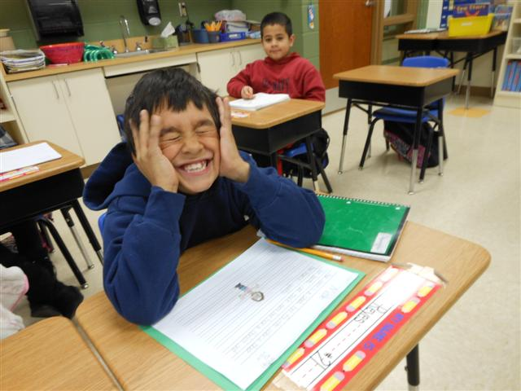
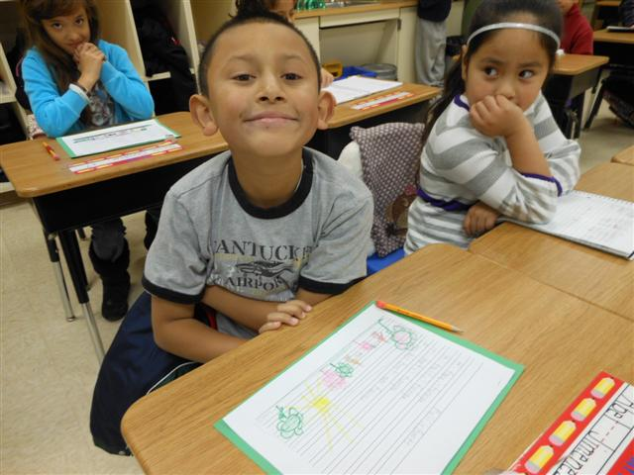
G - W.2.5 – With guidance and support from adults and peers, focus on a topic and strengthen writing as needed by revising and editing.
Students share their writing and reflect on the goal: How did revising your writing using a repeated word or phrase create a vivid word picture for the reader?
(2) Identifying Similarities and Differences
(3) Reinforcing Effort and Providing Recognition

Slide 14
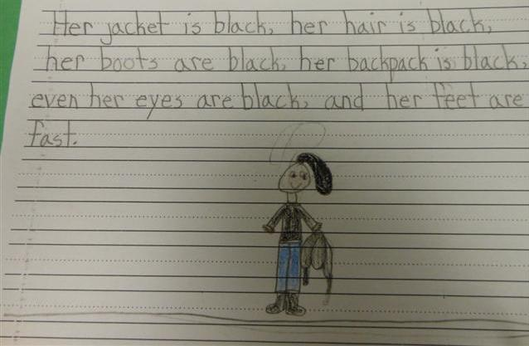
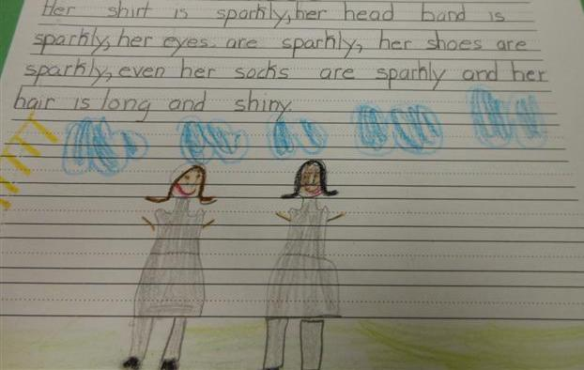
During the next few days, students experimented with this new literary device as they revised and published their writing.

Slide 15
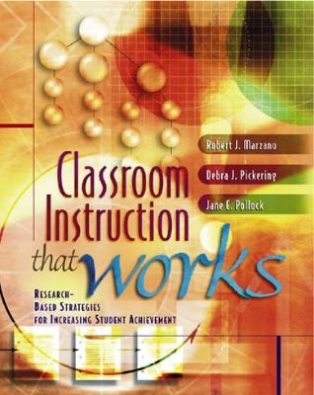
Marzano, R. J., Pickering, D. J., & Pollock, J. E. (2001). Classroom instruction that works: Research-based strategies for increasing student achievement. Alexandria, VA: Association for Supervision and Curriculum Development.
Pollock, J. E. (2007). Improving student learning one teacher at a time. Alexandria, VA: Association for Supervision and Curriculum Development.
Pollock, J. E., & Ford, Sharon M. (2009). Improving student learning one principal at a time. Alexandria, VA: Association for Supervision and Curriculum Development.

