Slide 1
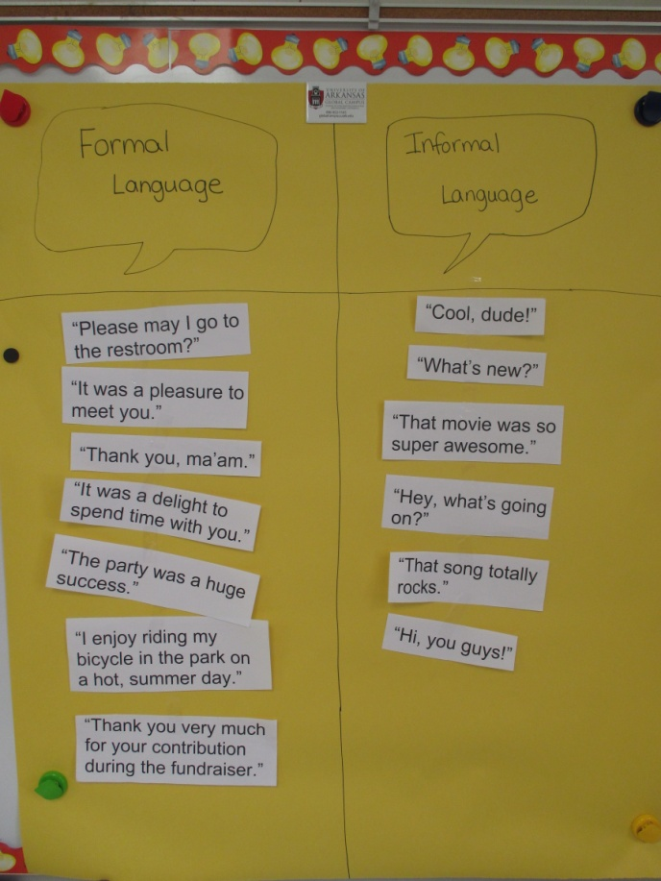
L.2.3.a Compare Formal and Informal Uses of Language
Lesson 2
Bonnie Grimes Elementary
Krista Roth

Slide 2
APK: Review the Formal/Informal T-chart poster.
Tell your ATT buddy one example of a formal language phrase/sentence.
Tell your ATT buddy one example of an informal language phrase/sentence.
Your ATT buddy is the person directly in front of you. The one you can “reach out and touch”.

Slide 3
GOAL: I can compare the formal and informal uses of English.
**Rate yourself.

Slide 4
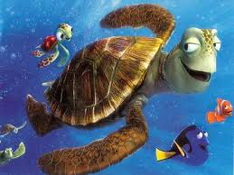
Informal Uses of English
* casual
* may not be complete sentences
* used with someone you feel comfortable with
* may include slang (improper English, informal words)
* shorter phrases or sentences
* can be spoken with a loud or soft voice

Slide 5
Examples of Informal Language
“Hey!”
“How are ya?”
“That’s so super cool!”
“I totally love that sweater!”

Slide 6
People You May Use Informal Language with…
* friends
* students on the playground
* students on the school bus
* brothers or sisters
* cousins
* maybe even your parents

Slide 7
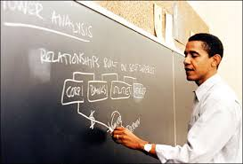
Formal Uses of English
* proper or formal English
* complete sentences (may be longer)
* used with adults or people you respect
* used in school or college
* may use more sophisticated vocabulary (juicy words)
* can be spoken with a loud or soft voice

Slide 8
Examples of Formal Language
“Hello. How are you?”
“I am very excited about the party this upcoming weekend.”
“I really love that blue and green sweater you are wearing.”
“May I please go to the library to check out a book to read?”

Slide 9
People You May Use Formal Language with…
* teachers
* principal
* firemen
* police officers
* doctor
* adults at church

Slide 10
Application:
Each partner will receive a slip of paper with “formal” or “informal” written on it. Work together with your buddy to create a formal or informal statement or question to share with the group.

Slide 11
Just a reminder….

Slide 12
Informal Uses of English
* casual
* may not be complete sentences
* used with someone you feel comfortable with
* may include slang (improper English, informal words)
* shorter phrases or sentences
* may be spoken with a loud or soft voice

Slide 13
Formal Uses of English
* proper or formal English
* complete sentences (may be longer)
* used with adults or people you respect
* used in school or college
* may use more sophisticated vocabulary (juicy words)
* may be spoken with a loud or soft voice

Slide 14
Write a sentence that tells one difference between the use of formal and informal language.

Slide 15
Restate the GOAL: I can compare the formal and informal uses of English.
**Rate yourself after the lesson and score your effort.

