Slide 1
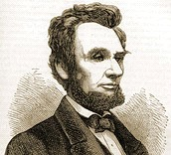
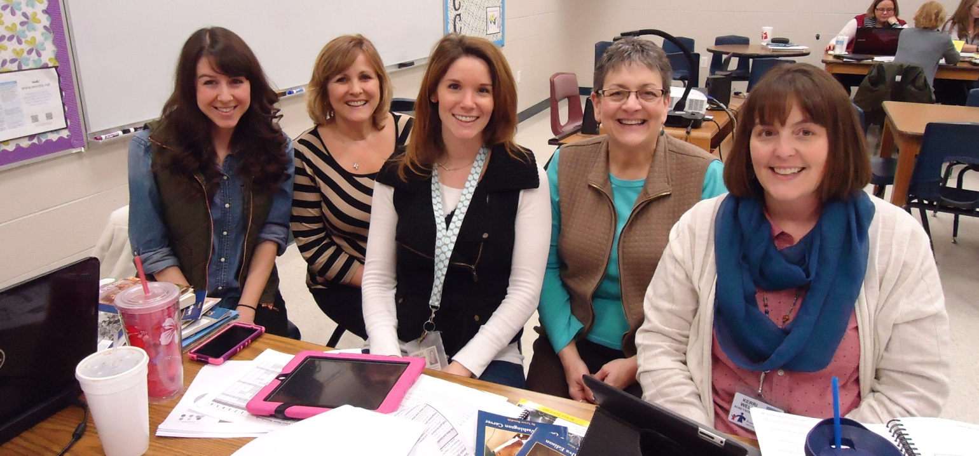

American Contributions
First Grade Unit 5
Planning Team:
Alana Alecusan, Christine Pinkley, Kenley Johnson, Karen Maloney and Kerri Wells
Notes:
Always keep in mind this is one team’s interpretation of the standards and how to use the texts and resources from our district. The team that worked together to plan unit 5 was made up of 1st grade teachers: Alana, Christine, Kenley, and literacy facilitators: Karen and Kerri

Slide 2
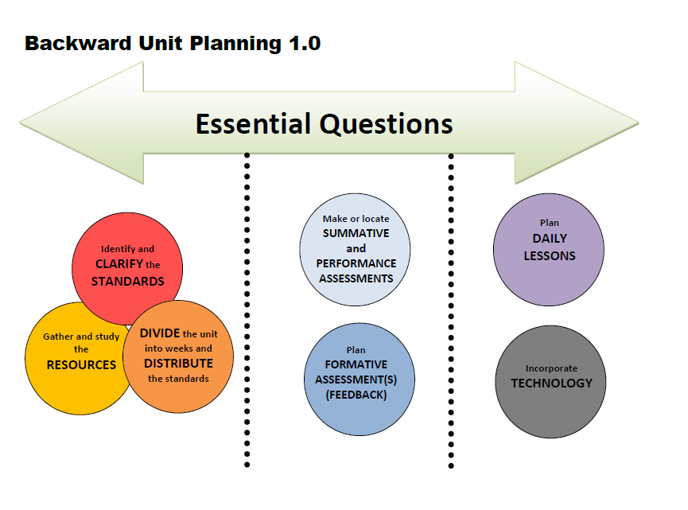

Slide 3

American
Contributions
Essential Question
How do the connections between extraordinary Americans in history help us learn?

Slide 4
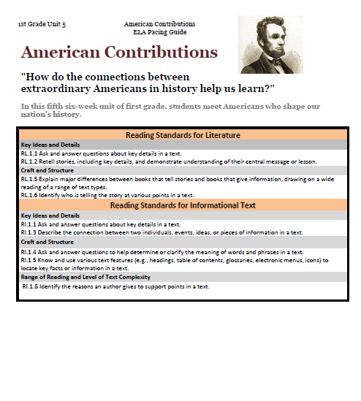
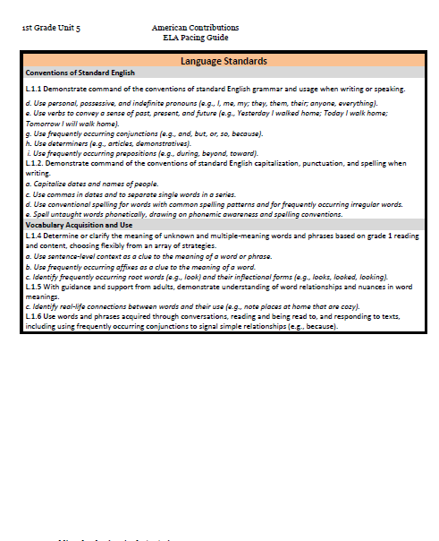
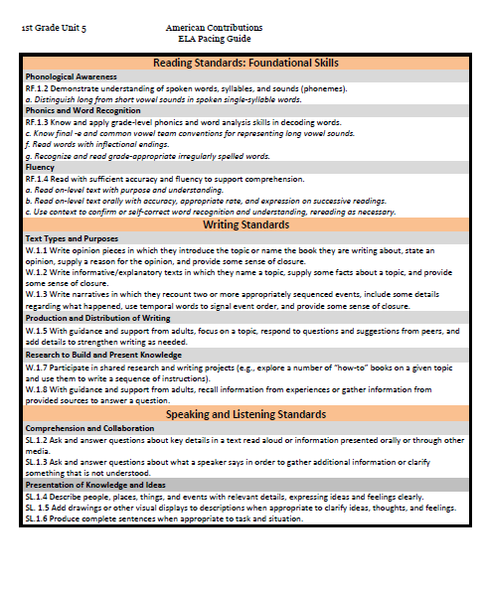
Notes:
Many of the standards we included in this unit have already been explicitly taught during your year. This unit will be an opportunity to work on them using new text types: biographies.

Slide 5


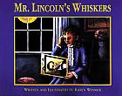
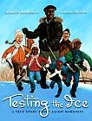
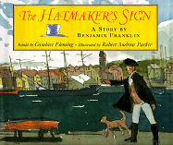
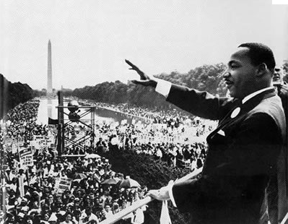
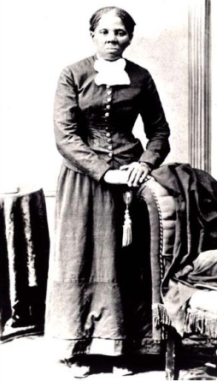
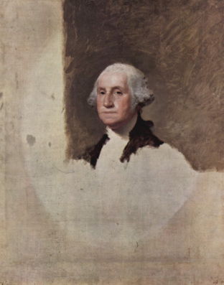
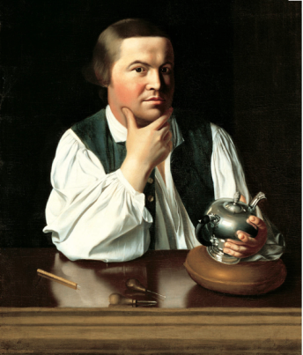
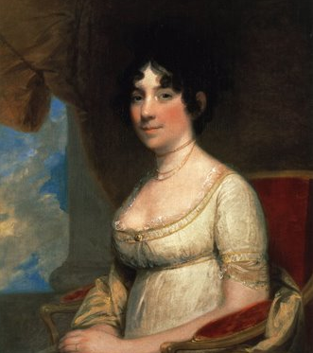
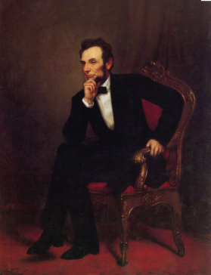
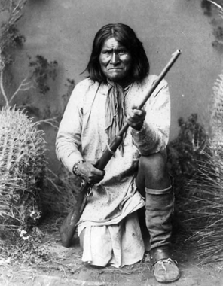
Literature
1st Grade
Print Resources
Unit 5
Read Aloud
Poems (Read Aloud)
“Hope” Langston Hughes
“Washington” Nancy Byrd Turner
“You’re a Grand Old Flag” George M. Cohan
Songs
“Yankee Doodle Boy” George M. Cohan
“You’re a Grand Old Flag” George M. Cohan
Art

Slide 6
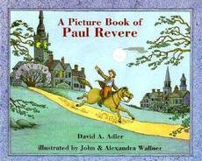
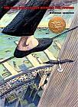

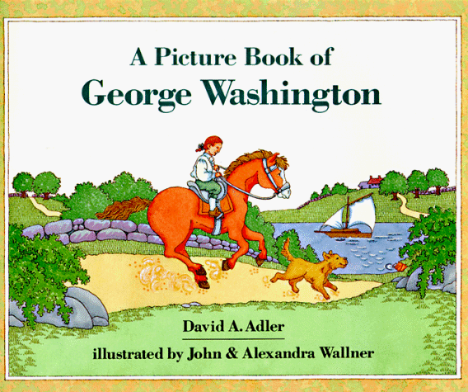

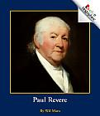
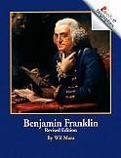
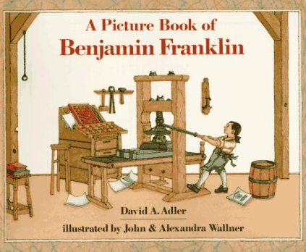
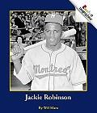
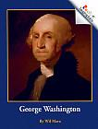
Informational Text
Read Aloud
14 copies

Slide 7

E-Resources
Liberty’s Kids Videos
https://www.youtube.com/results?search_query=liberty%27s+kids
Washington DC Tour Video
https://www.youtube.com/watch?v=QTZQ9bta31w&app=desktop
Brain Pop Jr:
George Washington , Abraham Lincoln, Martin Luther King Jr.
Notes:
In our plan we used the photo of MLK speaking at the Lincoln Memorial. The Washington Monument is in the background. These are resources to give students a video tour of these sites. The idea here is to facilicitate connections between people and or events.

Slide 8
Week | Standards | Texts | Suggested Activity
1 | RI.1.3- Describe the connection between two individuals, events, ideas, or pieces of information in a text. RL.1.5- Explain major differences between books that tell stories and books that give information, drawing on a wide reading of a range of text types. W.1.3-Write narratives in which they recount two or more appropriately sequenced events, include some details regarding what happened , use temporal words to signal event order, and provide some sense of closure. | Song: “Yankee Doodle Boy” George M. Cohan | Rl.1.3- Create classroom timeline. W.1.3- Students create their own timelines using personal experiences. RL.1.5- Discuss the difference/ authors purpose between the George Washington texts. Song: about George Washington
2&3 | W.1.2-Write informative/explanatory texts in which they name a topic, supply from facts about the topic, and provide some sense of closure. RI.1.3- Describe the connection between two individuals, events, ideas, or pieces of information in a text. RL.1.5- Explain major differences between books that tell stories and books that give information, drawing on a wide reading of a range of text types. RI.1.8- Identify reasons an author gives to support points in a text. | (optional) (text talk) | W.1.2- Write to inform about George Washington/ Paul Revere RL.1.5- Create a T-chart (Ben Franklin and Hatmaker’s Story RI.1.3- Continue to makes connections between books and timelines (check teacher created resources for timeline) RI.1.8- Use opening statement from biographies and have students find points from the text that support the statement.
Notes:
To start this unit you may want to send home a timeline for families to do at home. This will be used for students to write their own biography. It could be used during a week when there are no other writing tasks such as week 5 when students should be familiar with timelines and have finished writing their informative paragraphs.
During the first week, to facilitate students making connections across the unit we suggest creating a classroom timeline to include people that you will be reading about. We suggest starting this week with pictures of your class this year followed by historical events such as the invention of the camera, automobile, and plane. Pictures for these events can be located on the district teacher created resources page. It might be helpful to add pilgrims and Native Americans if you already taught about them.
We included the song Yankee Doodle Boy because it is about George Washington and he is the focus of this week’s text.
During our planning we discussed the importance of including women in this unit(Pocahontas and Lauga Ingalls Wilder are included already) although the vast majority of our resources are about men. Some women we thought of included Helen Keller, Sally Ride, Abigail Adams, Georgia O’Keefe, Cady Stanton… we tried to brainstorm a list of women not covered in the other k-5 elementary units.
Week 2: The focus of weeks 2 & 3 will be RI 1.8 Identifying the reasons an author gives to support points in a text. In looking at the resources we found statements in the rookie biographies that lend themselves to teaching this standard. Using the biography of Paul Revere, we thought we would write the statement(In one night, Paul Revere helped change history) found in the text at the top of the chart. Then students could locate in the text(think text-dependent here) what evidence the author gives to support this statement and you could record those on the chart. This will give you a chart to refer back to when writing opinion pieces or informational paragraphs. We envisioned using a shared reading format on day one to read Paul Revere rookie biography and make a chart. Then, on day two give partners a choice of which biography they wanted to read(George Washington or Ben Franklin) and locate evidence to support statements the author makes in those.
There is a summative assessment for RI.1.8 using Abe Lincoln rookie biography written in passage form on the district resources.

Slide 9
Week | Standards | Texts | Suggested Activity
4 | RL.1.6- Identify who is telling the story at various points in the text. RL.1.2- Retell stories, including key details, and demonstrate understanding of the their central message or lesson. L.1.4a: Use sentence-level context as a clue to the meaning of a word or phrase. L.1.1h: use determiners (e.g, articles and demonstratives, when to use A vs. An) | (text talk) | RL.1.2- Little House in the Big Woods (use the mini stories Pa tells the girls at the end of some chapters). L.1.4a- Text talk words from chapter 2 of Little House in the Big Woods.
5 | RL.1.1: Ask and answer questions about key details in a text. L.1.4c: Identify frequently occurring root words and their inflectional forms. L.1.6: Use words and phrases acquired through conversations, reading and being read to, and responding to texts, including using frequently occurring conjunctions to signal simple relationships. SL.1.2: Ask and answer questions about key details in a text read aloud or information presented orally or through other media. | (text talk ) (photo) | L.1.6 and L.1.4c: Testing the Ice text talk words contain root words that can be identified. SL.1.2: Martin Luther King Jr. Photo
6 | RI.1.1: Ask and answer questions about key details in a text. RI.1.5: Use various text features to locate facts and information W.1.1: Write opinion pieces in which they introduce the topic or name the book they are writing about, state an opinion, and provide some sense of closure. | (text talk) | RI.1.5: Model how to use the index in Pocahontas to find answers to questions. Independently, students can use the index in Jackie Robinson to find answers to questions. W.1.1: Listen to the voiceover for suggested prompts
Notes:
During week 4 we add no new writing standards, rather a continuation from the previous weeks’ focus. So we added language standards to focus on including using determiners.
We begin reading Little House during week 4 and use Laura Ingalls Wilder biography as background. Day one we planned to read her biography and add Laura to timeline. Students can be expected to use the pictures as well as text to place her in approximately the correct time period. Day two we would begin reading Little House and ask questions to help students connect who is telling the story.
Little House is a great text to use for context clues when teaching vocabulary. Words could be shown in context using the text talk powerpoint from district resources. Rather than showing students definitions or telling them the meanings, have students read words in text and use context to determine meaning(or read it aloud to them as they follow along, we were picturing shared reading here). Then reveal the definitions in district PPT to confirm meanings.
During Week 5 we shift from informational standards and text to narrative and literature standards. We suggest you choose the texts that best fit your students from the district narrative texts. Focus on using illustrations and text to answer the questions(think text-dependent here). There is other art work to choose from besides the MLK, Jr. photograph we used here.
During this week we want to focus on students writing opinions of the Americans they have learned about. They will have plenty of background information to support their statements by this point. We thought we would use two types of statements to get them started. The first being centered on themselves, George Washington is my favorite American; the second moving away from themselves, George Washington was a leader. The first will be easier for students as they supply facts they choose and they could be any they have learned. The second type must supply facts that support his being a leader(or whatever point they make). This type of statement will be more difficult but you may have students ready for that challenge.

Slide 10
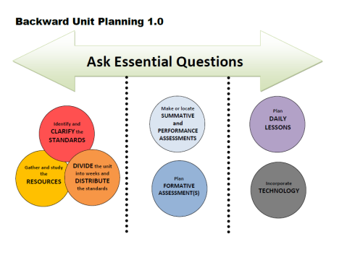
Week | Standards | Essential Questions
1 |  | How do the connections between extraordinary Americans in history help us learn?
2
3
4
5
6
Notes:
We revised the question to what we felt was a broader statement. We want students to learn about extraordinary Americans because it helps them learn about themselves and the world around them. There are connections students can make to themselves by learning about these Americans, such as “George Washington loved math and so do I” or “Abraham Lincoln loved books and reading and so do I”

Slide 11
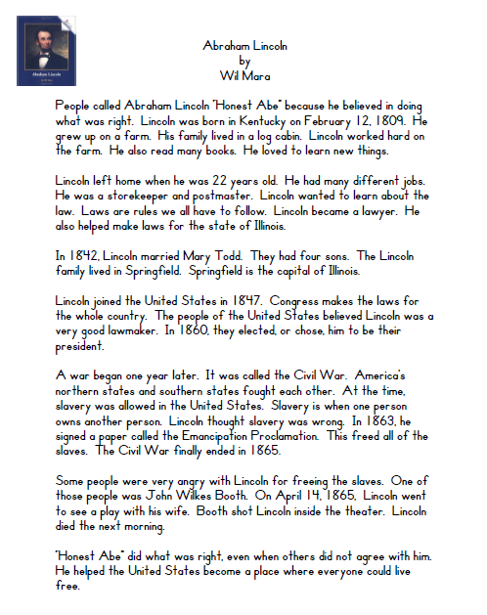
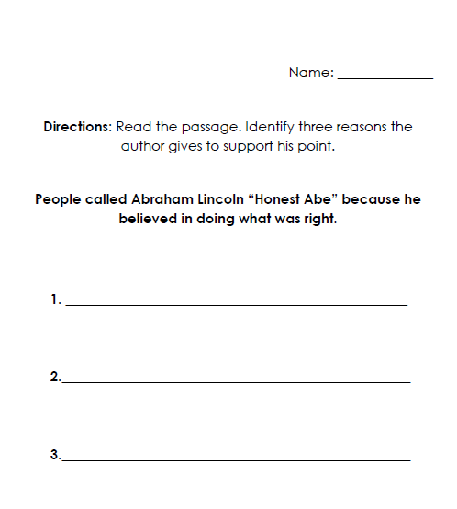
Assessment
Notes:
This assessment focuses on RI.1.8- Identify reasons an author gives to support points in a text. It includes text dependent thinking about a passage. This particular passage is from a Rookie Biography that you may have a copy of.

Slide 12
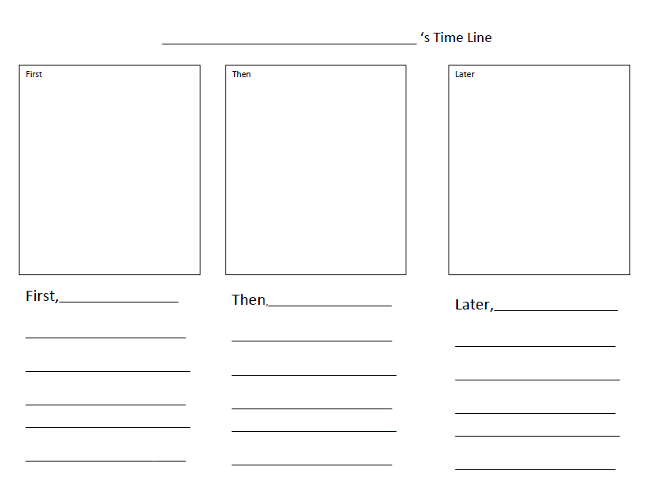
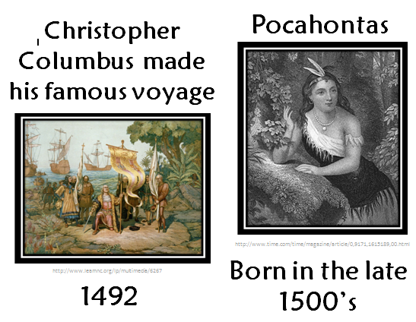
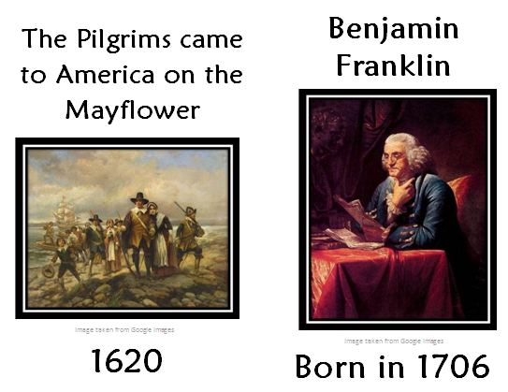
Lesson Resources
Notes:
These are resources to help you build your classroom timeline and are available on the teacher created resources page for this unit.

Slide 13

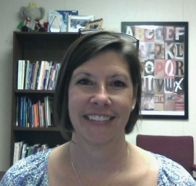

RESOURCES
Susan Hensley
Elementary Curriculum Specialist
shensley@rps.k12.ar.us

