Slide 1
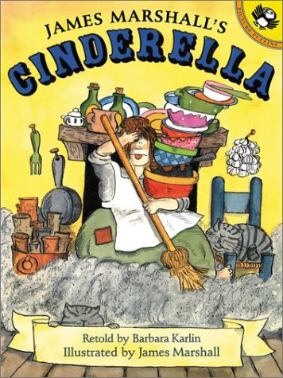
Name:_________________ Date:_________________
GOAL: I can use words I learn from a text.
B: 4 3 2 1
APK: What is a new word you have learned this week?
____________________________________________
Today’s New Book:
New Word | What it means
ragged
shrieked
enchanting
On the back, write your own sentences/draw your own pictures of the
new words you learned today.
A: 4 3 2 1 EFFORT: 4 3 2 1

Slide 2

Name:_________________ Date:_________________
GOAL: I can use words I learn from a text.
B: 4 3 2 1
APK: What is a new word you have learned this week?
____________________________________________
Today’s New Book:
New Word | What it means
beamed
scolded
anxious
On the back, write your own sentences/draw your own pictures of the
new words you learned today.
A: 4 3 2 1 EFFORT: 4 3 2 1

Slide 3

Name:_________________ Date:_________________
GOAL: I can use words I learn from a text.
B: 4 3 2 1
APK: What is a new word you have learned this week?
____________________________________________
Today’s New Book:
New Word | What it means
crafty
filthy
tattered
On the back, write your own sentences/draw your own pictures of the
new words you learned today.
A: 4 3 2 1 EFFORT: 4 3 2 1

Slide 4

Name:_________________ Date:_________________
GOAL: I can use words I learn from a text.
B: 4 3 2 1
APK: What is a new word you have learned this week?
____________________________________________
Today’s New Book:
New Word | What it means
jealous
flustered
glimpse
On the back, write your own sentences/draw your own pictures of the
new words you learned today.
A: 4 3 2 1 EFFORT: 4 3 2 1

Slide 5

Name:_________________ Date:_________________
GOAL: I can use words I learn from a text.
B: 4 3 2 1
APK: What is a new word you have learned this week?
____________________________________________
Today’s New Book:
New Word | What it means
misery
hideous
elegant
On the back, write your own sentences/draw your own pictures of the
new words you learned today.
A: 4 3 2 1 EFFORT: 4 3 2 1

Slide 6

Name:_________________ Date:_________________
GOAL: I can use words I learn from a text.
B: 4 3 2 1
APK: What is a new word you have learned this week?
____________________________________________
Today’s New Book:
New Word | What it means
seldom
scarcely
murmured
On the back, write your own sentences/draw your own pictures of the
new words you learned today.
A: 4 3 2 1 EFFORT: 4 3 2 1

Slide 7

Name:_________________ Date:_________________
GOAL: I can use words I learn from a text.
B: 4 3 2 1
APK: What is a new word you have learned this week?
____________________________________________
Today’s New Book:
New Word | What it means
astonishment
nudged
hurled
On the back, write your own sentences/draw your own pictures of the
new words you learned today.
A: 4 3 2 1 EFFORT: 4 3 2 1

Slide 8

Name:_________________ Date:_________________
GOAL: I can use words I learn from a text.
B: 4 3 2 1
APK: What is a new word you have learned this week?
____________________________________________
Today’s New Book:
New Word | What it means
ragged
stammered
exclaimed
On the back, write your own sentences/draw your own pictures of the
new words you learned today.
A: 4 3 2 1 EFFORT: 4 3 2 1

