Slide 1

1st Grade Text Talk
Unit 6

Slide 2
I can use words I learn from a text.
Notes:
Goal-
Students need to engage with the goal- read it, repeat it, write it, etc.

Slide 3
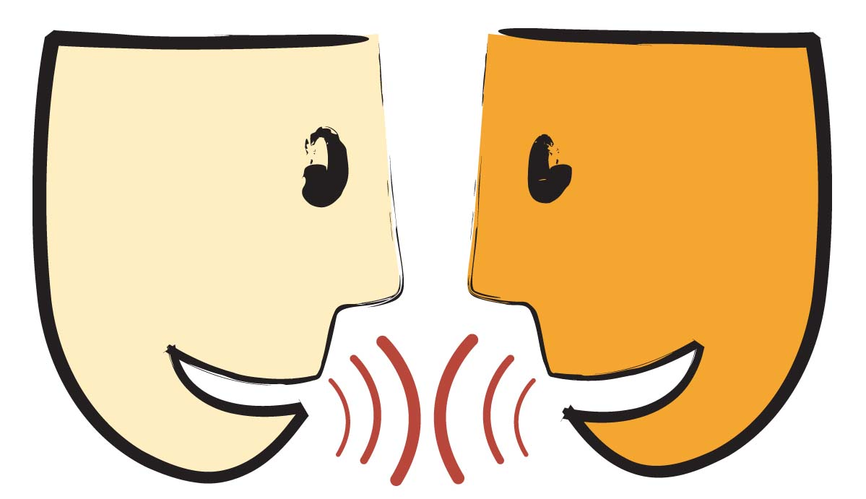
Tell your partner about a new word you learned last week.
Notes:
Access Prior Knowledge- (APK)
Turn and Talk

Slide 4
Notes:
New Information-
Read the book- provide a brief explanation of any words that may be new or unfamiliar to the students.

Slide 5
beamed
Notes:
Contextualize the word- Find it in the text
Say the word together

Slide 6


beamed
To smile widely
To shine
Notes:
Give student friendly definition
Use the word in other contexts

Slide 7
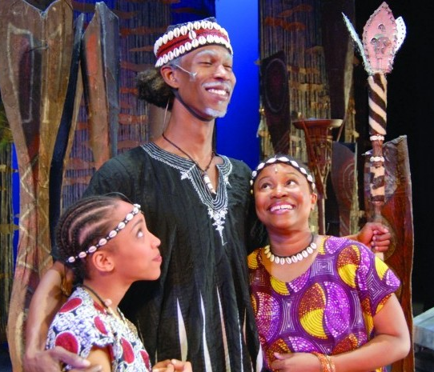
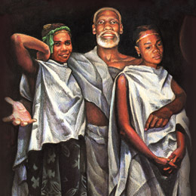
Why is Mufaro beaming with pride at the beginning of the story ?
Notes:
Engage the students with the word

Slide 8
scolded
Notes:
Contextualize the word- Find it in the text
Say the word together

Slide 9
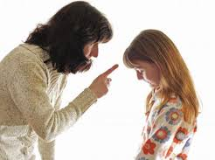
scolded
To tell someone they did
something wrong in an angry way.
Notes:
Give student friendly definition
Use the word in other contexts

Slide 10

Thumbs up if this is an example of scolded.
Thumbs down if not.
The teacher praised the students for doing a great job on their work.
The woman fussed at her dog when he tore up her new shoes.
My big brother yelled at me when I broke his Lego castle.
The little girl whispered, “Thank you,” in her friend’s ear.
Notes:
Engage the students with the word

Slide 11
anxious
Notes:
Contextualize the word- Find it in the text
Say the word together

Slide 12
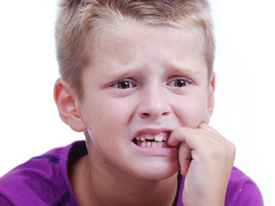
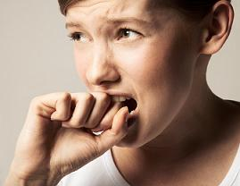
anxious
Wanting to do something;
impatient and concerned
Notes:
Give student friendly definition
Use the word in other contexts

Slide 13
Pretend like you are anxious about your birthday party and you can’t wait for it to begin.
Pretend like you are anxious about your first day of school.
Pretend like you are anxious because you are lost.
Notes:
Engage the students with the word

Slide 14
Who can use all 3 words in a sentence?
beamed
scolded
anxious
Notes:
Read all three words and see if you can use them in one sentence.

Slide 15


Draw a picture to show you know what these words mean.
beamed
scolded
anxious
Notes:
Application-
Students need an opportunity to use the words they just learned from the text.

Slide 16
I can use words I learn from a text.
Notes:
Goal-
Revisit the Goal

