Slide 1

1st Grade Text Talk
Unit 6

Slide 2
I can use words I learn from a text.
Notes:
Goal-
Students need to engage with the goal- read it, repeat it, write it, etc.

Slide 3

Tell your partner about a new word you learned last week.
Notes:
Access Prior Knowledge- (APK)
Turn and Talk

Slide 4
Notes:
New Information-
Read the book- provide a brief explanation of any words that may be new or unfamiliar to the students.

Slide 5
misery
Notes:
Contextualize the word- Find it in the text
Say the word together

Slide 6
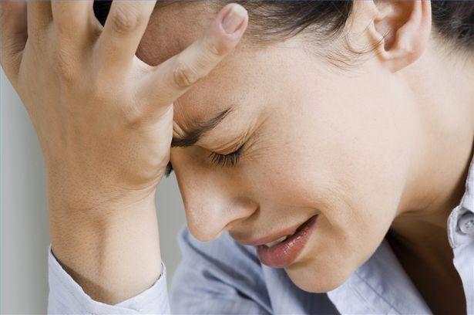
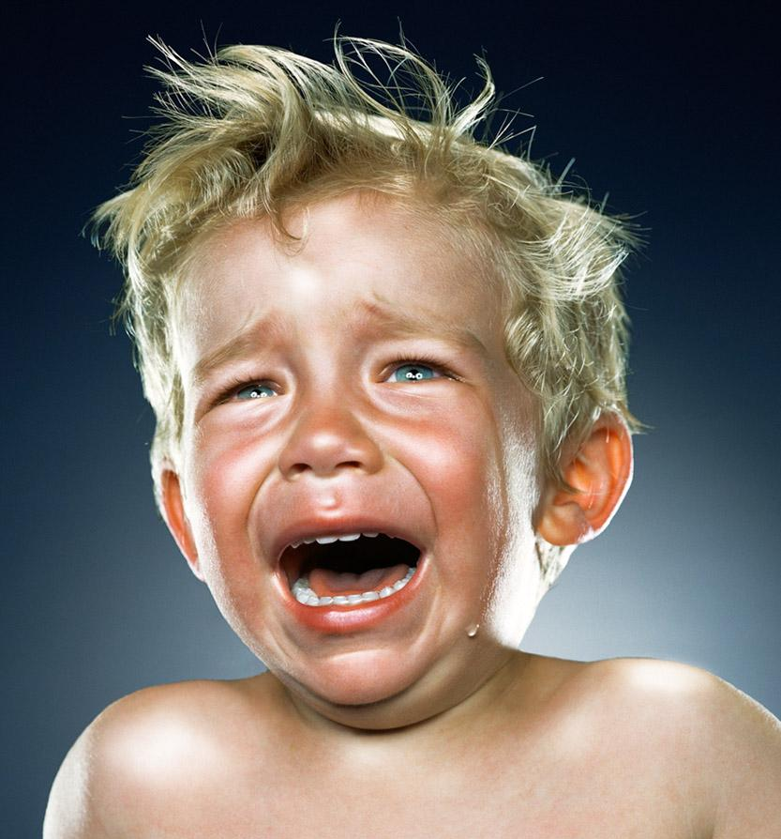
misery
Deep sadness; feeling like there is no hope
Notes:
Give student friendly definition
Use the word in other contexts

Slide 7
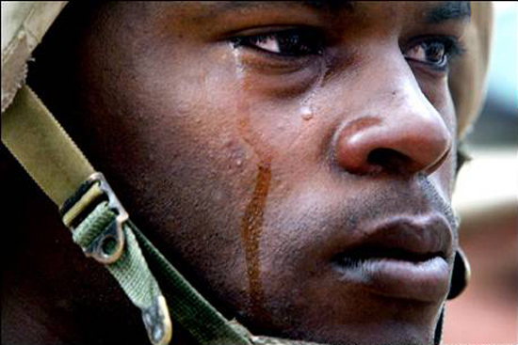

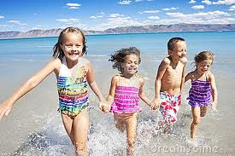
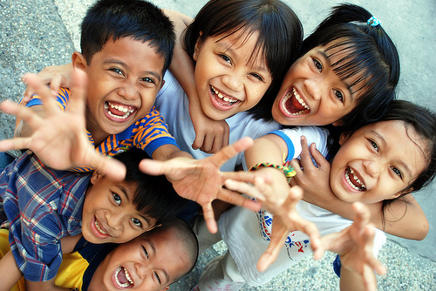
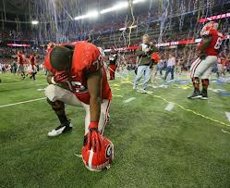
Which pictures illustrate misery?
Notes:
Engage the students with the word

Slide 8
hideous
Notes:
Contextualize the word- Find it in the text
Say the word together

Slide 9
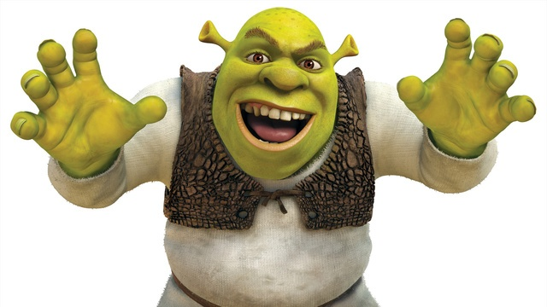
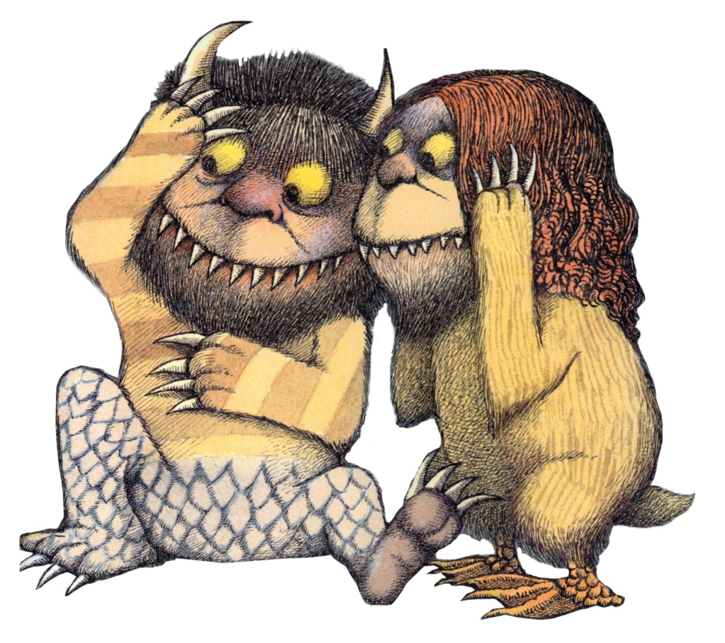

hideous
Frightening in looks; ugly
Notes:
Give student friendly definition
Use the word in other contexts

Slide 10
Make a hideous face.
Notes:
Engage the students with the word

Slide 11
elegant
Notes:
Contextualize the word- Find it in the text
Say the word together

Slide 12

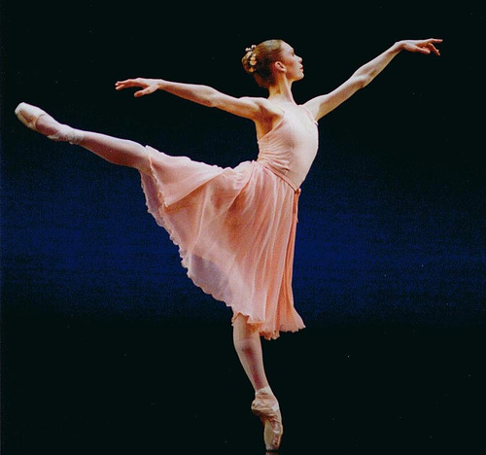
elegant
Graceful and attractive
Notes:
Give student friendly definition
Use the word in other contexts

Slide 13
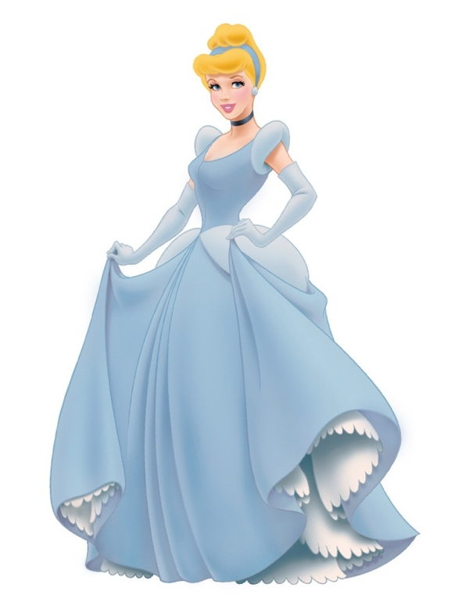
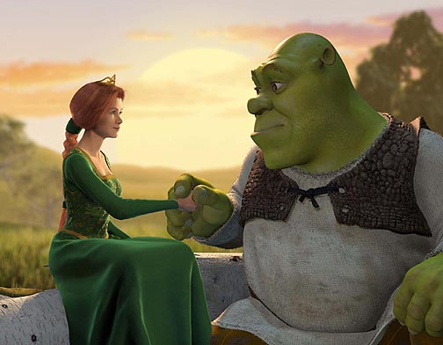
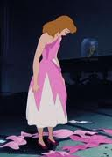
Where are the elegant characters?
Notes:
Engage the students with the word

Slide 14
Who can use all 3 words in a sentence?
misery
hideous
elegant
Notes:
Read all three words and see if you can use them in one sentence.

Slide 15


Draw a picture to show you know what these words mean.
misery
hideous
elegant
Notes:
Application-
Students need an opportunity to use the words they just learned from the text.

Slide 16
I can use words I learn from a text.
Notes:
Goal-
Revisit the Goal

