Slide 1

1st Grade Text Talk
Unit 6

Slide 2
I can use words I learn from a text.
Notes:
Goal-
Students need to engage with the goal- read it, repeat it, write it, etc.

Slide 3
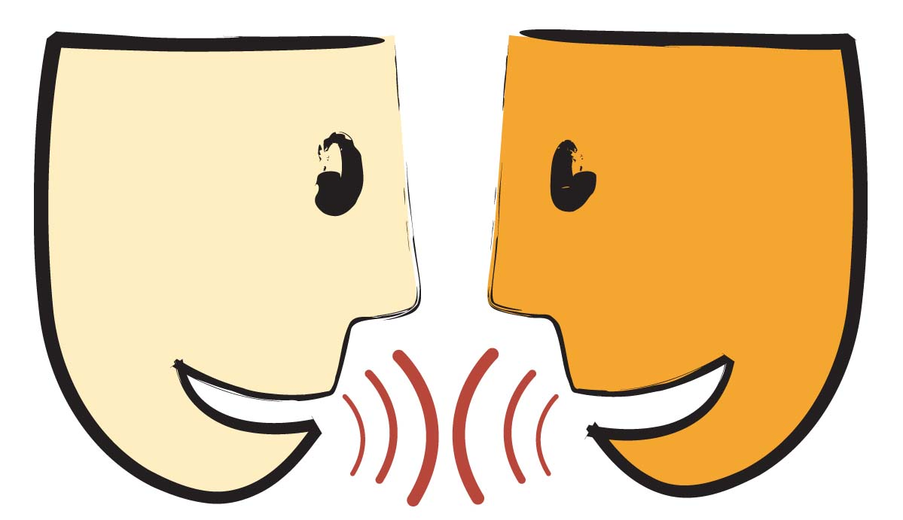
Tell your partner about a new word you learned last week.
Notes:
Access Prior Knowledge- (APK)
Turn and Talk

Slide 4
Notes:
New Information-
Read the book- provide a brief explanation of any words that may be new or unfamiliar to the students.

Slide 5
jealous
Notes:
Contextualize the word- Find it in the text
Say the word together

Slide 6
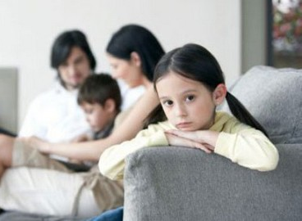
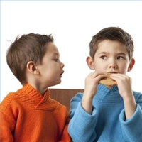
jealous
Wanting someone or something belonging to another person
Notes:
Give student friendly definition
Use the word in other contexts

Slide 7
When have you felt jealous ?
Pretend like you jealous of your friend because they have a new toy that you want.
Notes:
Engage the students with the word

Slide 8
flustered
Notes:
Contextualize the word- Find it in the text
Say the word together

Slide 9
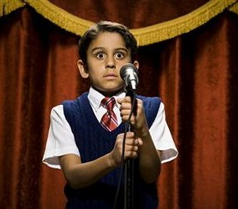
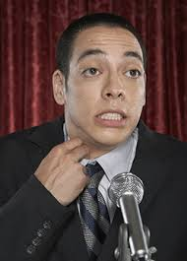
flustered
Upset and behaving awkwardly (not normal)
Notes:
Give student friendly definition
Use the word in other contexts

Slide 10

Thumbs up if this is something flustered.
Thumbs down if not.
The singer went on stage and gave a great performance.
The singer went on stage and was so nervous and embarrassed that she forgot all the words to the song and could not sing at all.
As the man was talking to the woman, he kept fumbling and dropping the papers in his hands.
Notes:
Engage the students with the word

Slide 11
glimpse
Notes:
Contextualize the word- Find it in the text
Say the word together

Slide 12

glimpse
A quick look
Notes:
Give student friendly definition
Use the word in other contexts

Slide 13
What are some other words that are similar to glimpse?
Pretend to get a glimpse of something in the classroom.
Notes:
Engage the students with the word

Slide 14
Who can use all 3 words in a sentence?
jealous
flustered
glimpse
Notes:
Read all three words and see if you can use them in one sentence.

Slide 15


Draw a picture to show you know what these words mean.
jealous
flustered
glimpse
Notes:
Application-
Students need an opportunity to use the words they just learned from the text.

Slide 16
I can use words I learn from a text.
Notes:
Goal-
Revisit the Goal

