Slide 1

1st Grade Text Talk
Unit 6

Slide 2
I can use words I learn from a text.
Notes:
Goal-
Students need to engage with the goal- read it, repeat it, write it, etc.

Slide 3

Tell your partner about a new word you learned last week.
Notes:
Access Prior Knowledge- (APK)
Turn and Talk

Slide 4
Notes:
New Information-
Read the book- provide a brief explanation of any words that may be new or unfamiliar to the students.

Slide 5
ragged
Notes:
Contextualize the word- Find it in the text
Say the word together

Slide 6
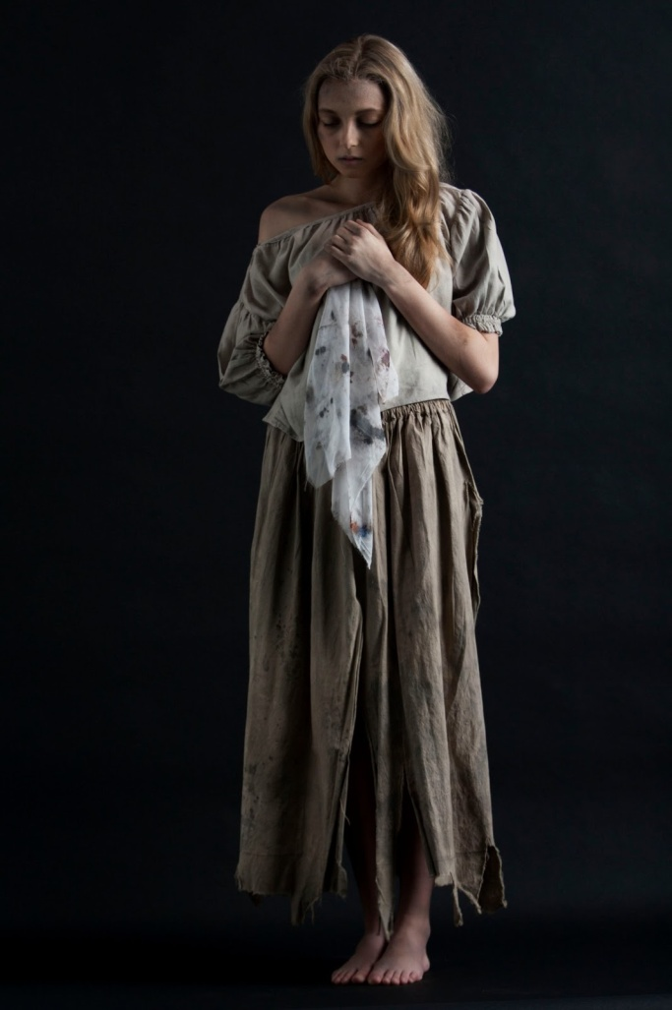
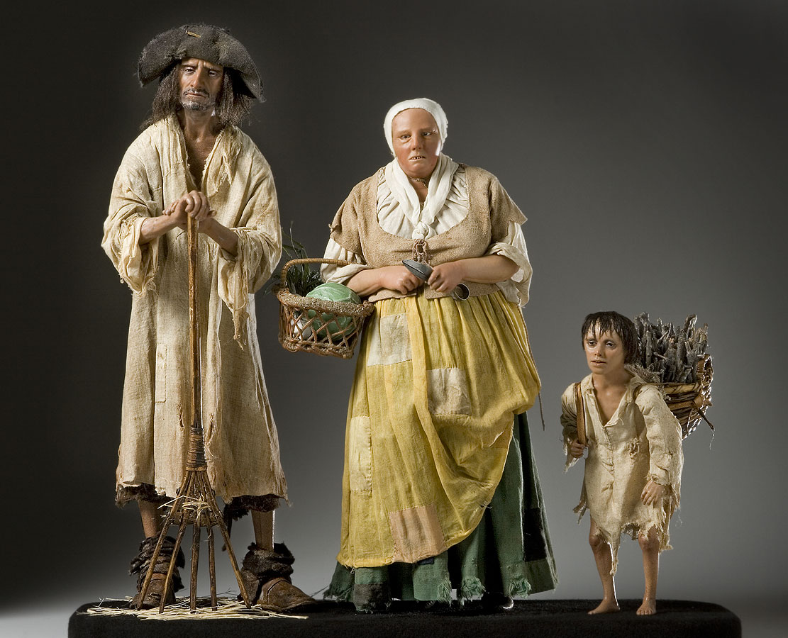
ragged
Dirty, old clothing
Notes:
Give student friendly definition
Use the word in other contexts

Slide 7

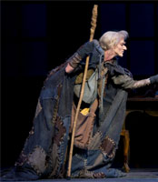
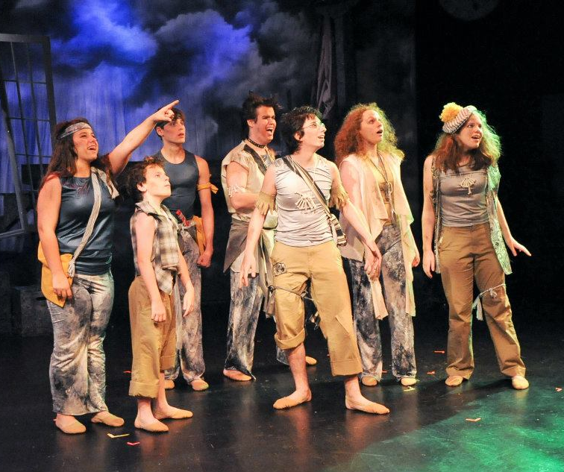
Which pictures show people in ragged clothes?
Notes:
Engage the students with the word

Slide 8
shrieked
Notes:
Contextualize the word- Find it in the text
Say the word together

Slide 9
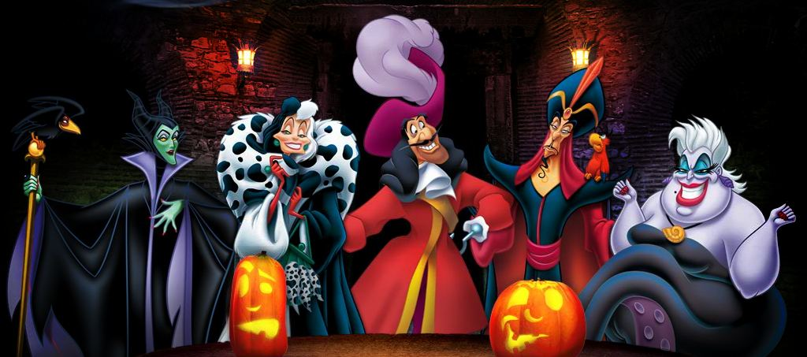
shriek
To screamed or cry loudly
Touch the picture to hear Disney villains shrieking with laughter.
Notes:
Give student friendly definition
Use the word in other contexts

Slide 10

Thumbs up if this is an example of shrieked.
Thumbs down if not.
The Wicked Witch of the West screamed and laughed as she disappeared in a cloud of smoke.
Someone answered the telephone.
The teacher called on you when you raised your hand.
A little girl screamed as a spider jumped in her lap.
Notes:
Engage the students with the word

Slide 11
enchanting
Notes:
Contextualize the word- Find it in the text
Say the word together

Slide 12
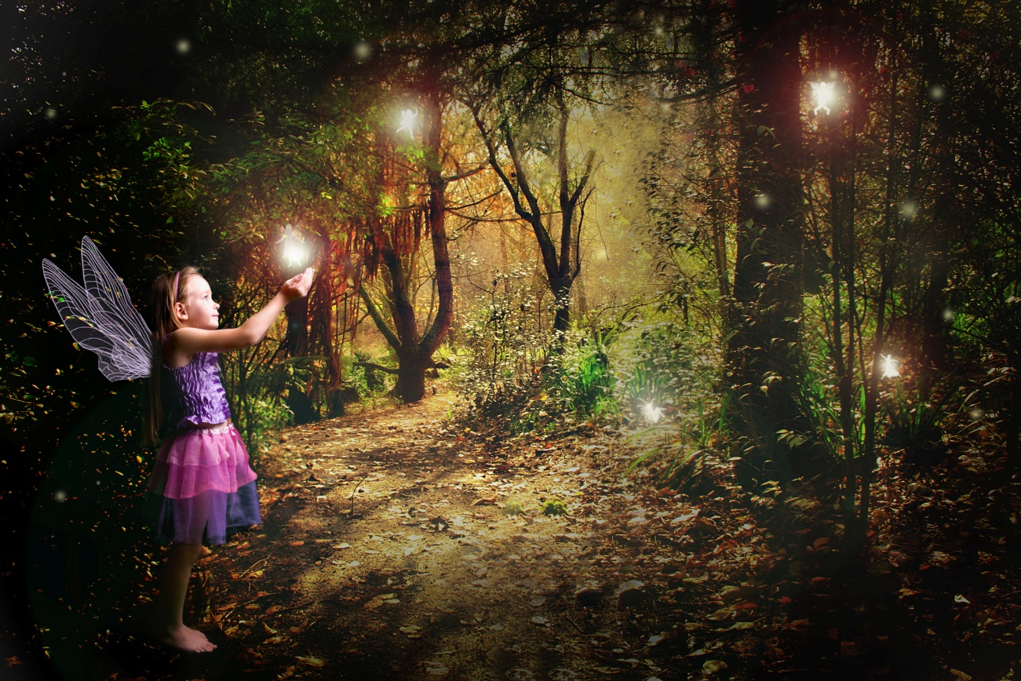
enchanting
Charming and delightful
Notes:
Give student friendly definition
Use the word in other contexts

Slide 13

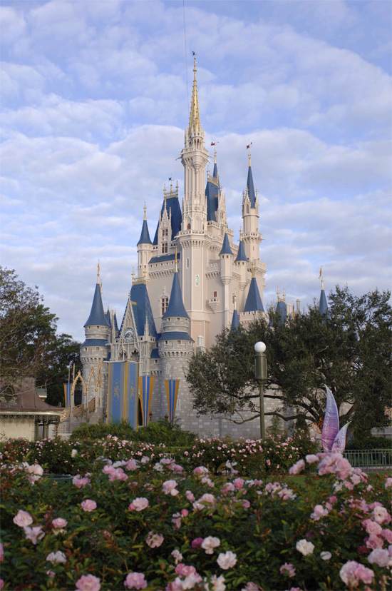
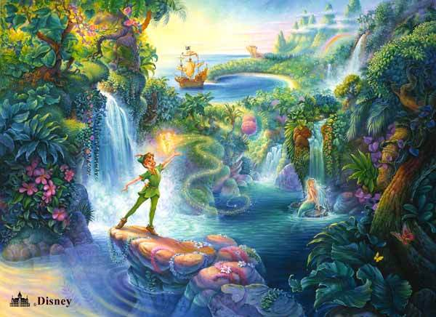
How do these pictures illustrate
enchanting.
Notes:
Engage the students with the word

Slide 14
Who can use all 3 words in a sentence?
ragged
shrieked
enchanting
Notes:
Read all three words and see if you can use them in one sentence.

Slide 15


Draw a picture to show you know what these words mean.
ragged
shrieked
enchanting
Notes:
Application-
Students need an opportunity to use the words they just learned from the text.

Slide 16
I can use words I learn from a text.
Notes:
Goal-
Revisit the Goal

