Slide 1
Masks of the World
Grade 1, Unit 6

Slide 2
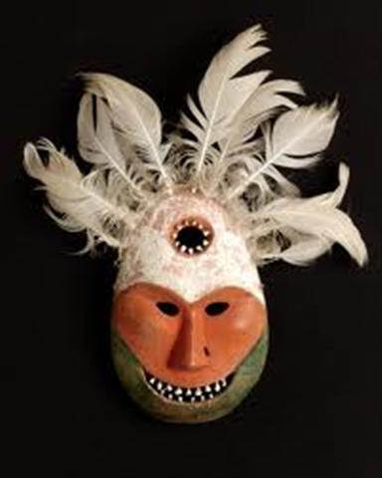
Shaman’s Mask

Slide 3
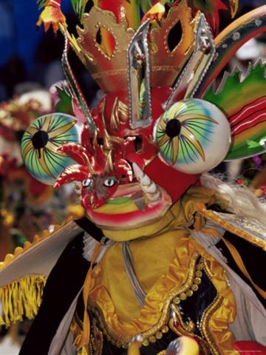
Devil Dance Mask

Slide 4
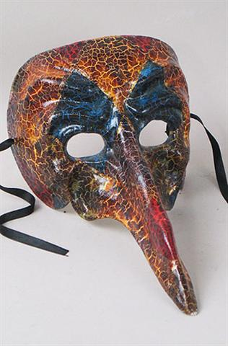
Captain Scaramouche - Europe

Slide 5
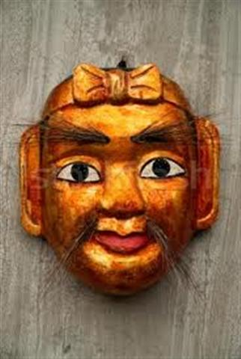
Asian Puppet Mask

Slide 6
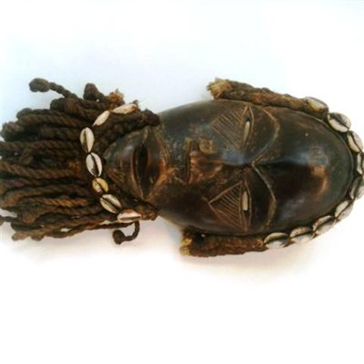
African Mask – Ivory Coast

Slide 7
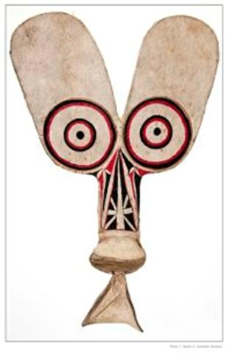
Australian Display Mask

