Slide 1
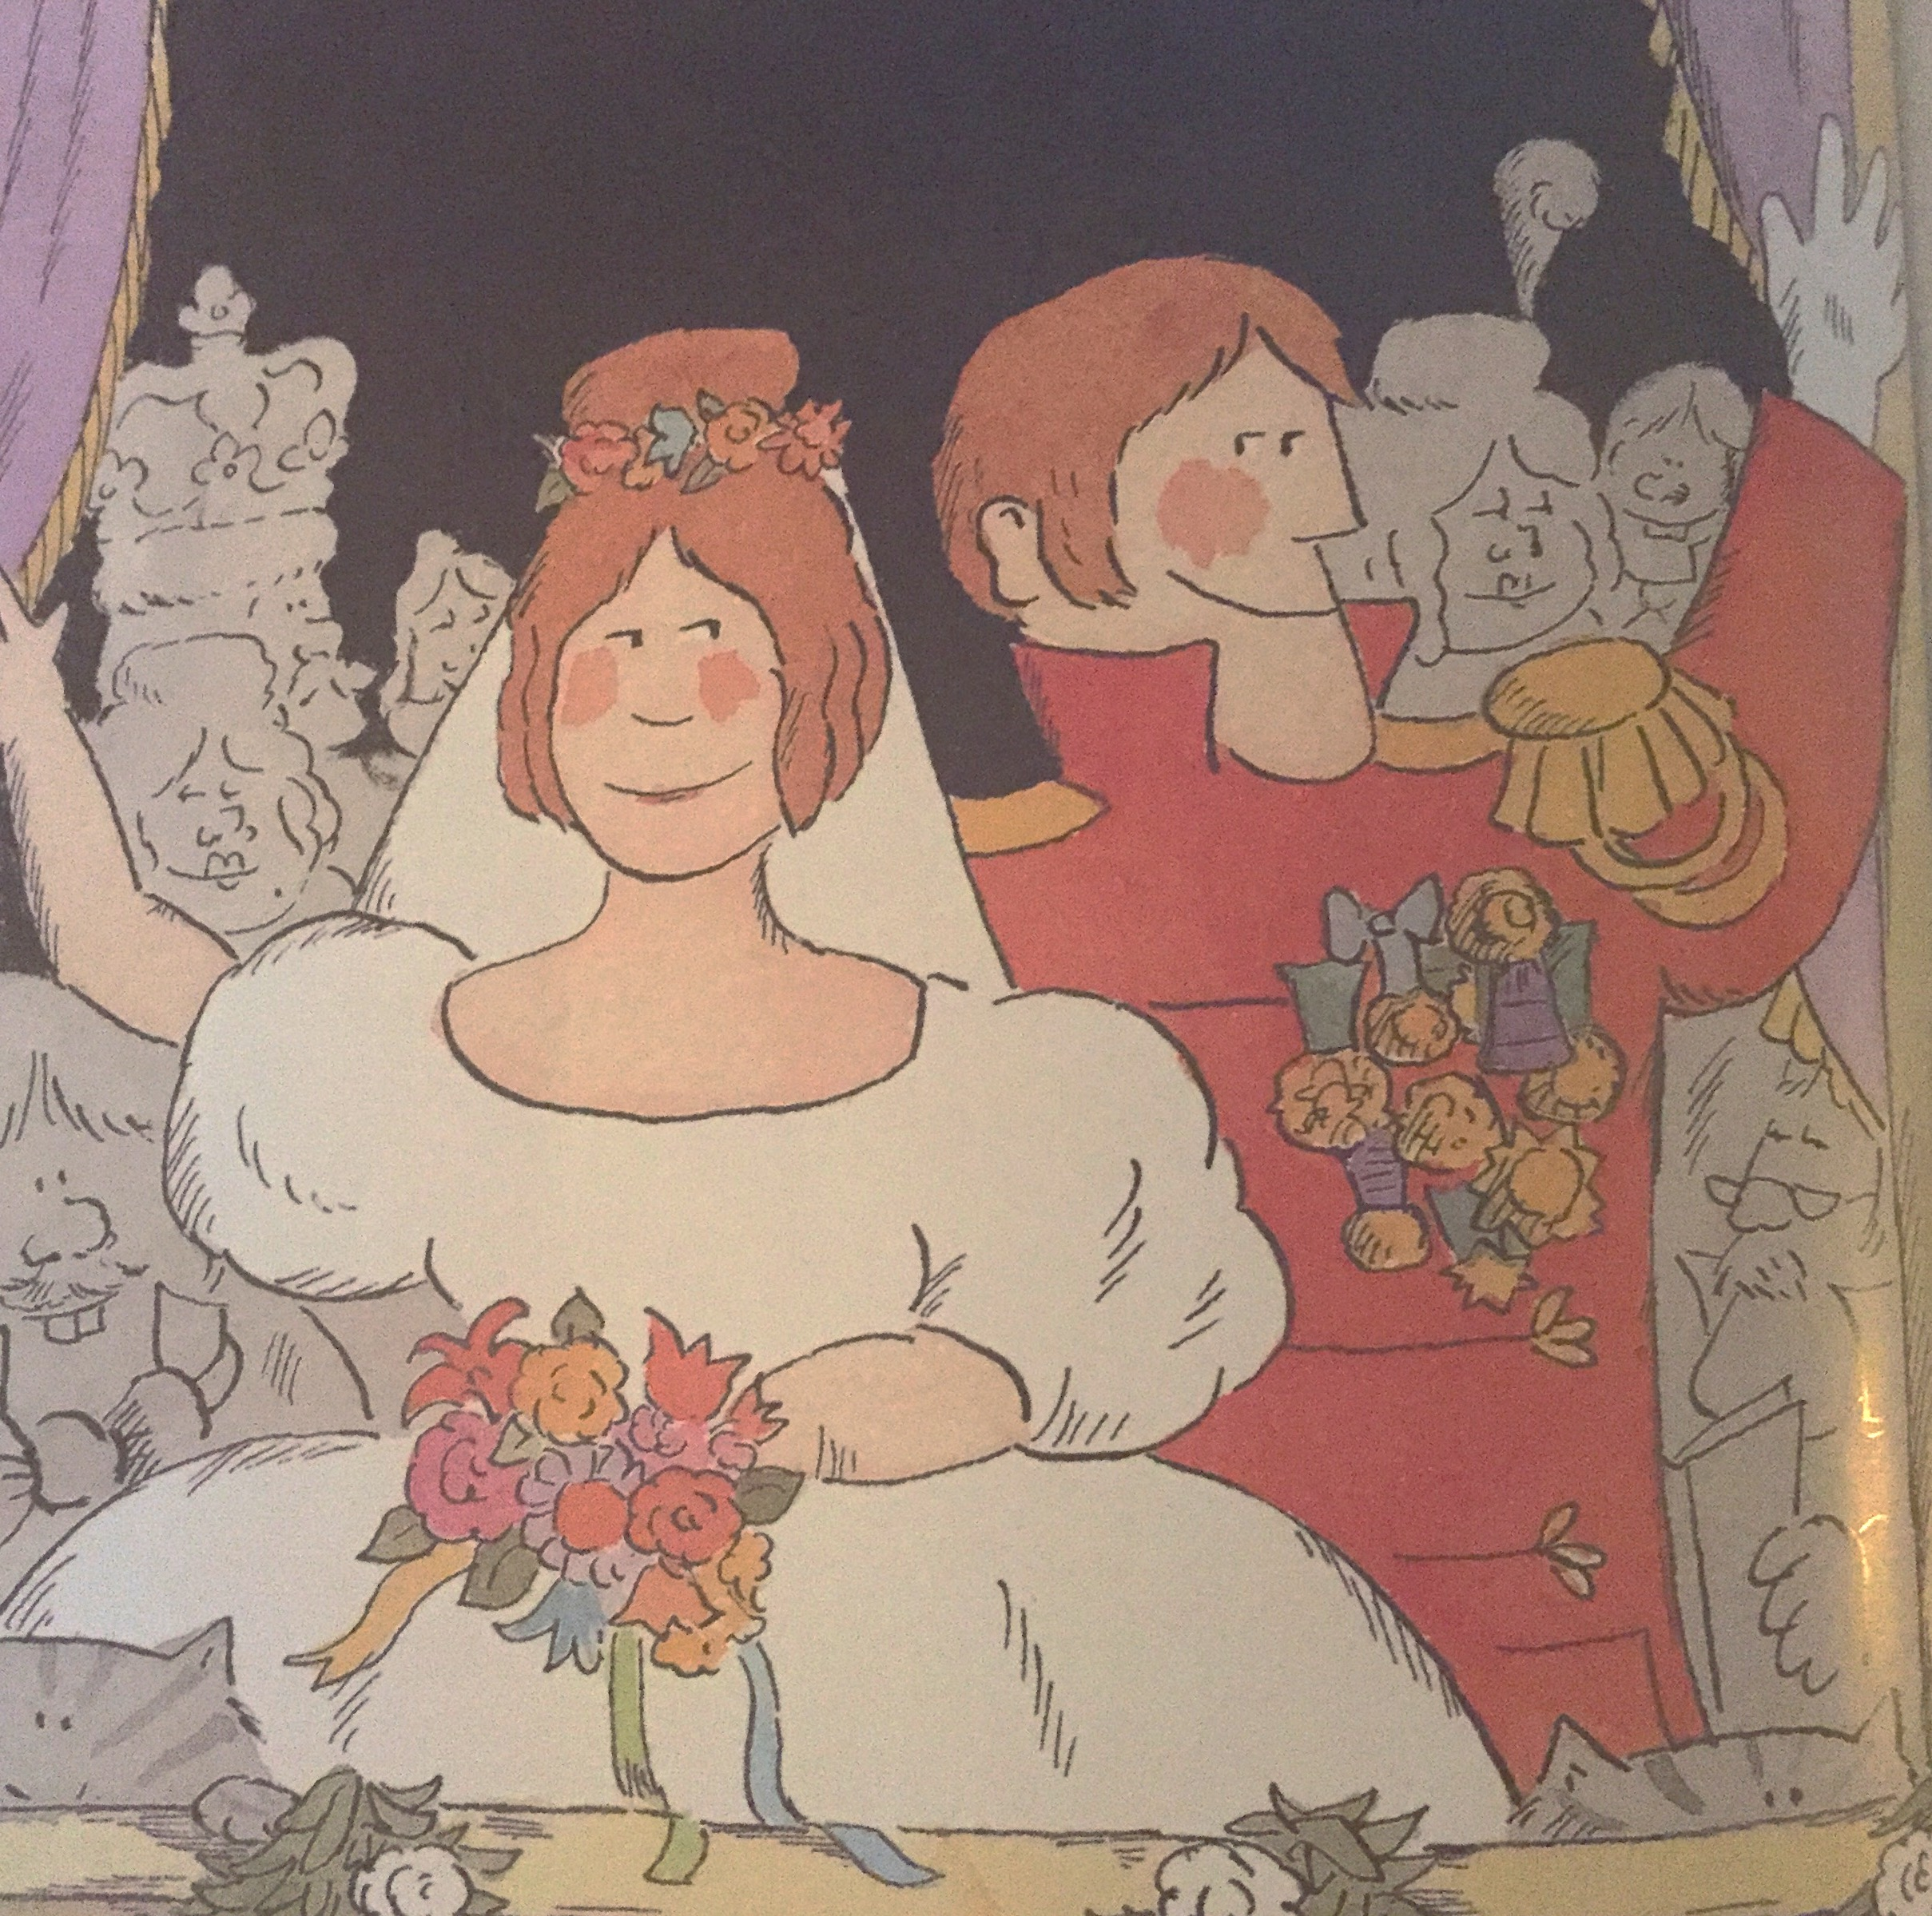
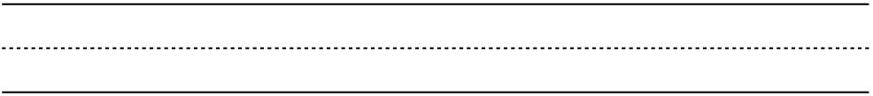
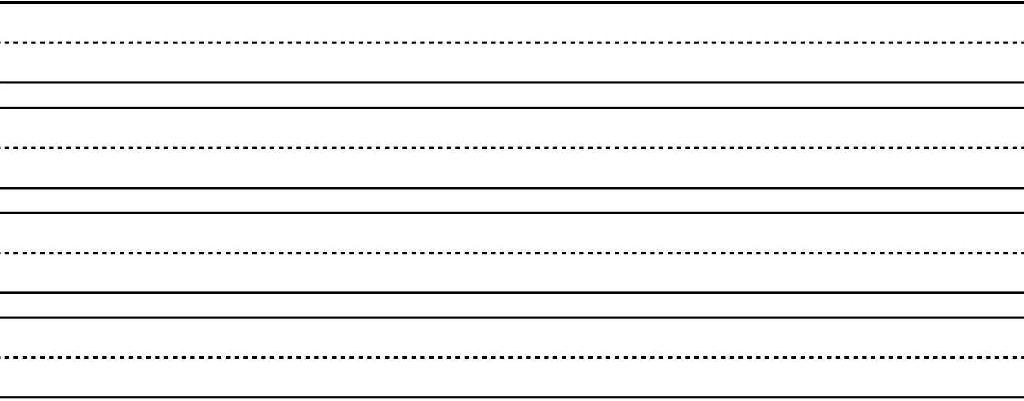
RL.1.2
How did Cinderella’s life change from the beginning to the end of the story? Name:_________________

Slide 2
RL.1.2
How did Cinderella’s life change from the beginning to the end of the story? Name:_________________

