Slide 1

1st Grade Text Talk
Unit 5

Slide 2
I can use words I learn from a text.
Notes:
Goal-
Students need to engage with the goal- read it, repeat it, write it, etc.

Slide 3

Tell your partner about a new word you learned last week.
Notes:
Access Prior Knowledge- (APK)
Turn and Talk

Slide 5
swayed
Notes:
Contextualize the word- Find it in the text
Say the word together

Slide 6
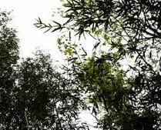
sway
To move back and forth
Touch the picture to
watch a video of
trees swaying in the wind.
Notes:
Give student friendly definition
Use the word in other contexts

Slide 7
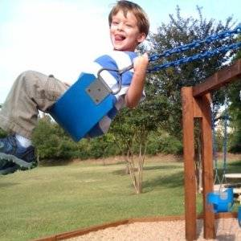
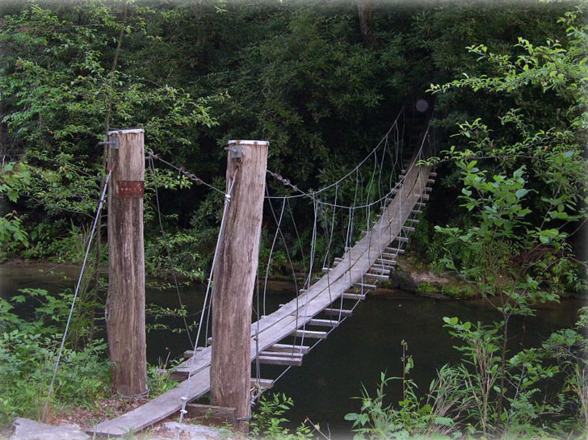

Which of these pictures show
things that can sway?
Notes:
Engage the students with the word

Slide 8
terrifying
Notes:
Contextualize the word- Find it in the text
Say the word together

Slide 9
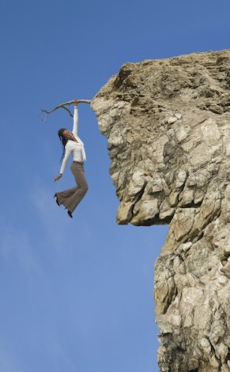
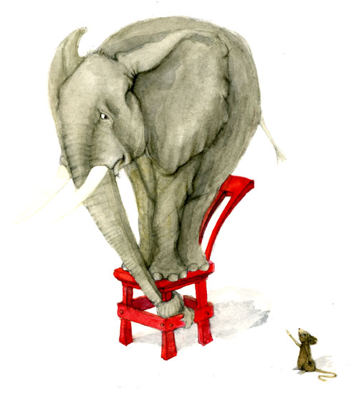
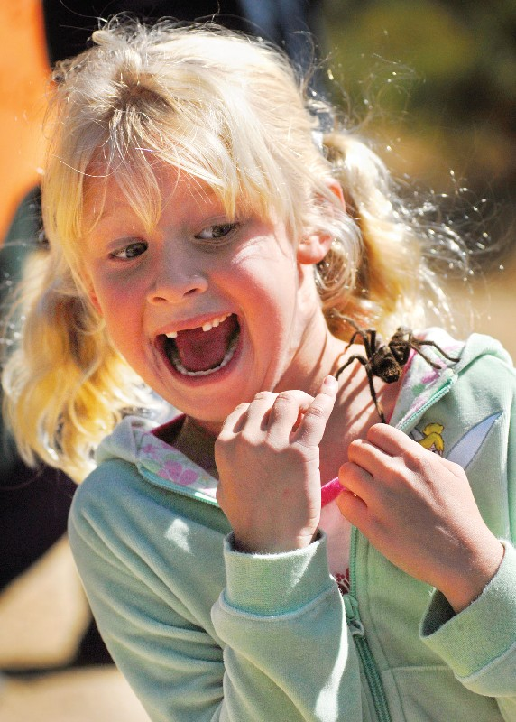
terrifying
scary
Notes:
Give student friendly definition
Use the word in other contexts

Slide 10
What would you look like if you saw something terrifying?
Tell me something that you think is terrifying?
Notes:
Engage the students with the word

Slide 11
performer
Notes:
Contextualize the word- Find it in the text
Say the word together

Slide 12
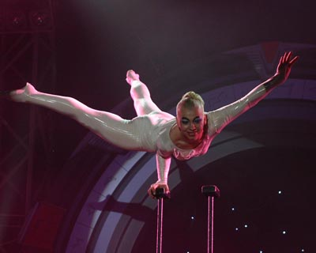
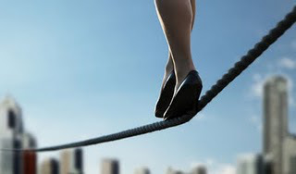
performer
Someone who entertains people
Touch the feet in the picture above
to see a performer walking on a
tightrope.
Notes:
Give student friendly definition
Use the word in other contexts

Slide 13

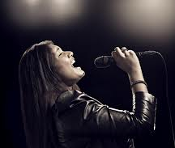
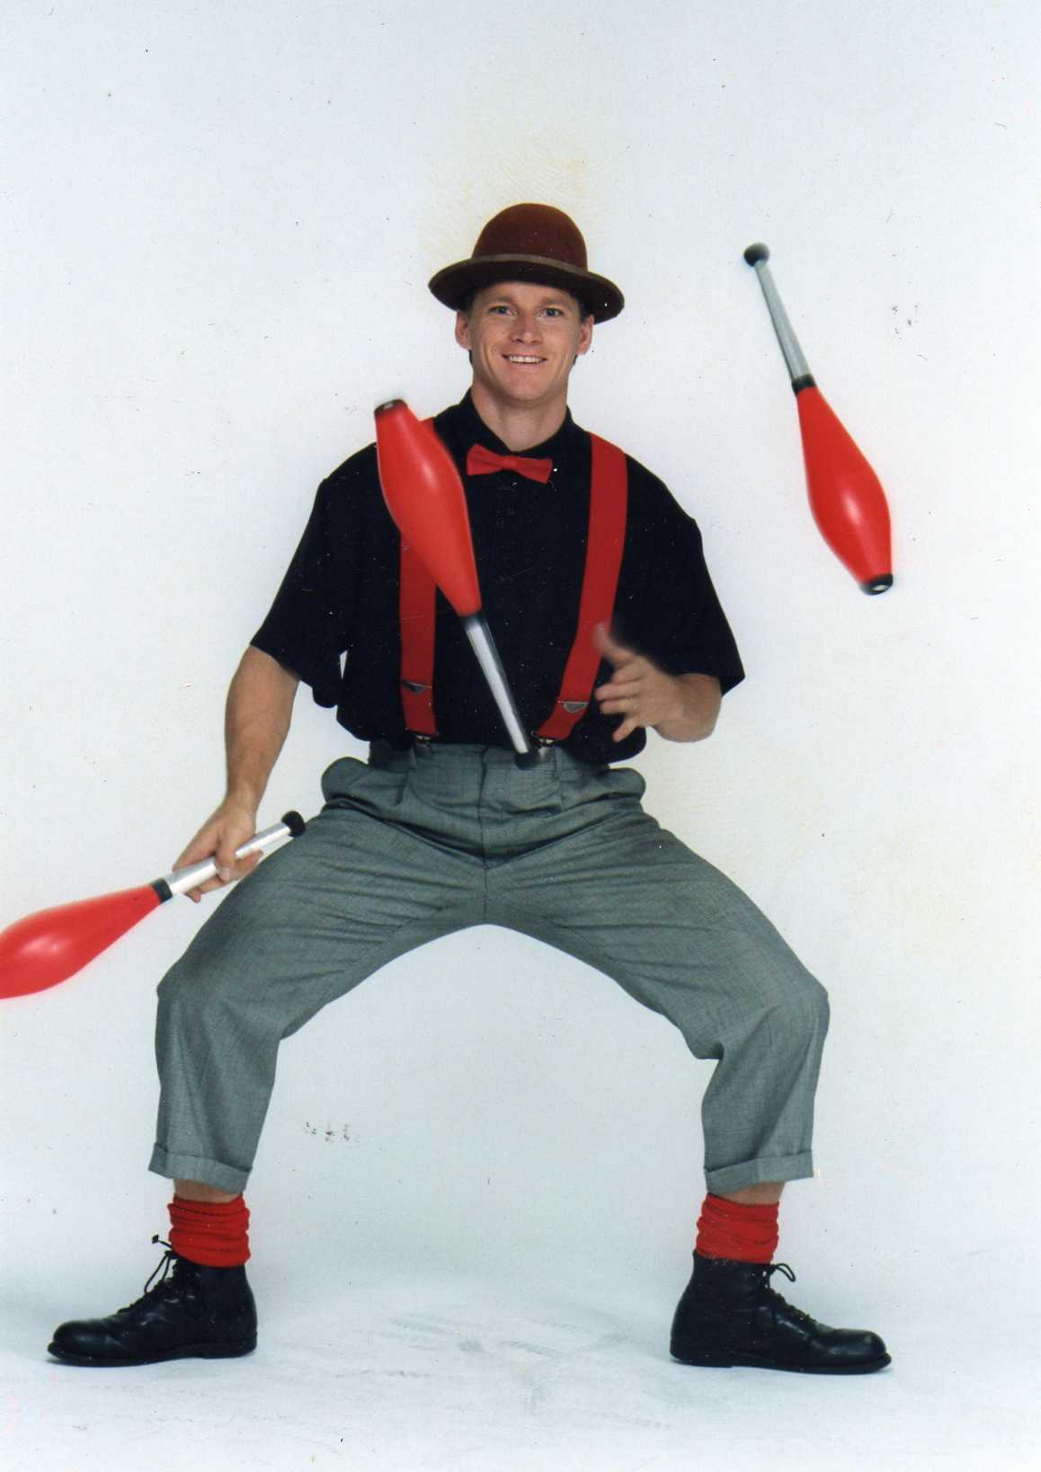
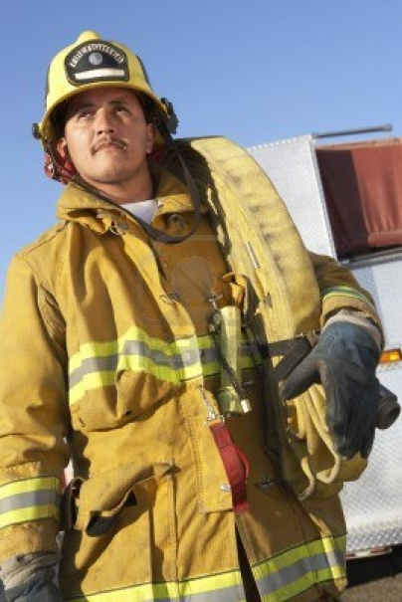
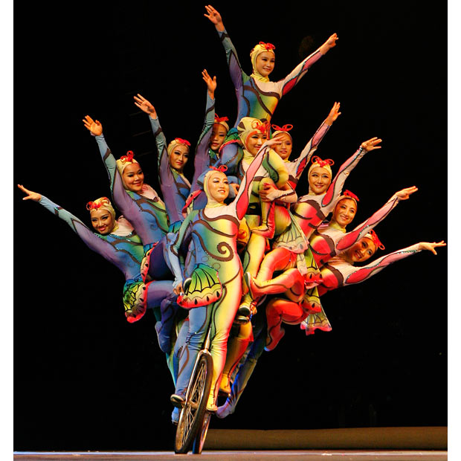
Which pictures show examples of performers?
Notes:
Engage the students with the word

Slide 14
Who can use all 3 words in a sentence?
swayed
terrifying
performer
Notes:
Read all three words and see if you can use them in one sentence.

Slide 15


Draw a picture to show you know what these words mean.
swayed
terrifying
performer
Notes:
Application-
Students need an opportunity to use the words they just learned from the text.

Slide 16
I can use words I learn from a text.
Notes:
Goal-
Revisit the Goal

