Slide 1
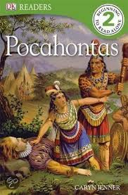
1st Grade Text Talk
Unit 5

Slide 2
I can use words I learn from a text.
Notes:
Goal-
Students need to engage with the goal- read it, repeat it, write it, etc.

Slide 3
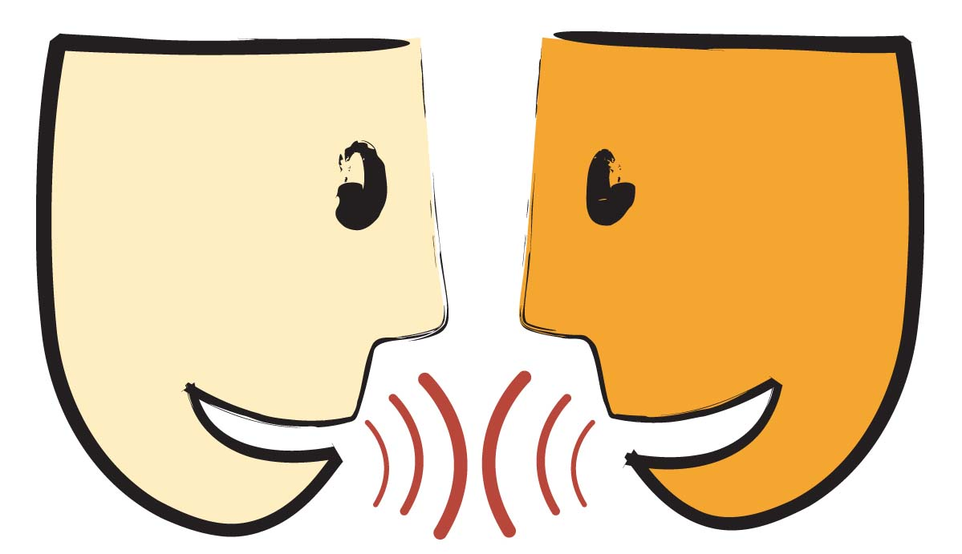
Tell your partner about a new word you learned last week.
Notes:
Access Prior Knowledge- (APK)
Turn and Talk

Slide 5
harsh
Notes:
Contextualize the word- Find it in the text
Say the word together

Slide 6
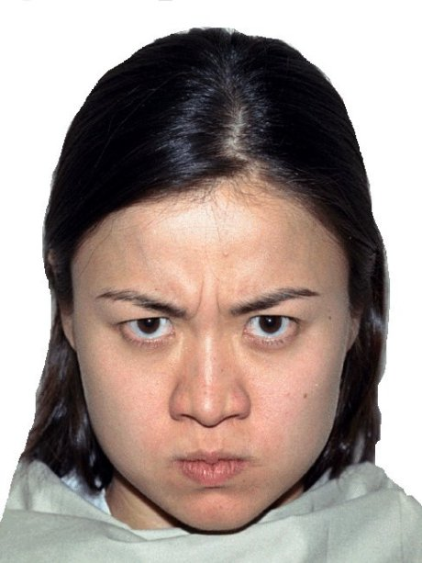
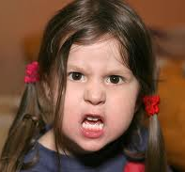
harsh
Hard or mean
Notes:
Give student friendly definition
Use the word in other contexts

Slide 7

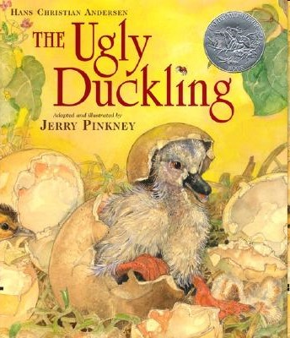
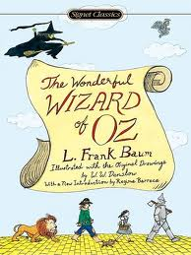
Who were the harsh characters from these
stories? Why were they harsh?
The Tortoise and the Hare
The Ugly Duckling
The Wizard of Oz
Notes:
Engage the students with the word

Slide 8
charming
Notes:
Contextualize the word- Find it in the text
Say the word together

Slide 9
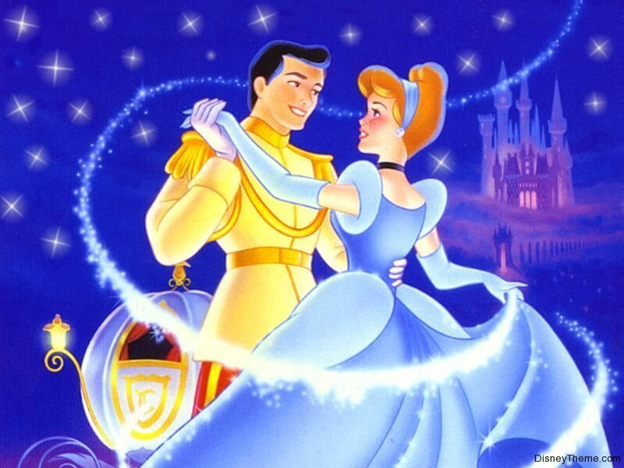
charming
Friendly and likeable
Notes:
Give student friendly definition
Use the word in other contexts

Slide 10

Thumbs up if this is an example of charming. Thumbs down if not.
The little girl stuck her tongue out at the little boy.
The girl asked the new student if there was anything she could do to help her.
The man let the door close right in front of the woman.
The man stopped to hold the door open so the woman could go through.
Notes:
Engage the students with the word

Slide 11
clever
Notes:
Contextualize the word- Find it in the text
Say the word together

Slide 12

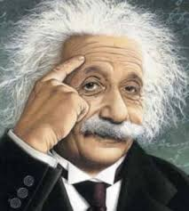
clever
Smart; quick at understanding
Notes:
Give student friendly definition
Use the word in other contexts

Slide 13
Make a frozen picture that shows clever.
Notes:
Engage the students with the word

Slide 14
Who can use all 3 words in a sentence?
harsh
charming
clever
Notes:
Read all three words and see if you can use them in one sentence.

Slide 15


Draw a picture to show you know what these words mean.
harsh
charming
clever
Notes:
Application-
Students need an opportunity to use the words they just learned from the text.

Slide 16
I can use words I learn from a text.
Notes:
Goal-
Revisit the Goal

