Slide 1
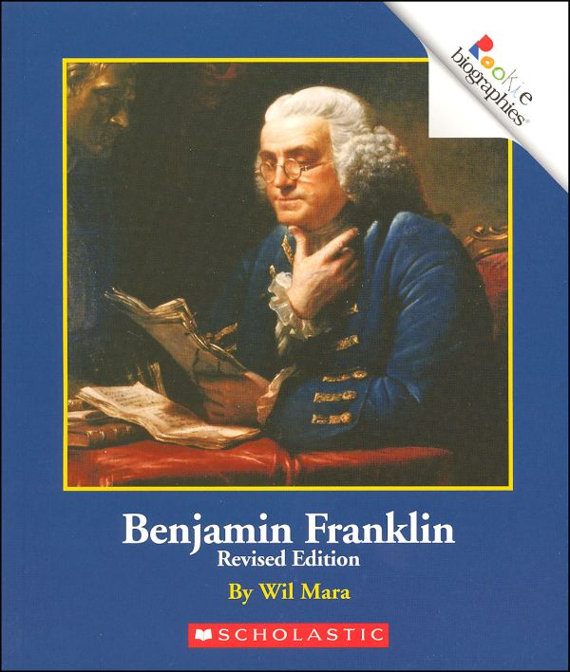
1st Grade Text Talk
Unit 5

Slide 2
I can use words I learn from a text.
Notes:
Goal-
Students need to engage with the goal- read it, repeat it, write it, etc.

Slide 3

Tell your partner about a new word you learned last week.
Notes:
Access Prior Knowledge- (APK)
Turn and Talk

Slide 5
correctly
Notes:
Contextualize the word- Find it in the text
Say the word together

Slide 6

correctly
To do it right
Notes:
Give student friendly definition
Use the word in other contexts

Slide 7
Show me the correct way to sit on the carpet.
Show me the correct way to line up.
What is something you know how to do the correct way?
Notes:
Engage the students with the word

Slide 8
improvements
Notes:
Contextualize the word- Find it in the text
Say the word together

Slide 9
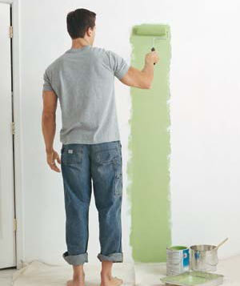
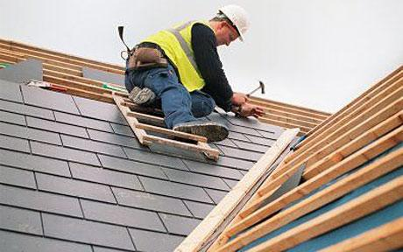
improvements
To make things better
Notes:
Give student friendly definition
Use the word in other contexts

Slide 10
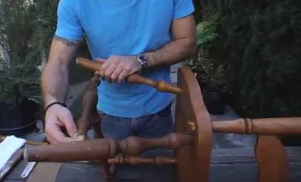
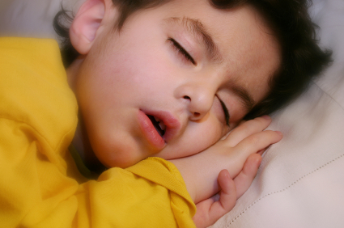
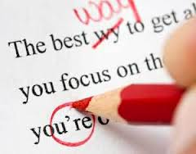
Which pictures show improvements being made?
Notes:
Engage the students with the word

Slide 11
inventions
Notes:
Contextualize the word- Find it in the text
Say the word together

Slide 12
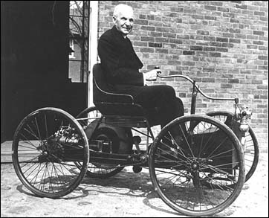
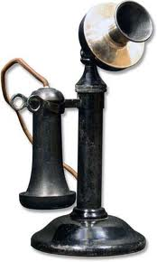
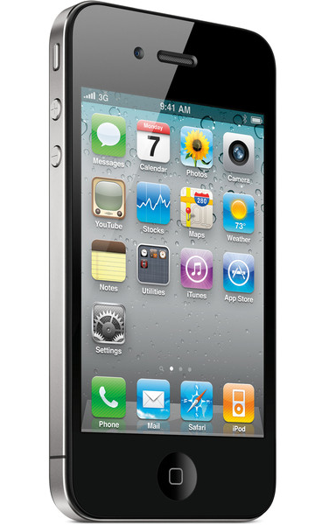
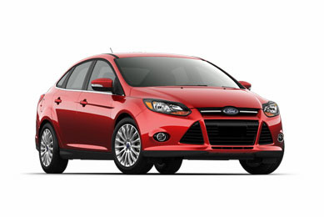
inventions
New ideas and products
created by someone
Notes:
Give student friendly definition
Use the word in other contexts

Slide 13
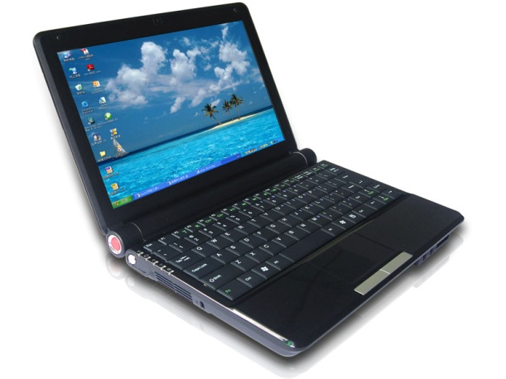


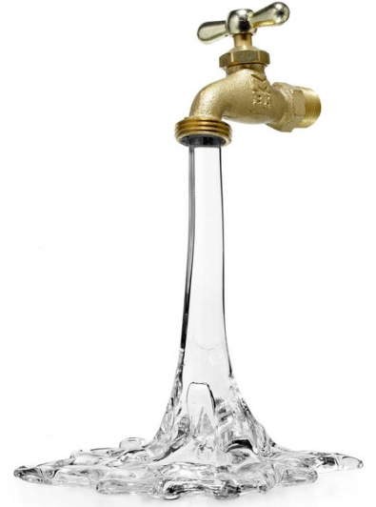
How have these inventions made our
lives easier?
Notes:
Engage the students with the word

Slide 14
Who can use all 3 words in a sentence?
correctly
improvements
inventions
Notes:
Read all three words and see if you can use them in one sentence.

Slide 15
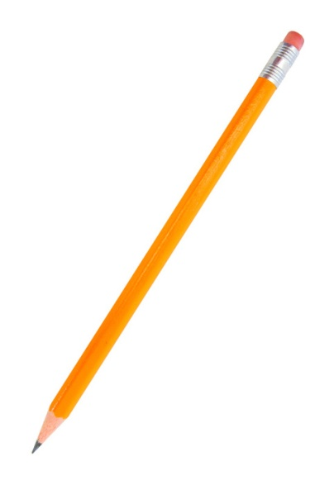

Draw a picture to show you know what these words mean.
correctly
improvements
inventions
Notes:
Application-
Students need an opportunity to use the words they just learned from the text.

Slide 16
I can use words I learn from a text.
Notes:
Goal-
Revisit the Goal

