Slide 1

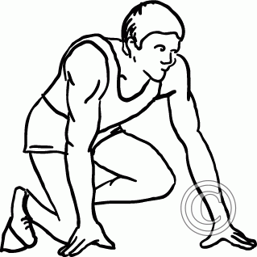

crouch
to get down low bending at the knees
visible
able to see

Slide 2
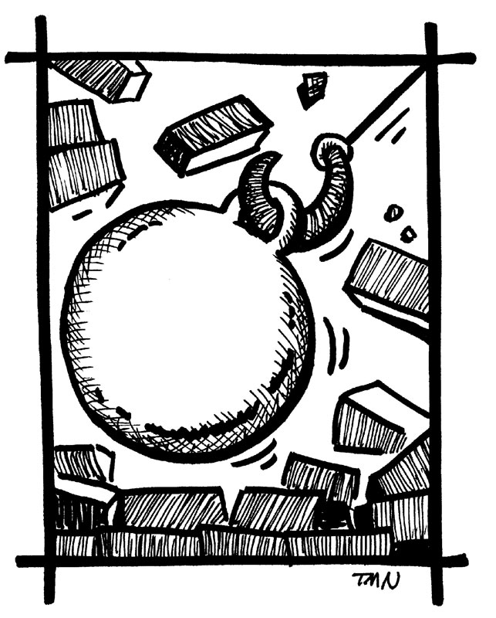
demolish
tear up or destroy

Slide 3


droop
to hang low
streak
to flash across the sky

Slide 4

expand
to get bigger

Slide 5
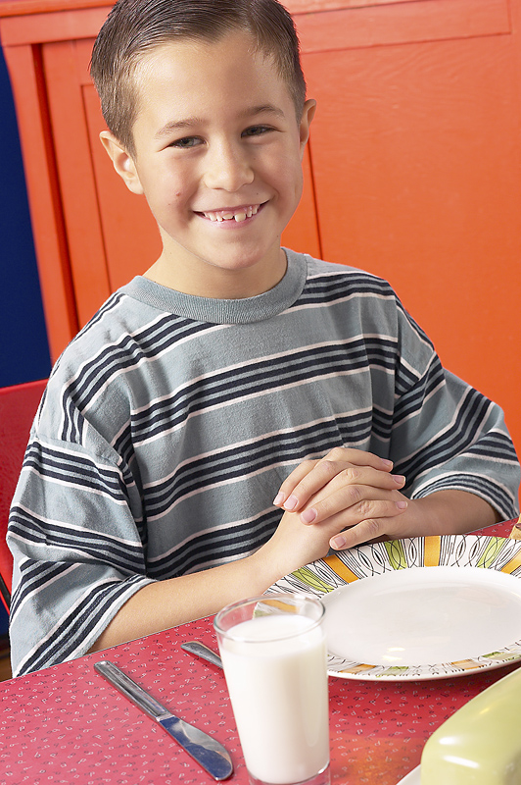

mature
to behave well
or grown up
immature
to act young
or behave
childish

Slide 6
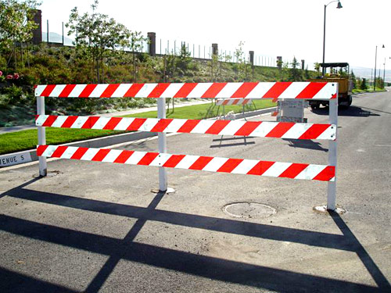
barricade
an object that blocks something from passing

Slide 7
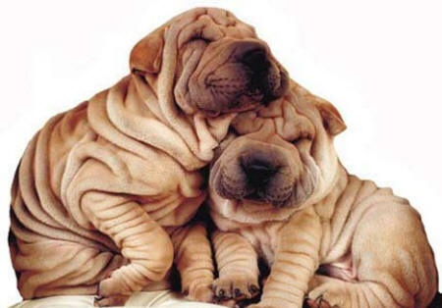
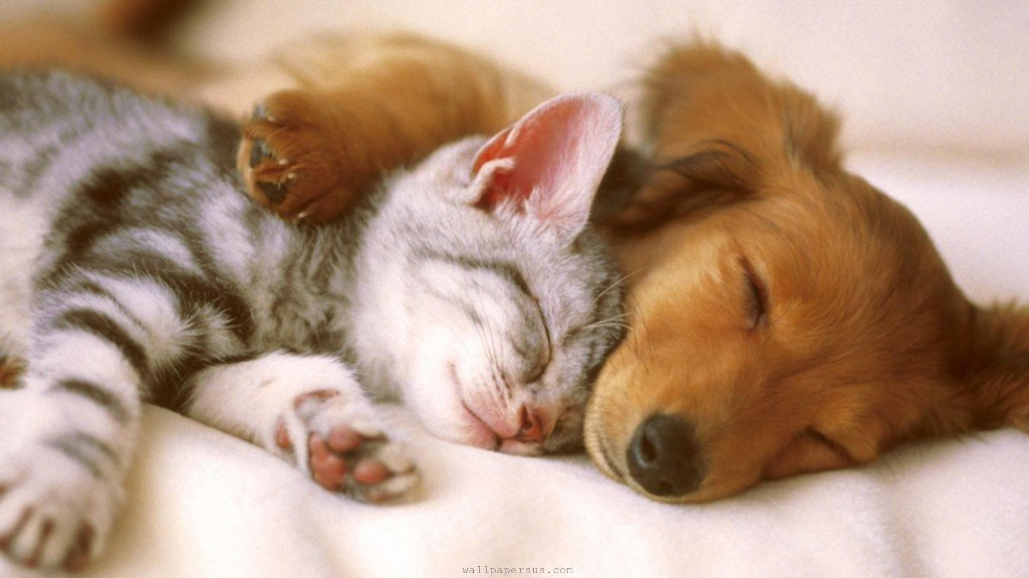
wrinkled
not smooth
with lines
and folds
cuddle
to hold
tenderly

Slide 8
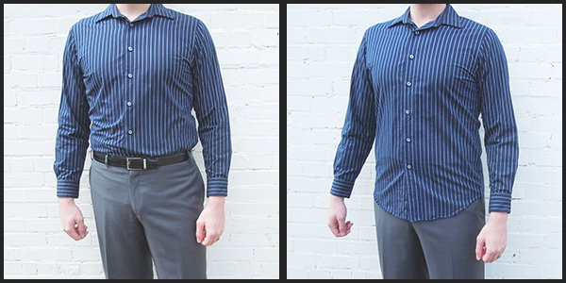
tuck
to put something inside OR to cover with blankets

