Slide 1
The Wonderful Wizard of Oz: Vocabulary Words
Chapters 4-8
Mrs. Latimer’s Class
First Grade

Slide 2

Dreary: unhappy looking
Dorothy described her home in Kansas as gray and dreary, but it was still her home.

Slide 3
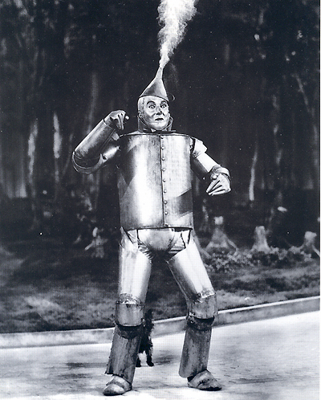

Groan: sound of misery; sound made by objects under pressure
The tin man made a loud groan. He had been groaning for more than a year.

Slide 4
Seized :to take quickly

Slide 5
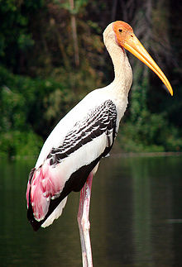
Stork: a tall long-legged bird
The stork carried Scarecrow to safety.

Slide 6
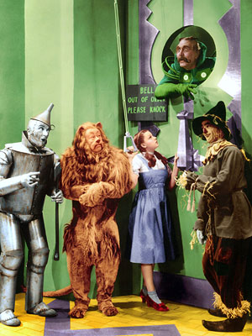
Comrade: a friend who shares the same activities
The Lion was a good comrade to the Scarecrow, Tin Man, and Dorothy.

Slide 7
Chopped: to cut repeatedly with an ax or a knife
The Tin Woodman chopped down a tree to make them a bridge.

Slide 8

Frightened : afraid or anxious, scared
The creatures frightened them and made them run quickly!

