Slide 1
Wizard of Oz
Vocabulary Introduction
Chapters 1-3 Vocabulary
Mrs . Latimer’s Class- First Grade

Slide 2

Cyclone
A strong system of winds rotating in a circular motion.(A strong storm)

Slide 3
Cellar
A room below ground level to keep you safe.

Slide 4
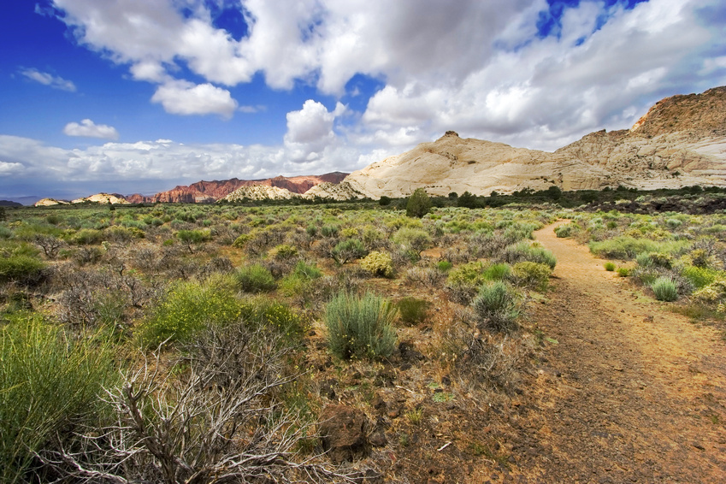
Prairie
A large open area of grass land.

Slide 5
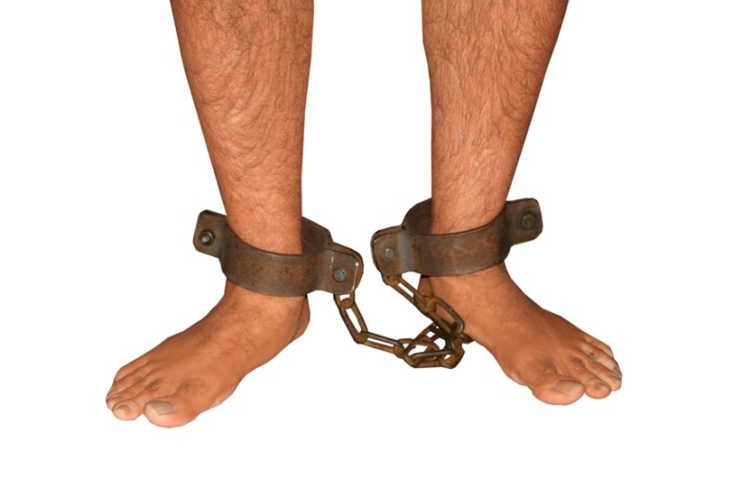
Bondage
Being physically restrained or forced to be enslaved or kept.

Slide 6
charm
A form of magic or delight. Or, a small ornament worn on a necklace or bracelet.

Slide 7
Pave
To cover with bricks or concrete to make smooth

Slide 8
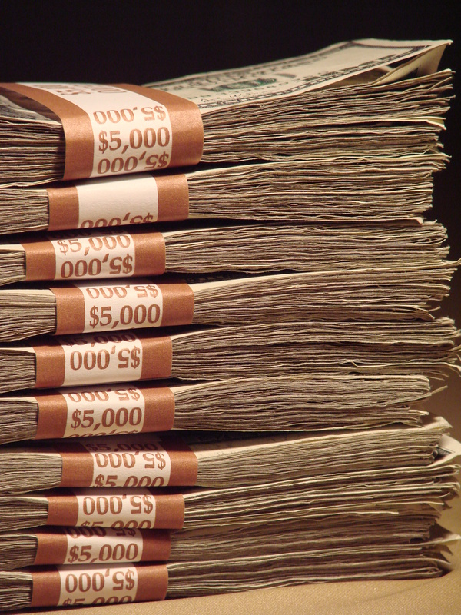
abundance
To have a large quantity of something

Slide 9
sorcerer
A person who claims to have magic powers

Slide 10

emerald
A bright green precious stone or coloring

Slide 11
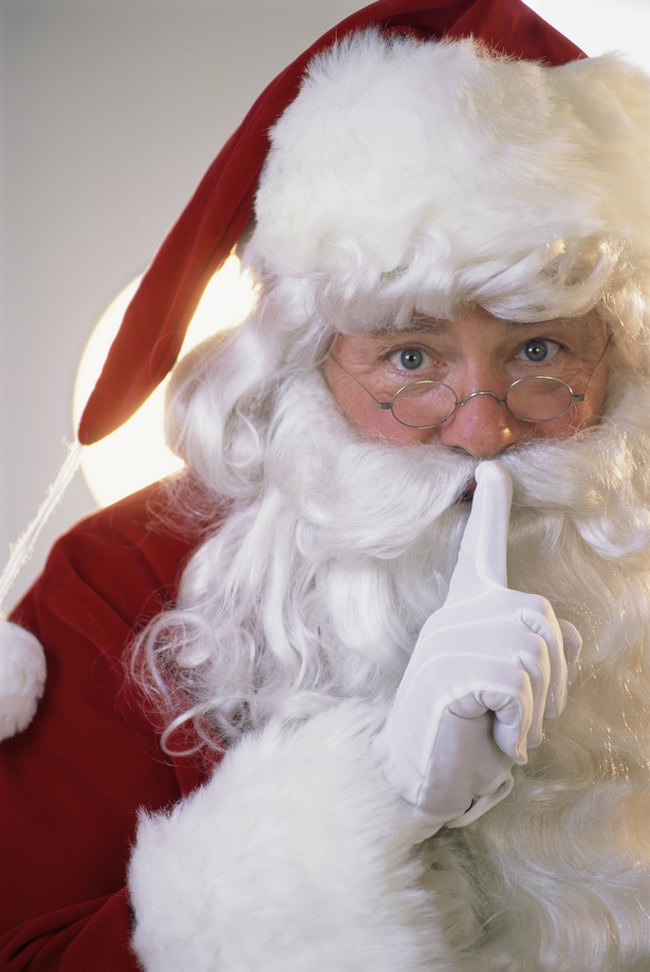
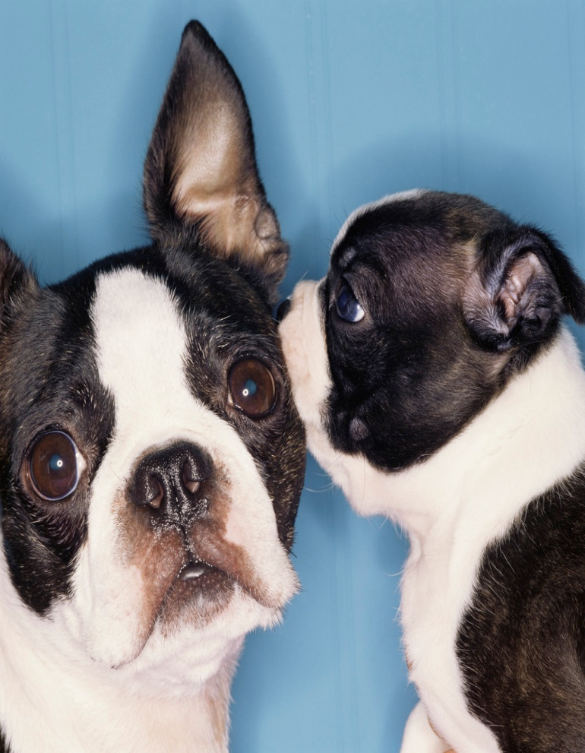
Confidential
Intended to be kept a secret

