Slide 1

1st Grade Text Talk
Unit 4

Slide 2
I can use words I learn from a text.
Notes:
Goal-
Students need to engage with the goal- read it, repeat it, write it, etc.

Slide 3

Tell your partner about a new word you learned last week.
Notes:
Access Prior Knowledge- (APK)
Turn and Talk

Slide 4
Notes:
New Information-
Read the book- provide a brief explanation of any words that may be new or unfamiliar to the students.

Slide 5
visible
Notes:
Contextualize the word- Find it in the text
Say the word together

Slide 6
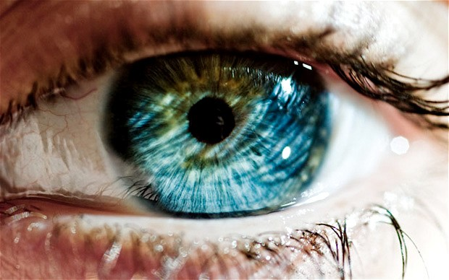
visible
Able to see
Notes:
Give student friendly definition
Use the word in other contexts

Slide 7

Thumbs up if this is an example of visible.
Thumbs down if not.
germs
Our SMARTBoard
the wind
your desk
Notes:
Engage the students with the word

Slide 8
demolish
Notes:
Contextualize the word- Find it in the text
Say the word together

Slide 9
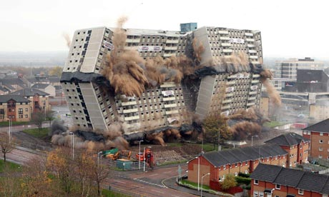
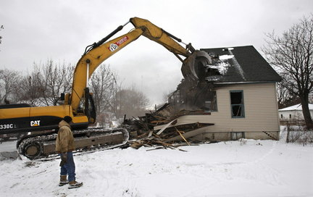
demolish
Tear up; destroy
Notes:
Give student friendly definition
Use the word in other contexts

Slide 10
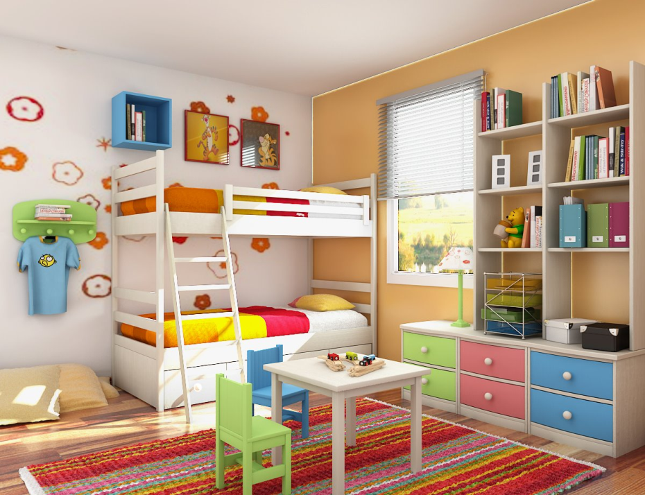
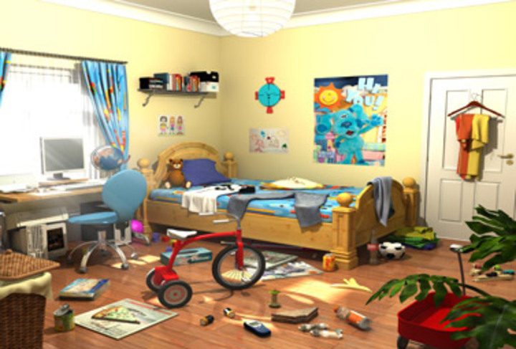
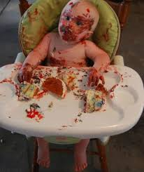
Which pictures shows demolish?
Notes:
Engage the students with the word

Slide 11
crouch
Notes:
Contextualize the word- Find it in the text
Say the word together

Slide 12
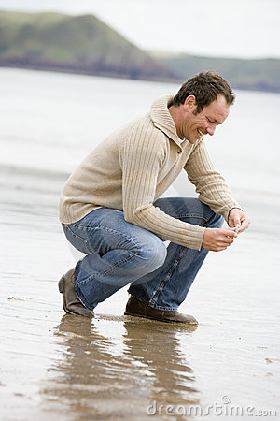
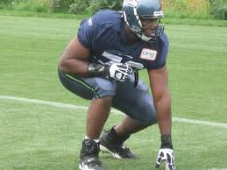
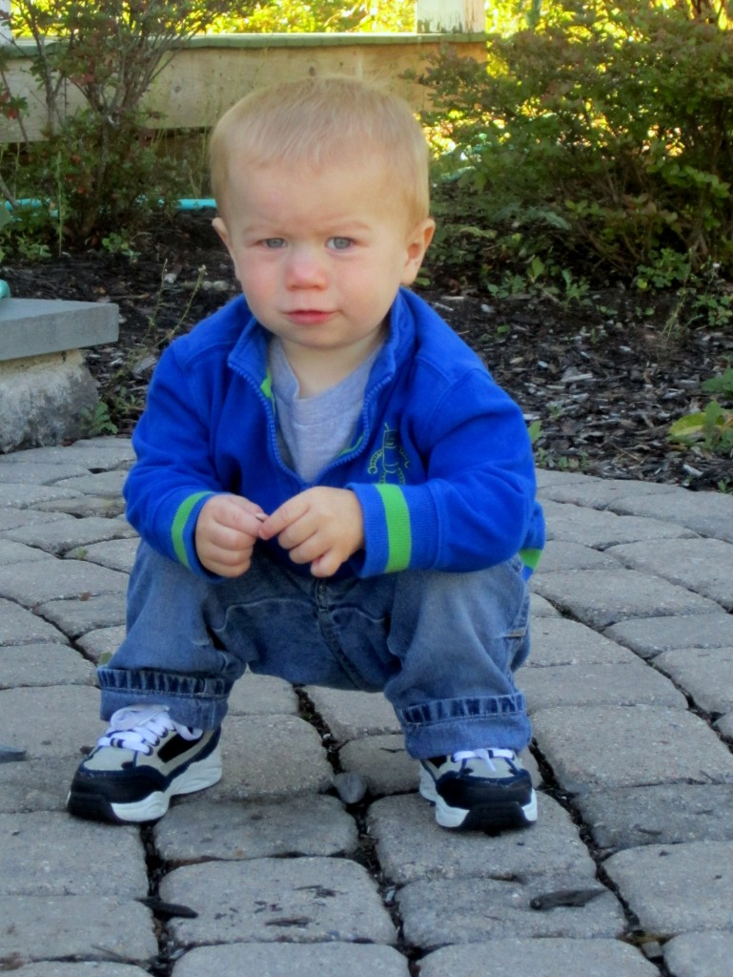
crouch
To get down low bending at the knees.
Notes:
Give student friendly definition
Use the word in other contexts

Slide 13
Show me a frozen picture of
someone crouching.
When I say “go,” walk around the room crouching.
Notes:
Engage the students with the word

Slide 14
Who can use all 3 words in a sentence?
visible
demolish
crouch
Notes:
Read all three words and see if you can use them in one sentence.

Slide 15


Draw a picture to show you know what these words mean.
visible
demolish
crouch
Notes:
Application-
Students need an opportunity to use the words they just learned from the text.

Slide 16
I can use words I learn from a text.
Notes:
Goal-
Revisit the Goal

