Slide 1

1st Grade Text Talk
Unit 4

Slide 2
I can use words I learn from a text.
1 2 3 4
Notes:
Goal-
Students need to engage with the goal- read it, repeat it, write it, etc.

Slide 3

Tell your PBJ partner about a new word you learned yesterday.
Notes:
Access Prior Knowledge- (APK)
Turn and Talk

Slide 4

Notes:
New Information-
Read the book- provide a brief explanation of any words that may be new or unfamiliar to the students.

Slide 5
tilt
6
Notes:
Contextualize the word- Find it in the text
Say the word together

Slide 6
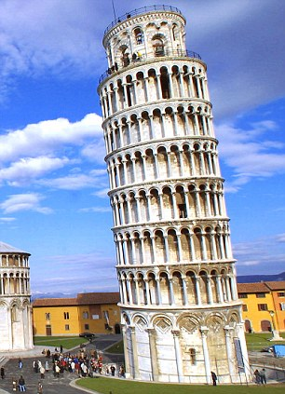
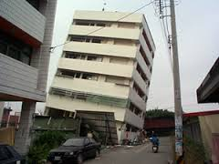
tilt
to lean on one side
Notes:
Give student friendly definition
Use the word in other contexts

Slide 7
Show me a frozen picture of
someone tilting to the right.
When I say “go,” walk around the room tilting to the left.
Notes:
Engage the students with the word

Slide 8
enhance
8
Notes:
Contextualize the word- Find it in the text
Say the word together

Slide 9
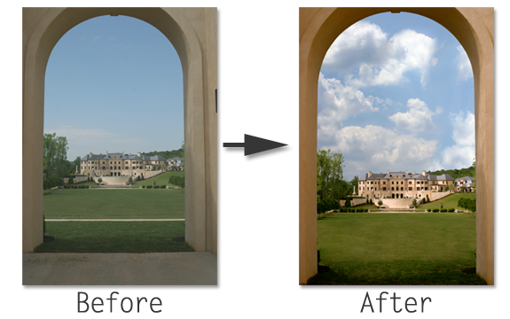
enhance
To improve or make better
Notes:
Give student friendly definition
Use the word in other contexts

Slide 10

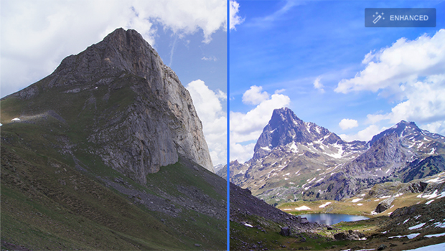

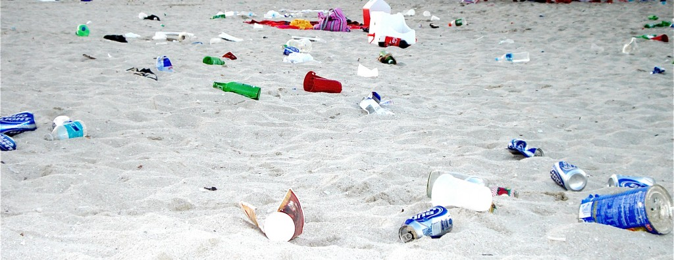
Which pictures show examples of enhance?
Notes:
Engage the students with the word

Slide 11
peel
13
Notes:
Contextualize the word- Find it in the text
Say the word together

Slide 12
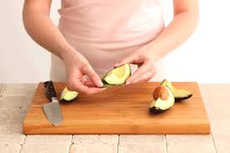
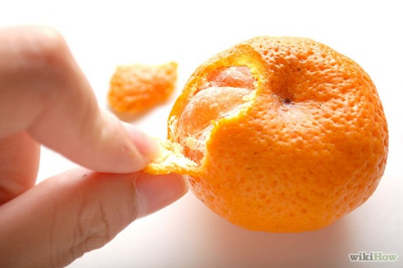

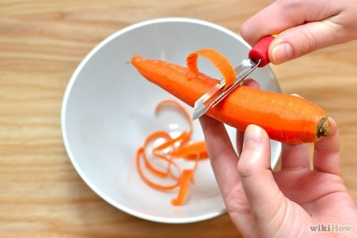
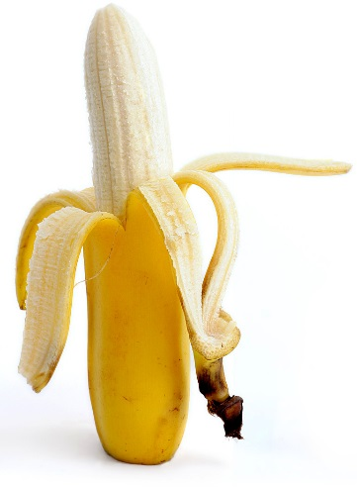

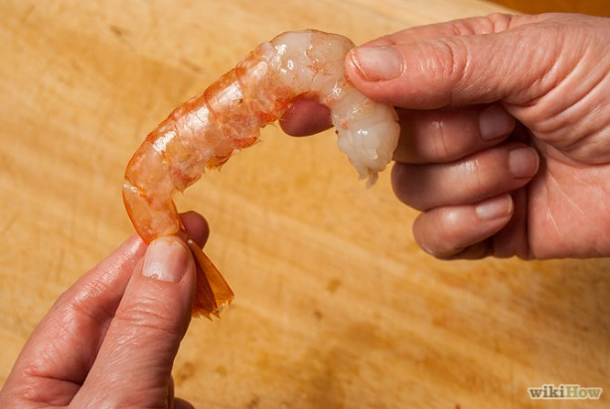
peel
to pull or tear the outer covering
Notes:
Give student friendly definition
Use the word in other contexts

Slide 13


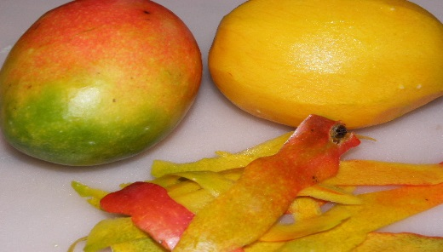
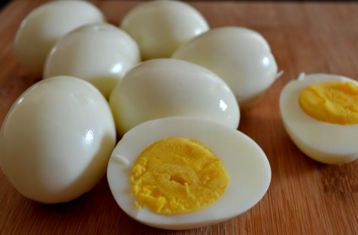

Thumbs up if these are things you can peel.
Thumbs down if they are not.
Car
Mangoes
Eggs
Colored Pencils
Notes:
Engage the students with the word

Slide 14
violent
20
Notes:
Contextualize the word- Find it in the text
Say the word together

Slide 15
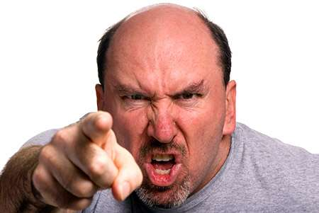

violent
acting with mighty strong, fierce force
Notes:
Give student friendly definition
Use the word in other contexts

Slide 16
Tell your knee buddy what you would do if someone is being violent with you.
Notes:
Engage the students with the word

Slide 17
Who can use all 4 words in a sentence?
tilt
enhance
peel
violent
Notes:
Read all three words and see if you can use them in one sentence.

Slide 18

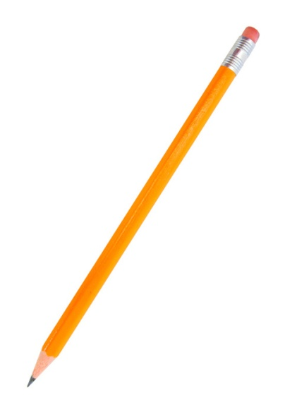
Draw a picture to show you know what these words mean.
tilt
enhance
peel
violent
Notes:
Application-
Students need an opportunity to use the words they just learned from the text.

Slide 19
I can use words I learn from a text.
1 2 3 4
Notes:
Goal-
Revisit the Goal

