Slide 1

1st Grade Text Talk
Unit 4

Slide 2
I can use words I learn from a text.
Notes:
Goal-
Students need to engage with the goal- read it, repeat it, write it, etc.

Slide 3
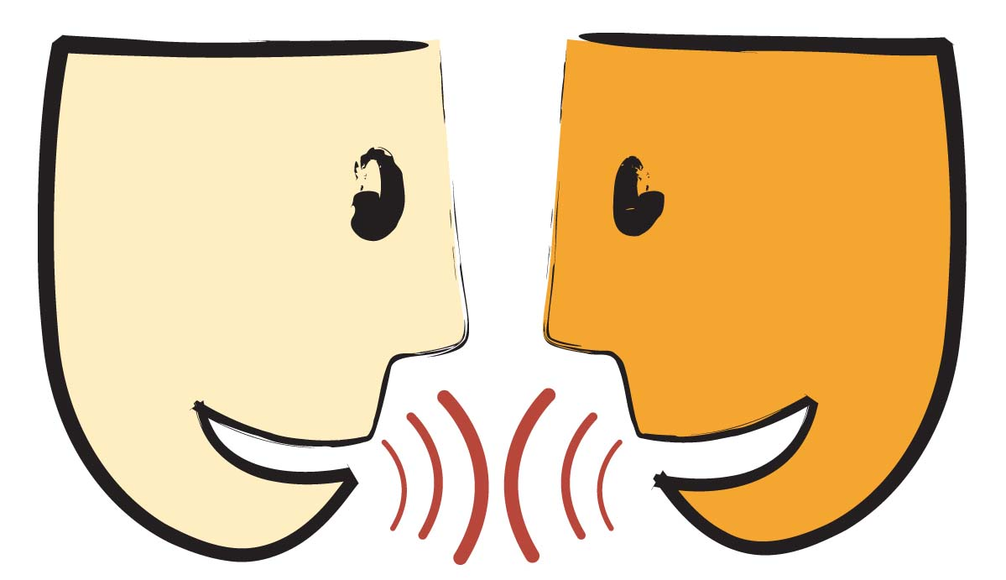
Tell your partner about a new word you learned last week.
Notes:
Access Prior Knowledge- (APK)
Turn and Talk

Slide 4
Notes:
New Information-
Read the book- provide a brief explanation of any words that may be new or unfamiliar to the students.

Slide 5
wrinkled
Notes:
Contextualize the word- Find it in the text
Say the word together

Slide 6
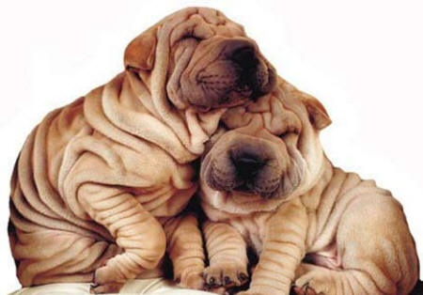
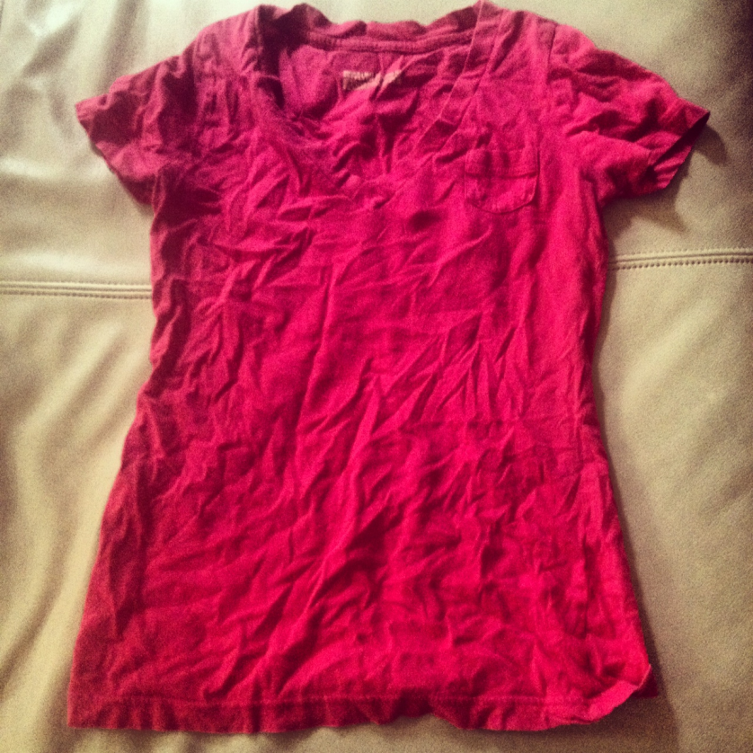
wrinkled
Not smooth; with lines and folds
Notes:
Give student friendly definition
Use the word in other contexts

Slide 7
Take a piece of paper.
Fold it in half twice.
Make your paper into a ball.
Now open it!
Look at all of the wrinkles!
Notes:
Engage the students with the word

Slide 8
cuddle
Notes:
Contextualize the word- Find it in the text
Say the word together

Slide 9
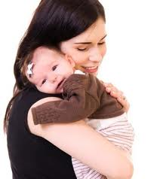
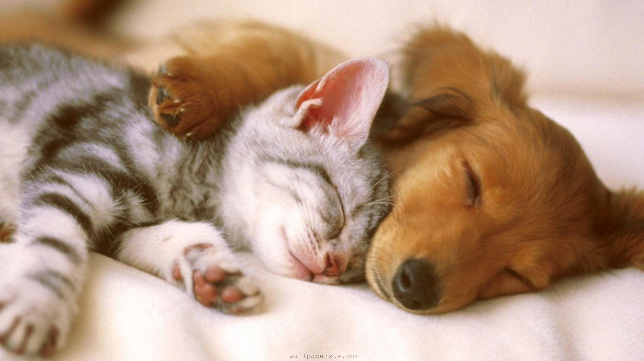
cuddle
To hold tenderly
Notes:
Give student friendly definition
Use the word in other contexts

Slide 10

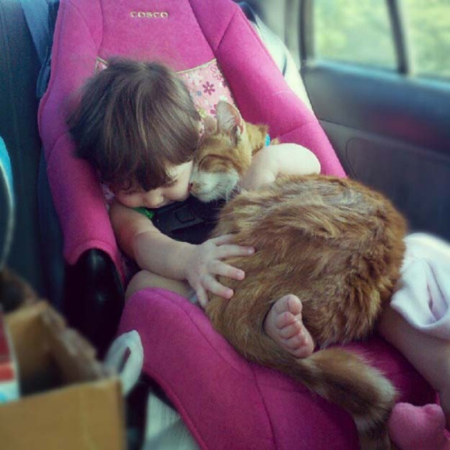
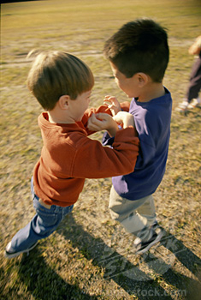
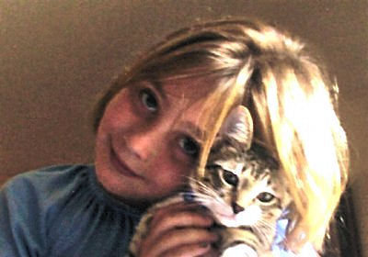
Which pictures shows a cuddle?
Notes:
Engage the students with the word

Slide 11
tuck
Notes:
Contextualize the word- Find it in the text
Say the word together

Slide 12

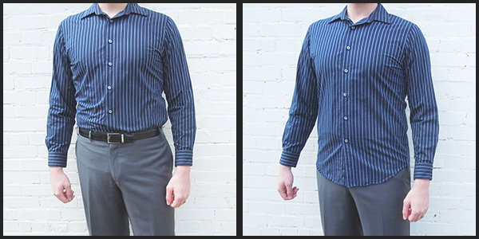
tuck
To put inside something
To put sheets or a blanket around you
Notes:
Give student friendly definition
Use the word in other contexts

Slide 13
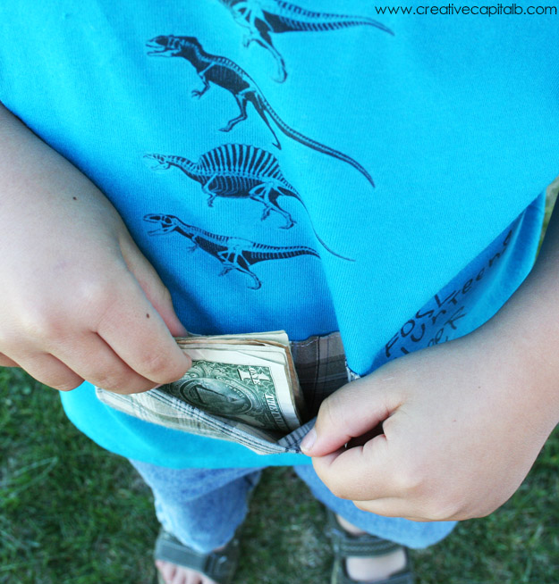
This boy is tucking money into his pocket.
Tell a friend about a time when you have tucked something.
.
Notes:
Engage the students with the word

Slide 14
Who can use all 3 words in a sentence?
wrinkled
cuddle
tuck
Notes:
Read all three words and see if you can use them in one sentence.

Slide 15

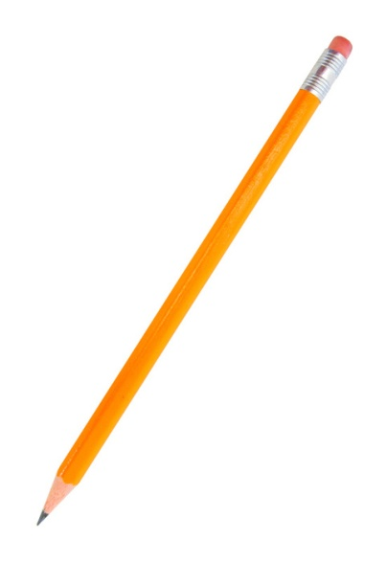
Draw a picture to show you know what these words mean.
wrinkled
cuddle
tuck
Notes:
Application-
Students need an opportunity to use the words they just learned from the text.

Slide 16
I can use words I learn from a text.
Notes:
Goal-
Revisit the Goal

