Slide 1

1st Grade Text Talk
Unit 4

Slide 2
I can use words I learn from a text.
Notes:
Goal-
Students need to engage with the goal- read it, repeat it, write it, etc.

Slide 3

Tell your partner about a new word you learned last week.
Notes:
Access Prior Knowledge- (APK)
Turn and Talk

Slide 4

Notes:
New Information-
Read the book- provide a brief explanation of any words that may be new or unfamiliar to the students.

Slide 5
droop
Notes:
Contextualize the word- Find it in the text
Say the word together

Slide 6
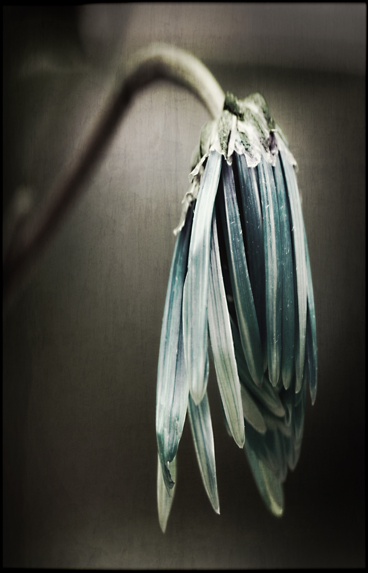
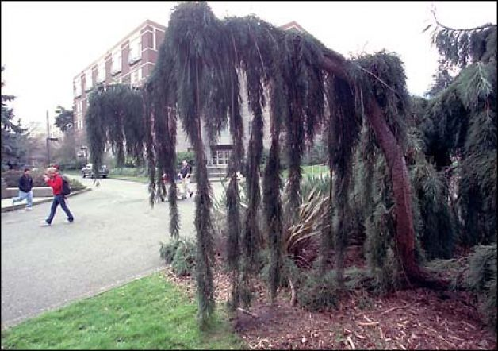
droop
To hang low with tiredness
Notes:
Give student friendly definition
Use the word in other contexts

Slide 7


Which pictures show something drooping?
Stand up straight and tall. Now, show me how you would look if you were drooping.
Notes:
Engage the students with the word

Slide 8
streak
Notes:
Contextualize the word- Find it in the text
Say the word together

Slide 9
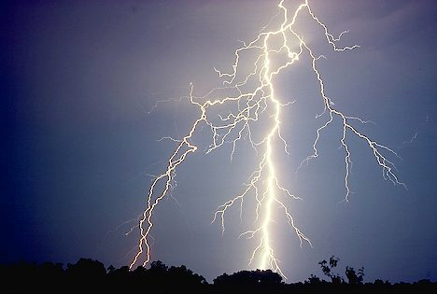

streak
To flash across the sky
Tap the picture of lightning to watch a video of lightning flashing across the sky.
Notes:
Give student friendly definition
Use the word in other contexts

Slide 10
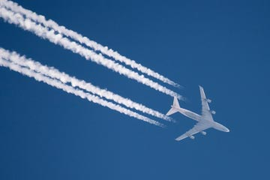
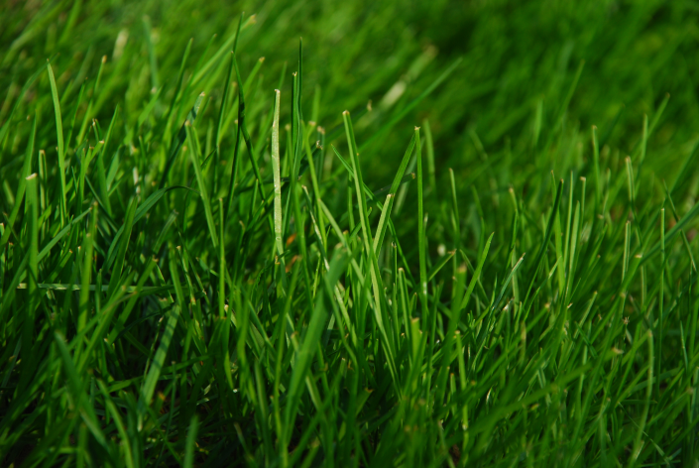
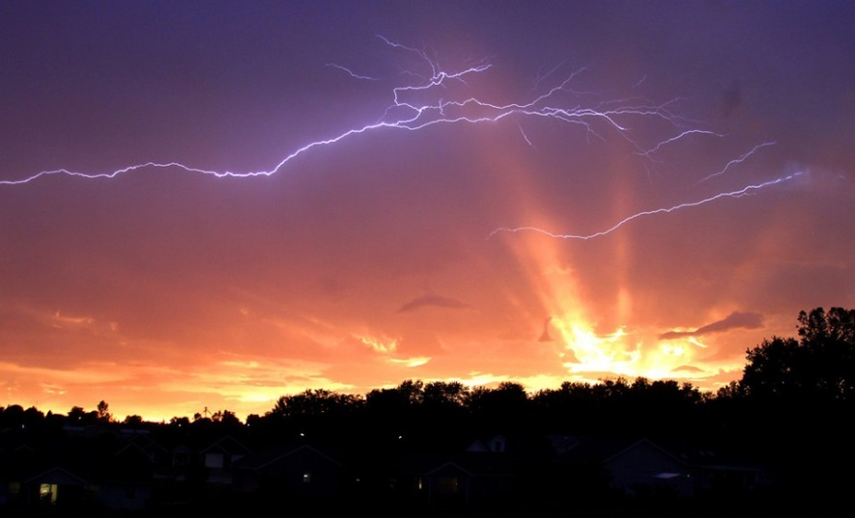
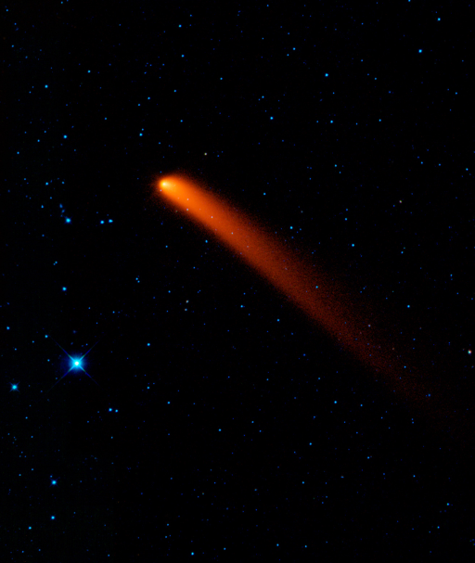
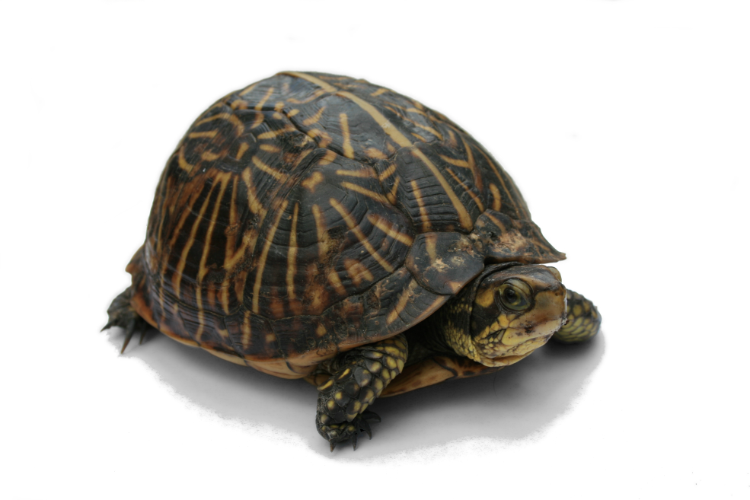
Which picture show something that might streak across the sky?
Notes:
Engage the students with the word

Slide 11
expand
Notes:
Contextualize the word- Find it in the text
Say the word together

Slide 12
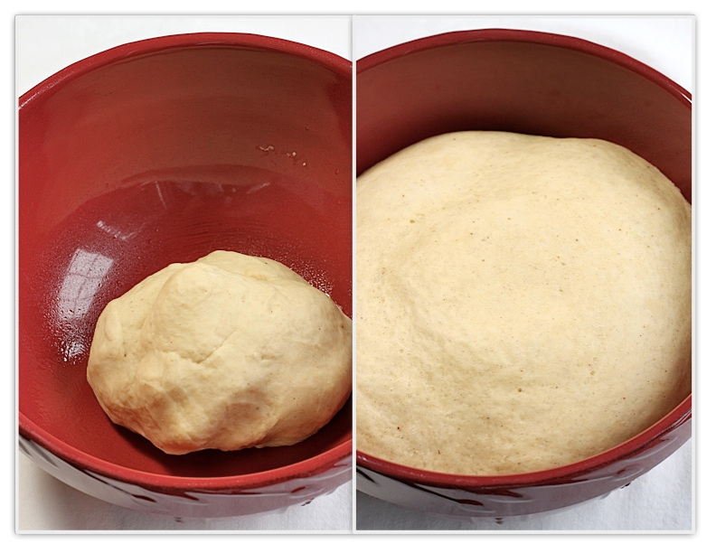
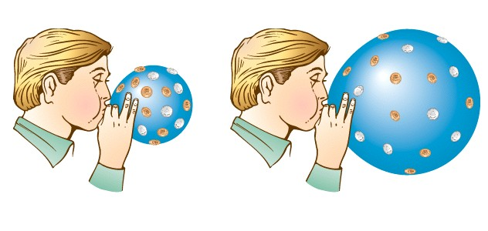
expand
Get bigger
Touch the picture of the balloon to watch a balloon expand.
Notes:
Give student friendly definition
Use the word in other contexts

Slide 13

Thumbs up if this is an example expand.
Thumbs down if not.
You added new pages to your interactive notebook and it got bigger!
You took your homework folder, library books and lunch box out of your backpack. Did your backpack expand?
Santa stuffed his bag full of toys.
Notes:
Engage the students with the word

Slide 14
Who can use all 3 words in a sentence?
droop
streak
expand
Notes:
Read all three words and see if you can use them in one sentence.

Slide 15

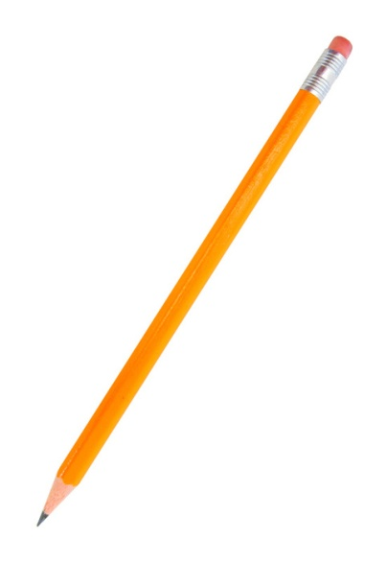
Draw a picture to show you know what these words mean.
droop
streak
expand
Notes:
Application-
Students need an opportunity to use the words they just learned from the text.

Slide 16
I can use words I learn from a text.
Notes:
Goal-
Revisit the Goal

