Slide 1
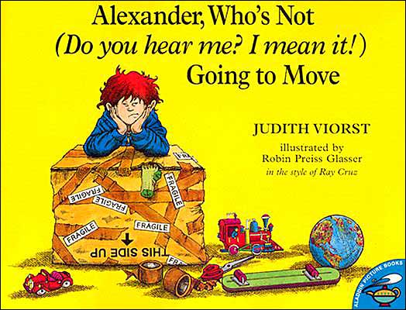
1st Grade Text Talk
Unit 4

Slide 2
I can use words I learn from a text.
Notes:
Goal-
Students need to engage with the goal- read it, repeat it, write it, etc.

Slide 3
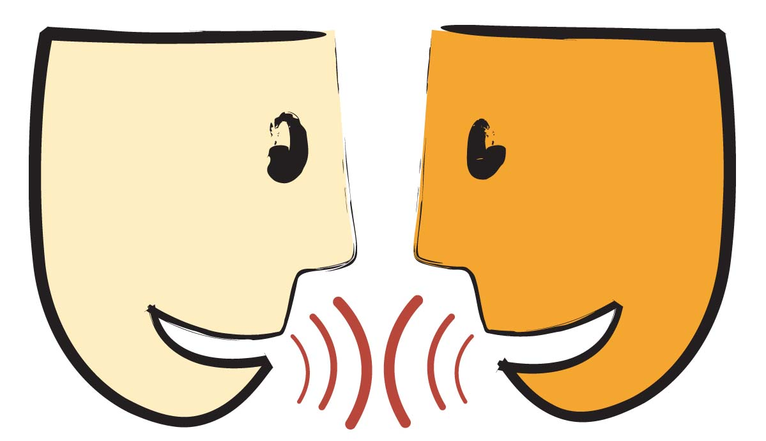
Tell your partner about a new word you learned last week.
Notes:
Access Prior Knowledge- (APK)
Turn and Talk

Slide 4
Notes:
New Information-
Read the book- provide a brief explanation of any words that may be new or unfamiliar to the students.

Slide 5
immature
Notes:
Contextualize the word- Find it in the text
Say the word together

Slide 6
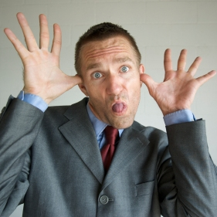
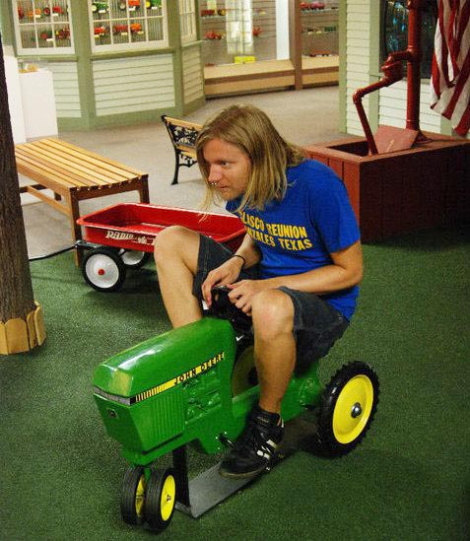
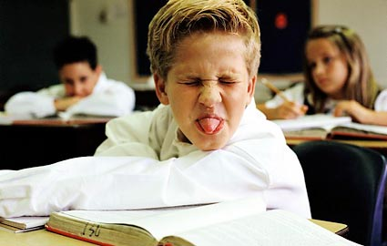
immature
Acts young or childish
Notes:
Give student friendly definition
Use the word in other contexts

Slide 7

Thumbs up if this is an example of immature.
Thumbs down if not.
Your little sister was crying because she wanted the snack you were eating. You shared with her without being told.
During Independent Reading time, you built a house with the books in your browse box.
You saw a friend being bullied at recess and you joined in.
Notes:
Engage the students with the word

Slide 8
barricade
Notes:
Contextualize the word- Find it in the text
Say the word together

Slide 9
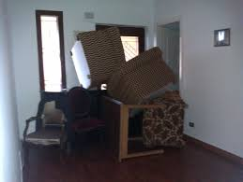
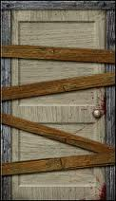
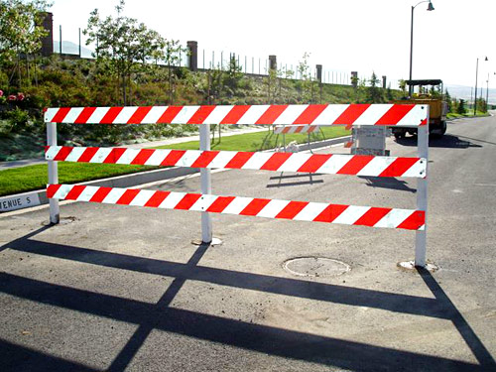
barricade
An object that blocks something from passing
Notes:
Give student friendly definition
Use the word in other contexts

Slide 10
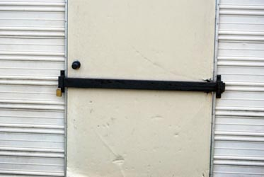
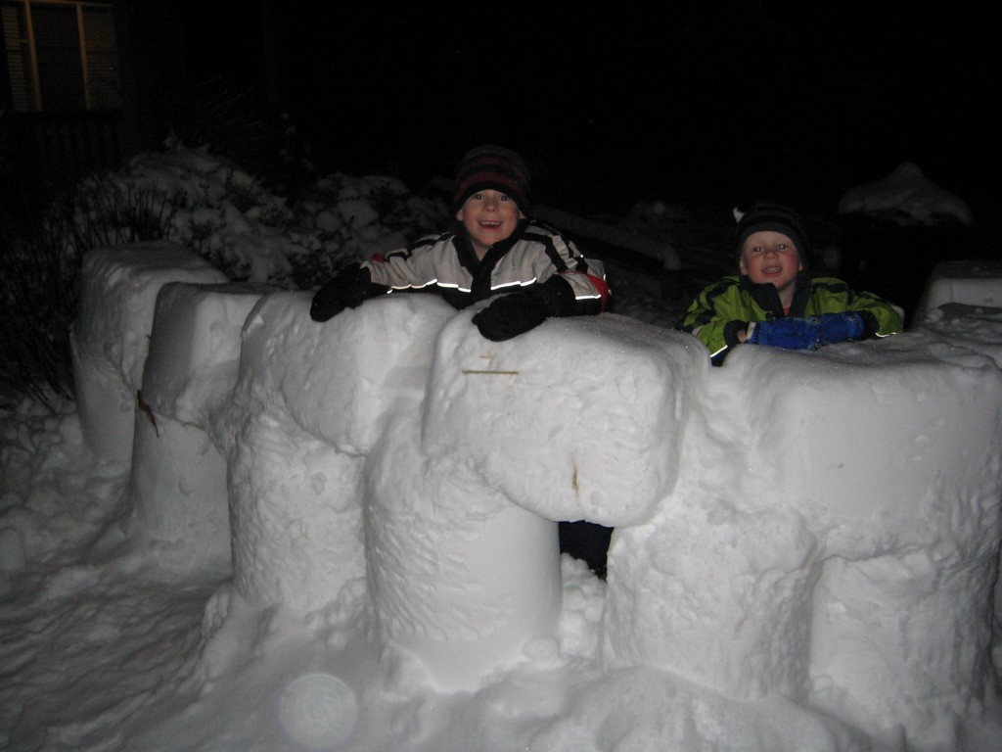
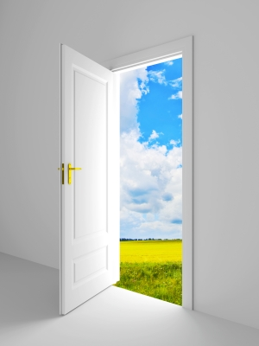
Which pictures shows a barricade?
Notes:
Engage the students with the word

Slide 11
mature
Notes:
Contextualize the word- Find it in the text
Say the word together

Slide 12

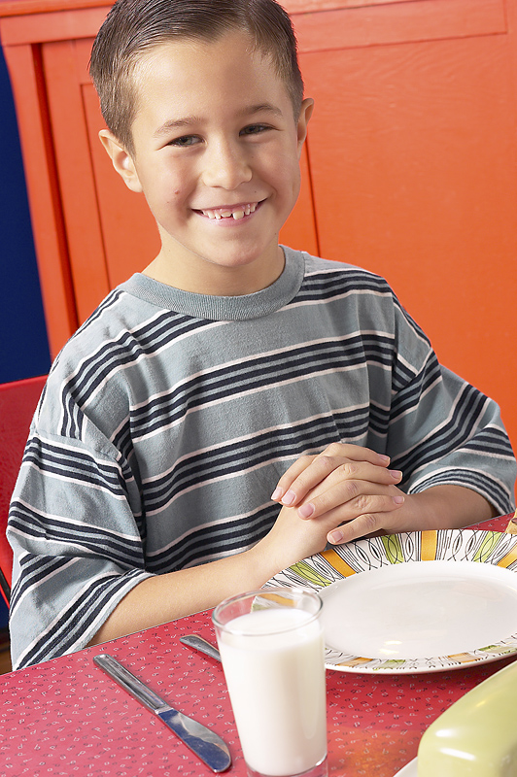
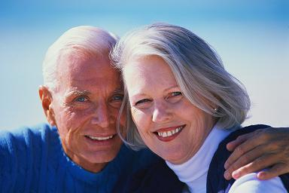
mature
Grown up
Notes:
Give student friendly definition
Use the word in other contexts

Slide 13
Thumbs up if this is an example of mature.
Thumbs down if not.
Your big brother called you a name. You stuck your tongue out at him.
Your mom told you that you could go to the movies this weekend. Then, your mom got sick. You helped take care of her!
You saw a friend being bullied at recess and you told the bullies to stop.
Notes:
Engage the students with the word

Slide 14
Who can use all 3 words in a sentence?
immature
blocked
mature
Notes:
Read all three words and see if you can use them in one sentence.

Slide 15

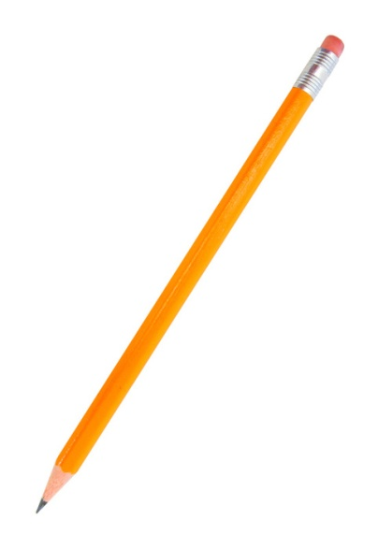
Draw a picture to show you know what these words mean.
immature
blocked
mature
Notes:
Application-
Students need an opportunity to use the words they just learned from the text.

Slide 16
I can use words I learn from a text.
Notes:
Goal-
Revisit the Goal

