Slide 1
GOAL:
I can determine the meaning of multiple meaning words by using context clues in a text.

Slide 2
Rate yourself on how well you understand multiple meaning words.
4- I can teach the class.
3-I can tell my shoulder partner about MM words.
2-I need some more help.
1-I don’t understand.

Slide 3


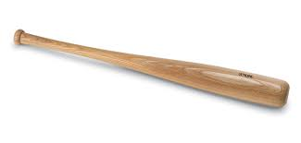


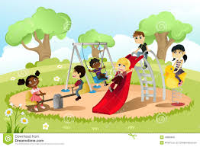
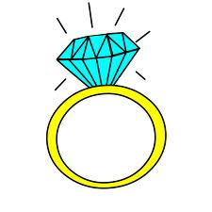

MULTIPULE MEANING WORDS

Slide 4
Ring
(Turn and Talk)
Use each word in a sentence.
Can you use both words in a sentence together?

Slide 5
Brainstorm a list of multiple meaning words:

Slide 6

Lets read…
Bat Boy and His Violin
Listen for Multiple Meaning words.
Use CLUES in the text to help figure out the meaning.

Slide 7
Find the multiple meaning word
Mr. Mosley, the third baseman, tips his cap because I hand him a bat.
Why don’t you relax a spell on the bench.
I’ll give you a chance to fiddle.
What evidence from the story helped you figure out the word???

Slide 8
Review GOAL:
I can determine the meaning of multiple meaning words by using context clues in a text.
Rate yourself: 4,3,2,1

