Slide 1

TEACHER MODEL COPY of Essential Question Assessment
You have listened to many stories of how change impacted the world. Circle your favorite story. Then, write how the change in the character’s life impacted their world.
_____________________________ changed in this story.
In the beginning, ____________________________________________________.
By the end, _________________________________________________________.
This change happened because ___________________________________________
____________________________________________________________________.

Slide 2

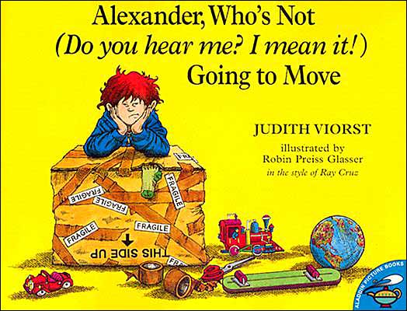

Name:_________________________________
You have listened to many stories of how change impacted the world. Circle your favorite story. Then, write how the change in the character’s life impacted their world.
_____________________________ changed in this story.
In the beginning, ____________________________________________________.
By the end, _________________________________________________________.
This change happened because ___________________________________________
____________________________________________________________________.

