Slide 1

1st Grade Text Talk
Unit 3

Slide 2
I can use words I learn from a text.
Notes:
Goal-
Students need to engage with the goal- read it, repeat it, write it, etc.

Slide 3
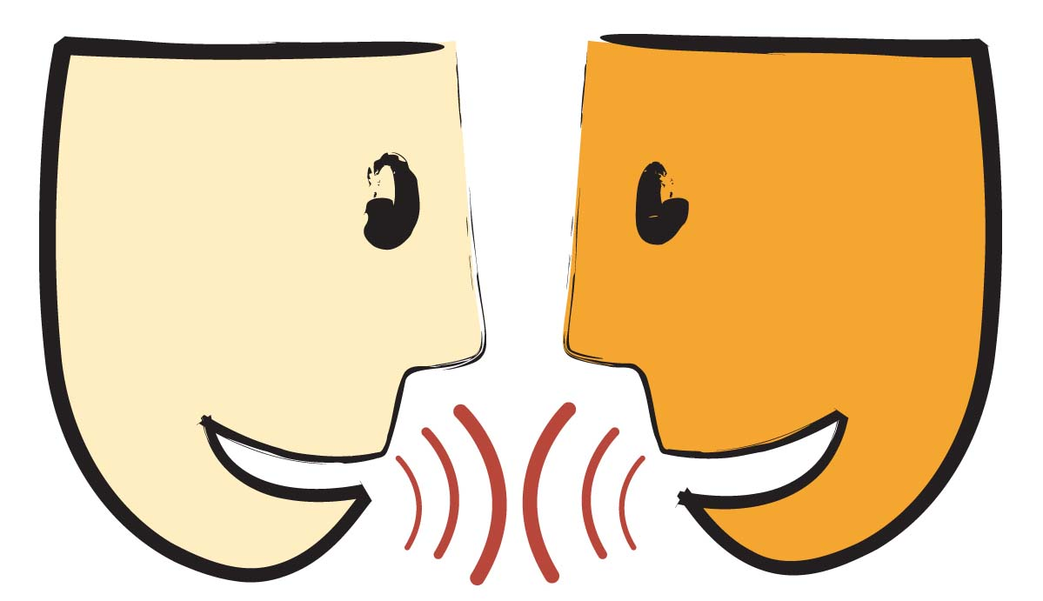
Tell your partner about a new word you learned last week.
Notes:
Access Prior Knowledge- (APK)
Turn and Talk

Slide 4

Notes:
New Information-
Read the book- provide a brief explanation of any words that may be new or unfamiliar to the students.

Slide 5
harmony
Notes:
Contextualize the word- Find it in the text
Say the word together

Slide 6
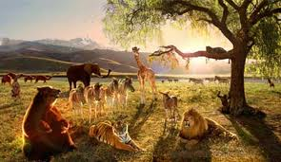
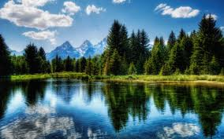
harmony
peaceful
Notes:
Give student friendly definition
Use the word in other contexts

Slide 7
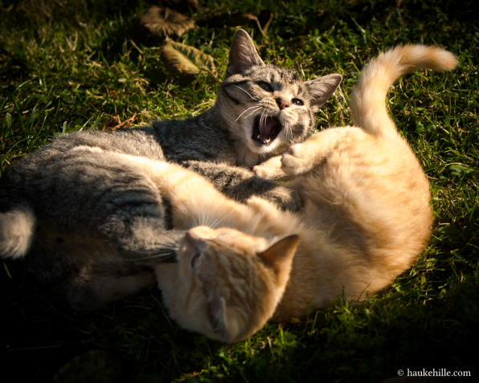
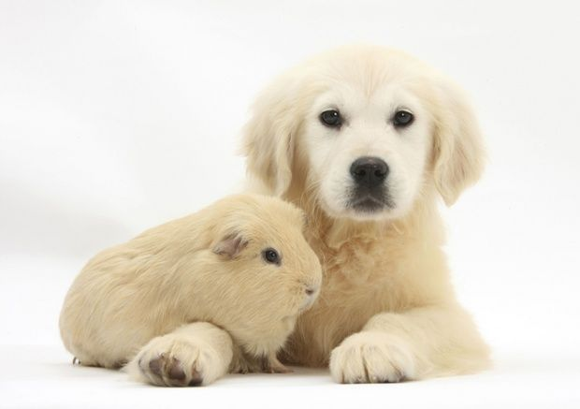
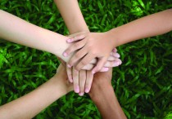
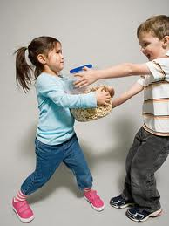
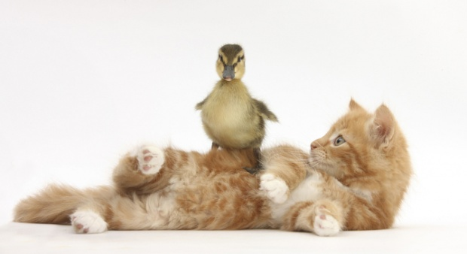
Which pictures show harmony?
Notes:
Engage the students with the word

Slide 8
disgrace
Notes:
Contextualize the word- Find it in the text
Say the word together

Slide 9
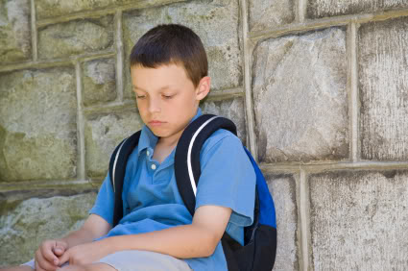
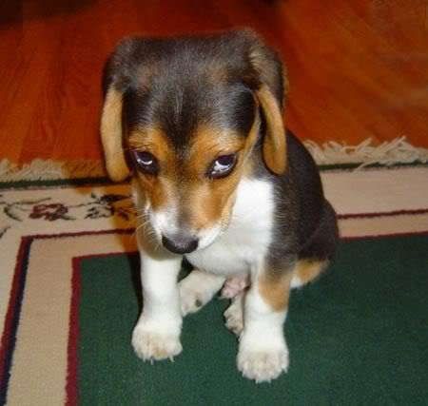
disgrace
To bring shame upon
Notes:
Give student friendly definition
Use the word in other contexts

Slide 10
Name something disgraceful that a kid could do.
How would your face look if you have done something disgraceful?
How would your face look if someone did something disgraceful to you?
Notes:
Engage the students with the word

Slide 11
creep
Notes:
Contextualize the word- Find it in the text
Say the word together

Slide 12
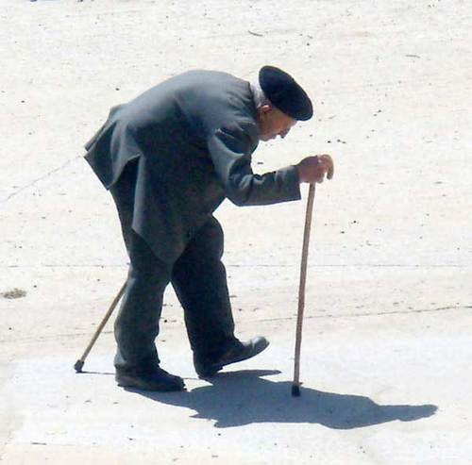
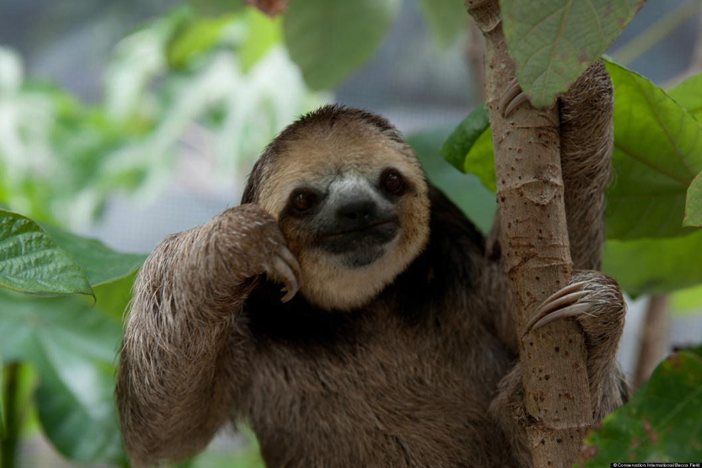
creep
To move slowly
Touch the picture of the sloth to watch him creep across the road.
Notes:
Give student friendly definition
Use the word in other contexts

Slide 13
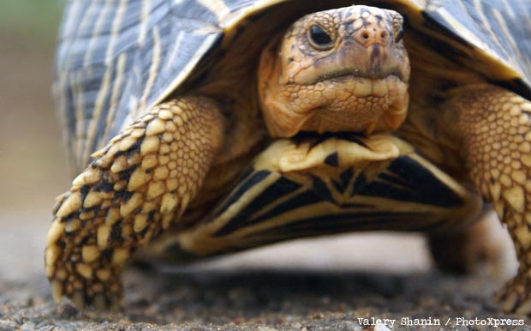
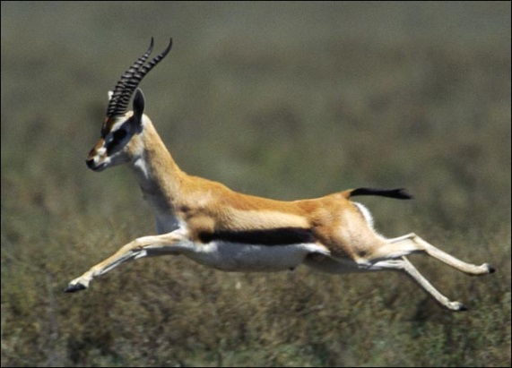
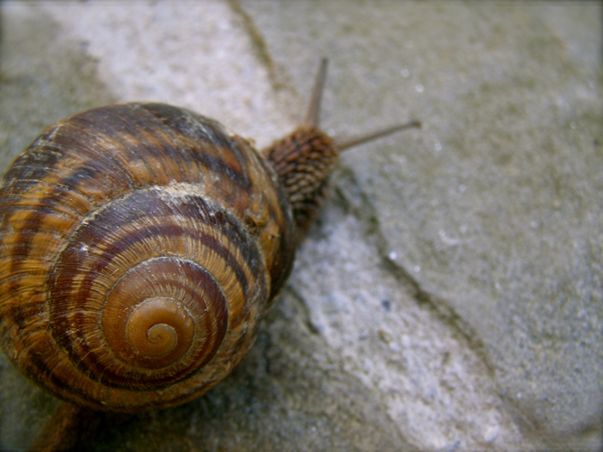
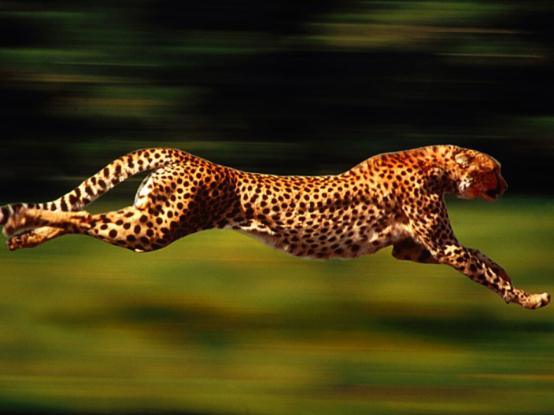
Which pictures show an animal that creeps?
Notes:
Engage the students with the word

Slide 14
Who can use all 3 words in a sentence?
harmony
creep
disgrace
Notes:
Read all three words and see if you can use them in one sentence.

Slide 15

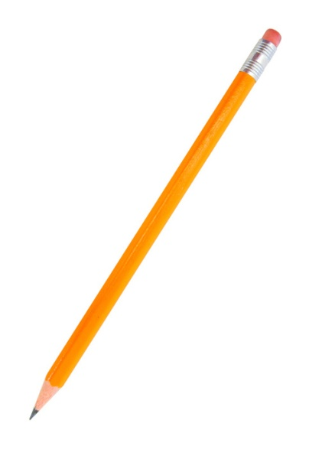
Draw a picture to show you know what these words mean.
harmony
creep
disgrace
Notes:
Application-
Students need an opportunity to use the words they just learned from the text.

Slide 16
I can use words I learn from a text.
Notes:
Goal-
Revisit the Goal

