Slide 1

1st Grade Text Talk
Unit 3

Slide 2
I can use words I learn from a text.
Notes:
Goal- Students need to engage with the goal- read it, repeat it, write it, etc.

Slide 3
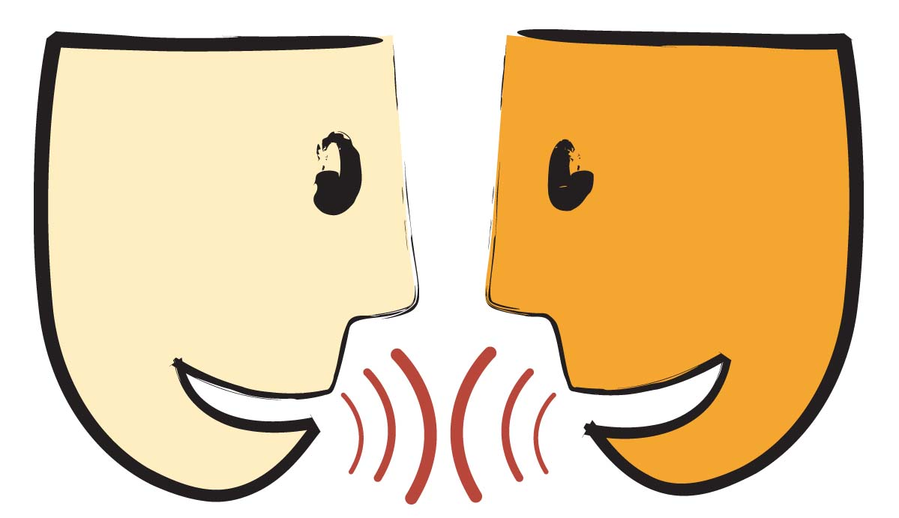
Tell your partner about a new word you learned last week.
Notes:
Access Prior Knowledge- (APK)
Turn and Talk

Slide 4
Notes:
New Information-
Read the book- provide a brief explanation of any words that may be new or unfamiliar to the students.

Slide 5
swift
“One bad day a tuna fish, swift, fierce and very hungry, came darting through the waves.”
Notes:
Contextualize the word- Find it in the text
Say the word together

Slide 6
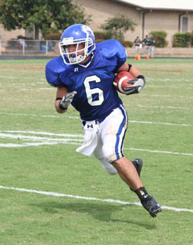
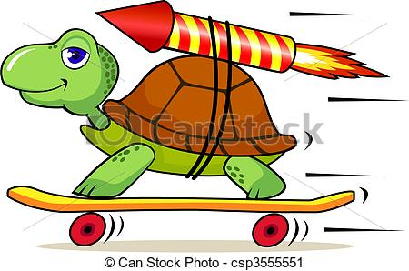
swift
quick or rapid
Notes:
Give student friendly definition
Use the word in other contexts

Slide 7
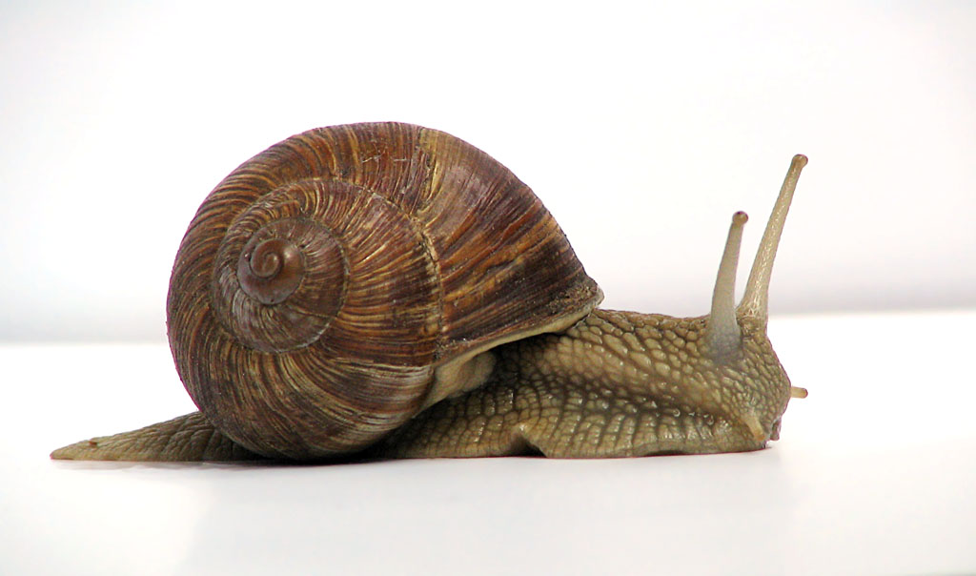
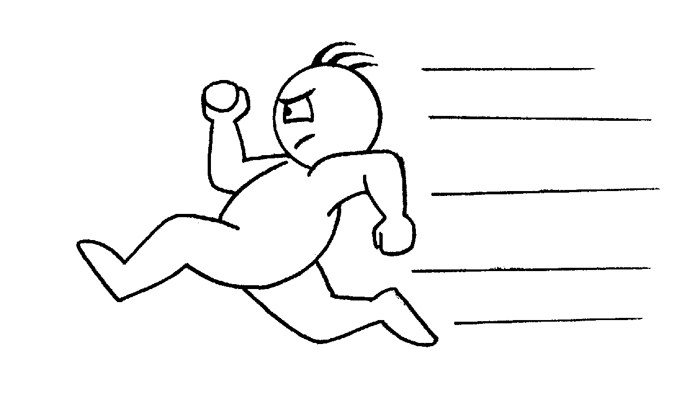
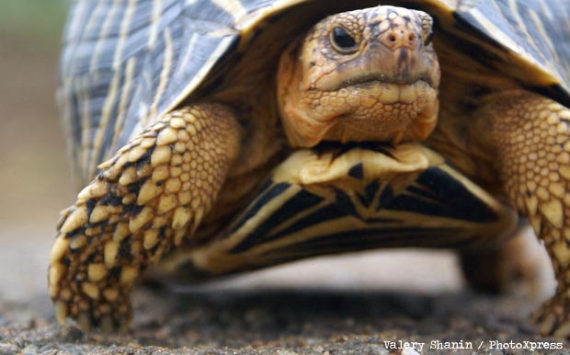
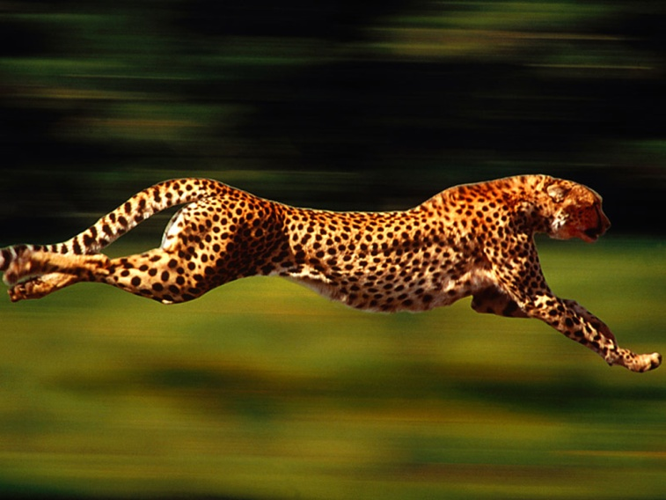
Which of these are swift?
Notes:
Engage the students with the word

Slide 8
gulp
“In one gulp he swallowed all the little red fish.”
Notes:
Contextualize the word- Find it in the text
Say the word together

Slide 9
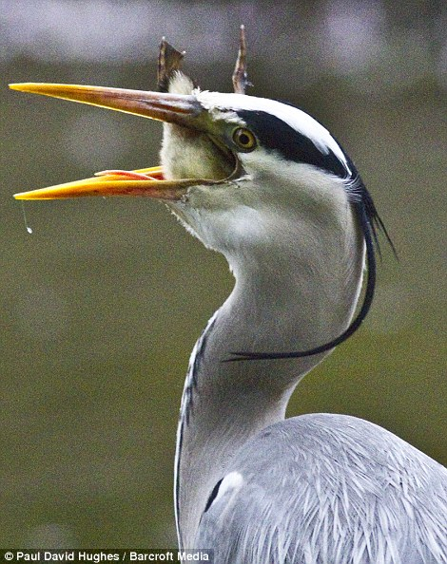
gulp
swallow loudly
Notes:
Give student friendly definition
Use the word in other contexts

Slide 10

Thumbs up if this is a time when you might gulp something down. Thumbs down if not.
You were really hungry and your mom gave you a cookie.
You don’t like green beans but you have to eat them anyway.
You’re late for school but you have to finish drinking your milk.
Notes:
Engage the students with the word

Slide 11
marvel
“But the sea was full of wonderful creatures, and as he swam from marvel to marvel Swimmy was happy again.”
Notes:
Contextualize the word- Find it in the text
Say the word together

Slide 12
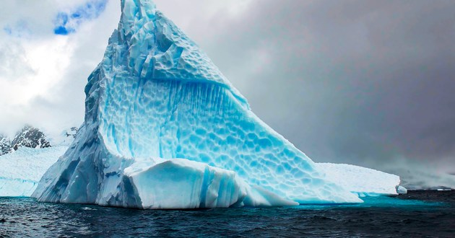
marvel
something beautiful or amazing
Notes:
Give student friendly definition
Use the word in other contexts

Slide 13
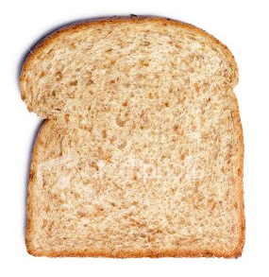
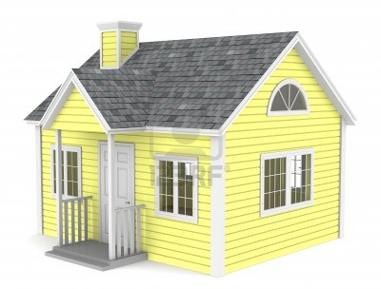
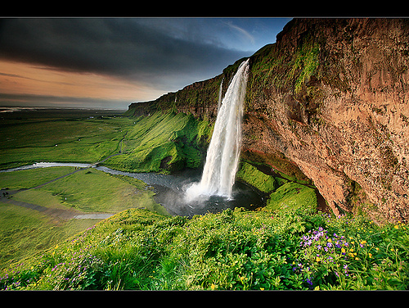
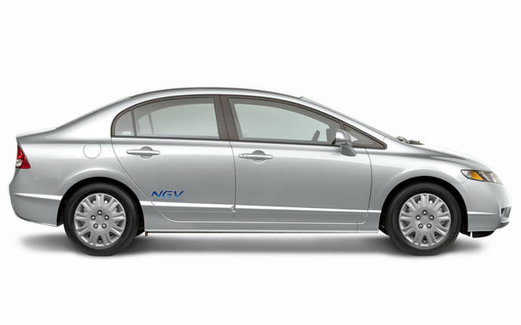
Which of these things is a marvel?
Notes:
Engage the students with the word

Slide 14
Who can use all 3 words in a sentence?
swift
gulp
marvel
Notes:
Read all three words and see if you can use them in one sentence.

Slide 15

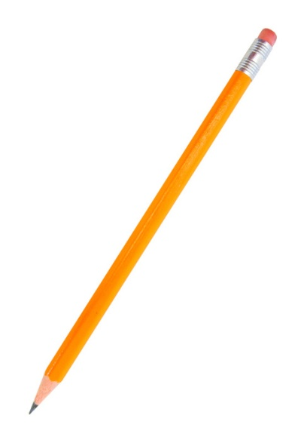
Draw a picture to show you know what these words mean.
swift
gulp
marvel
Notes:
Application-
Students need an opportunity to use the words they just learned from the text.

Slide 16
I can use words I learn from a text.
Notes:
Goal-
Revisit the Goal

