Slide 1
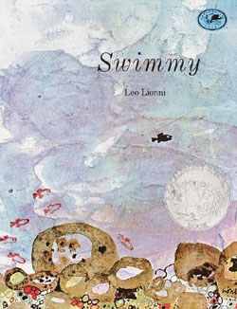
1st Grade Text Talk
Unit 2

Slide 2
I can use words I learn from a text.
Notes:
Goal-
Students need to engage with the goal- read it, repeat it, write it, etc.

Slide 3

Tell your partner about a new word you learned last week.
Notes:
Access Prior Knowledge- (APK)
Turn and Talk

Slide 4
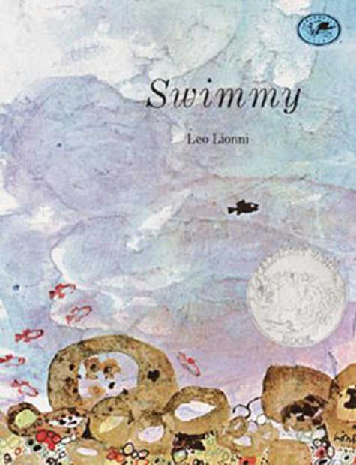
Notes:
New Information-
Read the book- provide a brief explanation of any words that may be new or unfamiliar to the students.

Slide 5
swift
Notes:
Contextualize the word- Find it in the text
Say the word together

Slide 6
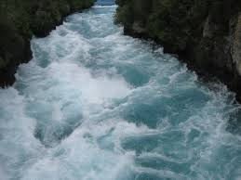
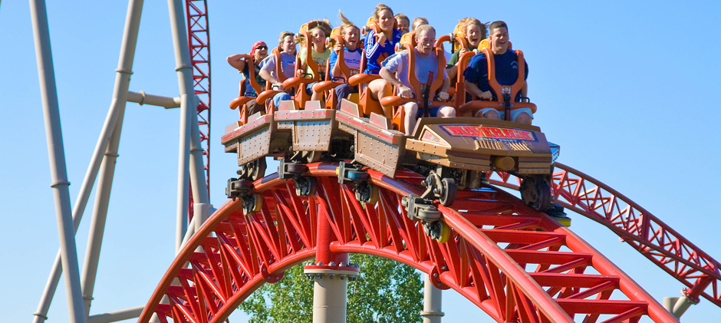
swift
Quick or rapid
http://pbskids.org/dragonflytv/show/rollercoasters.html
Tap the picture to watch a video of a swift roller coaster.
Notes:
Give student friendly definition
Use the word in other contexts

Slide 7

Thumbs up if this is an example swift.
Thumbs down if not.
A baby learned how to crawl.
The water quickly flowed down the mountain
The fire engine raced to save the burning building.
Our class walked to lunch in control of our bodies.
Notes:
Engage the students with the word

Slide 8
gulp
Notes:
Contextualize the word- Find it in the text
Say the word together

Slide 9
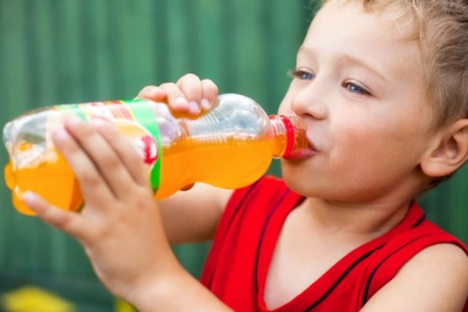
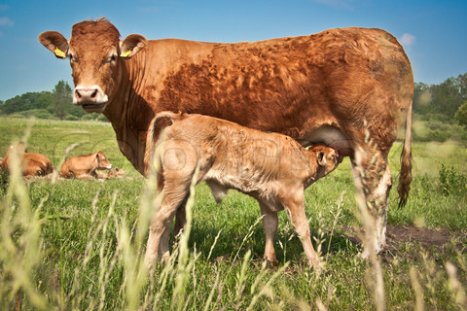
gulp
http://www.youtube.com/watch?v=nPhbVzFjU9w
Swallow loudly
Touch the picture to watch a video of a baby calf gulping milk from his mother.
Notes:
Give student friendly definition
Use the word in other contexts

Slide 10
How would your face look right before you take a gulp of your favorite drink?
Show me how you would gulp your favorite drink.
How would you look after you took a gulp of your favorite drink?
Notes:
Engage the students with the word

Slide 11
marvel
Notes:
Contextualize the word- Find it in the text
Say the word together

Slide 12
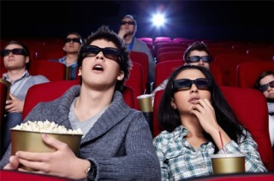
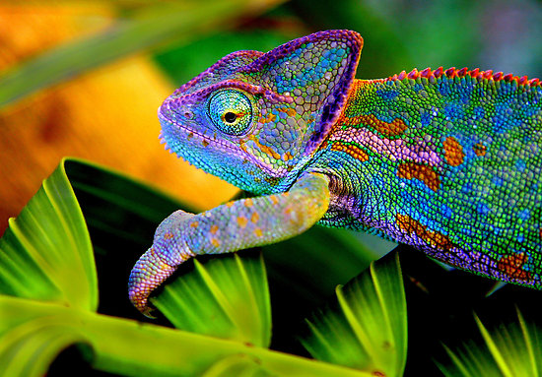
marvel
a wonderful person or thing
These people are marveling at the movie screen.
This lizard is a marvel in the animal world.
Notes:
Give student friendly definition
Use the word in other contexts

Slide 13
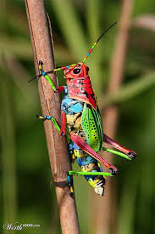
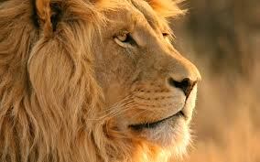
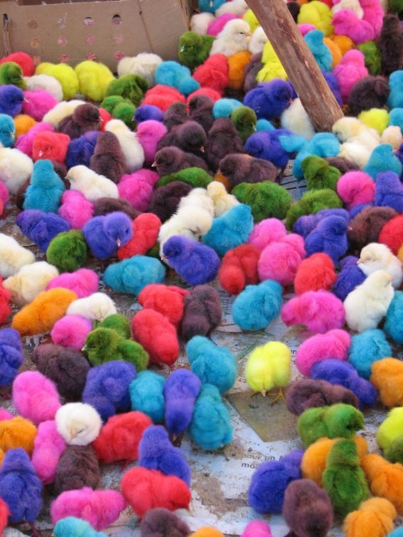
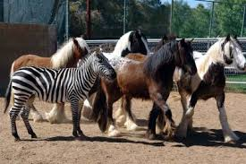
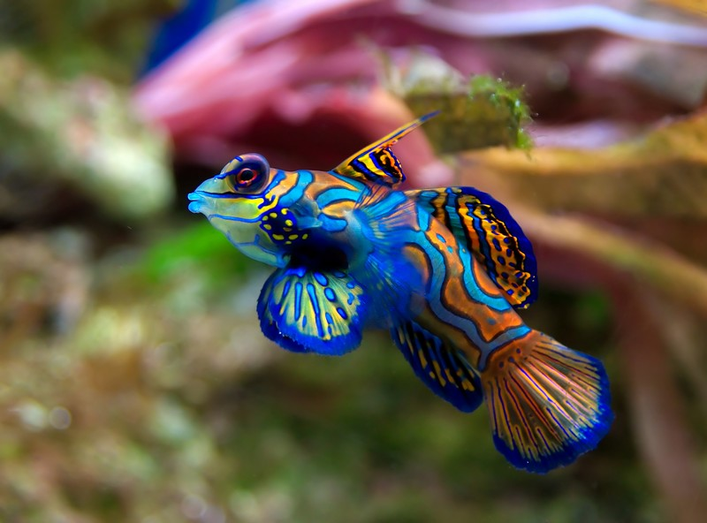
Describe one of these marvels in the animal world to a friend.
Notes:
Engage the students with the word

Slide 14
Who can use all 3 words in a sentence?
swift
gulp
marvel
Notes:
Read all three words and see if you can use them in one sentence.

Slide 15

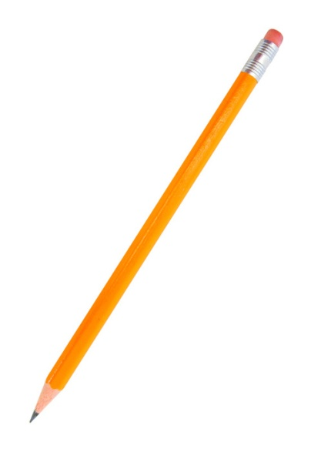
Draw a picture to show you know what these words mean.
swift
gulp
marvel
Notes:
Application-
Students need an opportunity to use the words they just learned from the text.

Slide 16
I can use words I learn from a text.
Notes:
Goal-
Revisit the Goal

