Slide 1

The Little Red Hen
Text Talk

Slide 2
I can use words I learn from a text.

Slide 3
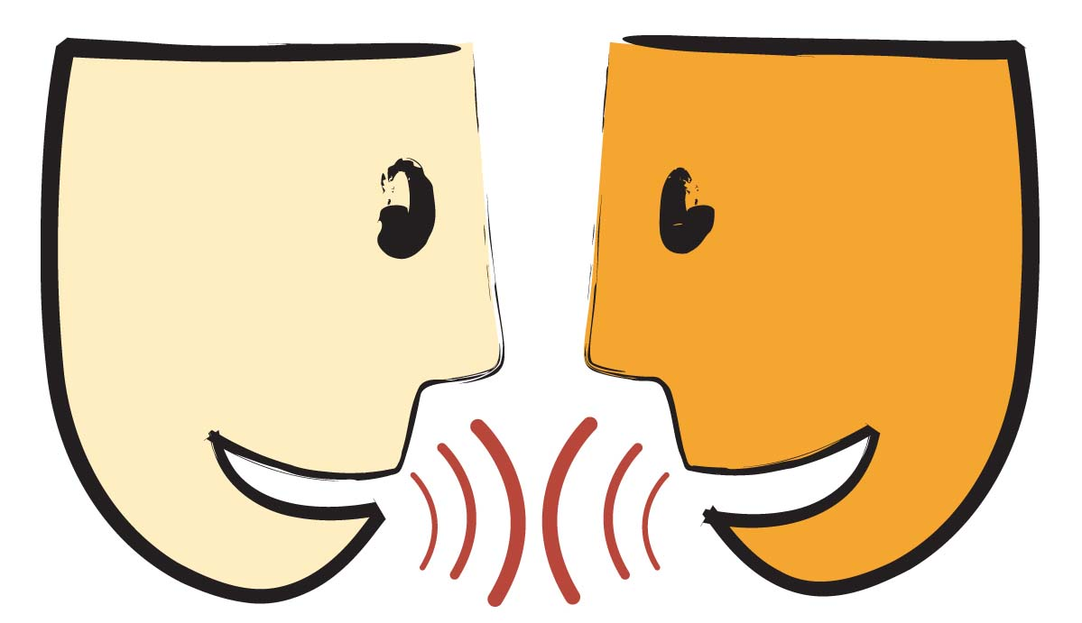
Tell your partner about a new word you learned last week.

Slide 4
Cozy

Slide 5

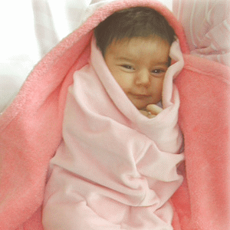
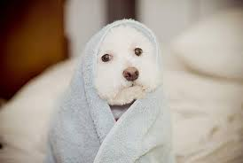
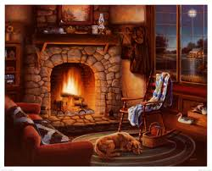
Cozy
Snugly warm and comfortable

Slide 6

Thumbs up if this is a time you would be cozy. Thumbs down if not.
You are sitting by the fire reading your favorite book.
You are at a restaurant sitting in a very uncomfortable, cold, hard chair.
You are snuggled up under your favorite blanket with your favorite teddy bear.

Slide 7
Stroll

Slide 8
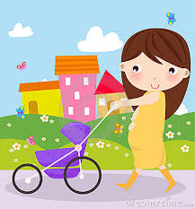
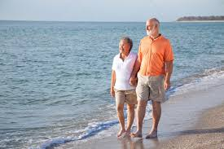
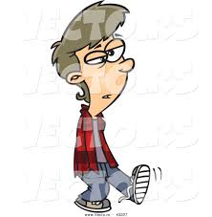
Stroll
A slow walk

Slide 9
Thumbs up if this is a time you would stroll. Thumbs down if not.
Your house is on fire and you need to get out.
You are looking for cereal in an aisle at Walmart.
You are looking at your neighbors beautiful flowers as you are on your walk.

Slide 10
Snooze

Slide 11
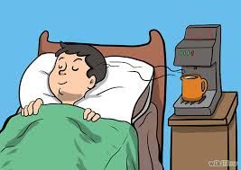
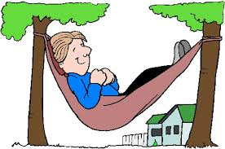
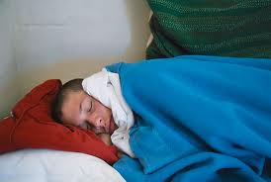
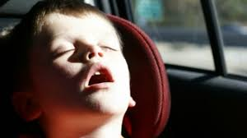
Snooze
To sleep

Slide 12
Pretend you are snoozing.
What does snoozing look like?

Slide 13
Who can use all 3 words in a sentence?
Snooze
Stroll
Cozy

Slide 14
I can use words I learn from a text

