Slide 1

1st Grade Text Talk
Unit 3

Slide 2
I can use words I learn from a text.
Notes:
Goal-
Students need to engage with the goal- read it, repeat it, write it, etc.

Slide 3

Tell your partner about a new word you learned last week.
Notes:
Access Prior Knowledge- (APK)
Turn and Talk

Slide 4

Notes:
New Information-
Read the book- provide a brief explanation of any words that may be new or unfamiliar to the students.

Slide 5
ordinary
Notes:
Contextualize the word- Find it in the text
Say the word together

Slide 6
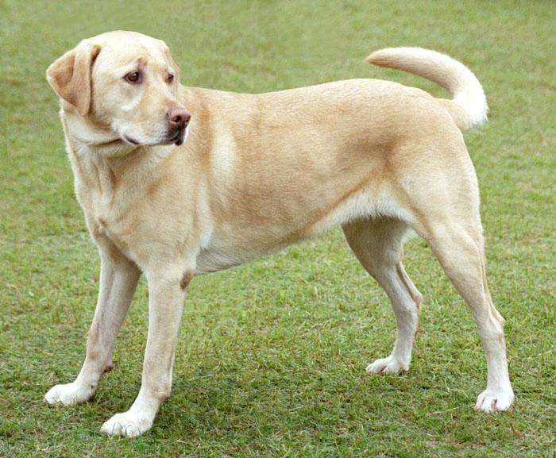
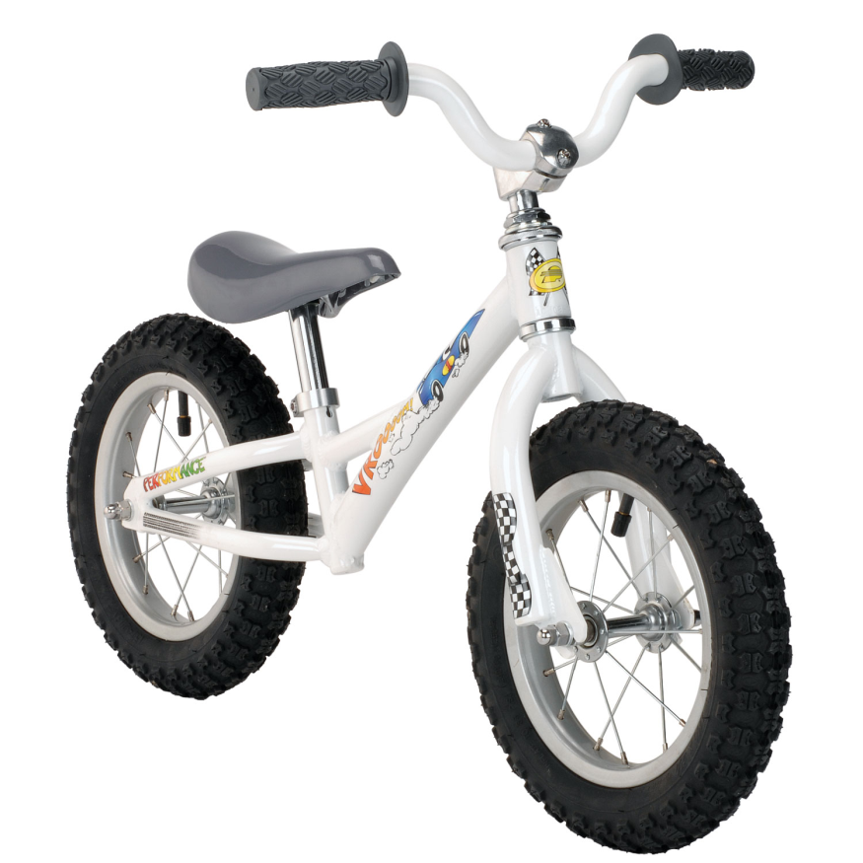
ordinary
common
Notes:
Give student friendly definition
Use the word in other contexts

Slide 7
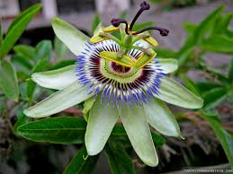
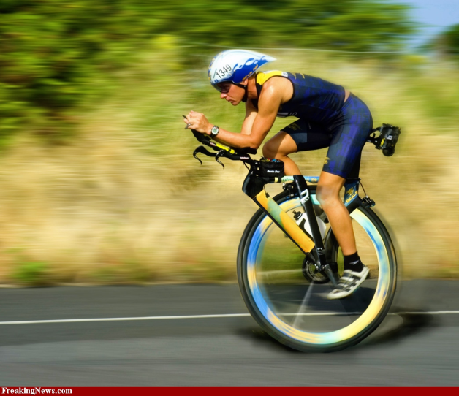

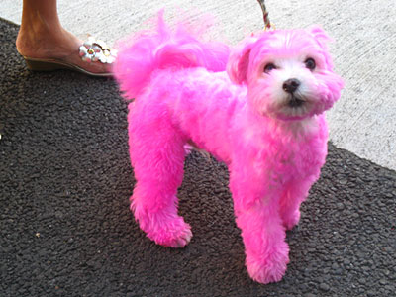

Which pictures show something ordinary?
Notes:
Engage the students with the word

Slide 8
envy
Notes:
Contextualize the word- Find it in the text
Say the word together

Slide 9
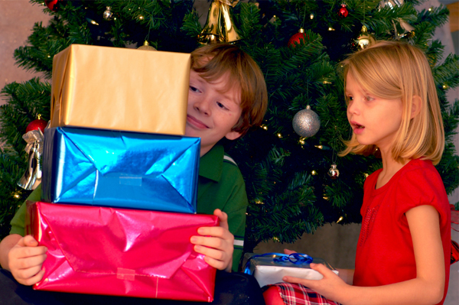
envy
Want something someone else has
Notes:
Give student friendly definition
Use the word in other contexts

Slide 10

Thumbs up if this is an example envy.
Thumbs down if not.
You did not get an award at the celebration assembly and you cried.
Your best friend brought a new box of crayons to school and you felt sad.
Your teammate scored three goals in your soccer game, and you gave them a high five!
Notes:
Engage the students with the word

Slide 11
vain
Notes:
Contextualize the word- Find it in the text
Say the word together

Slide 12
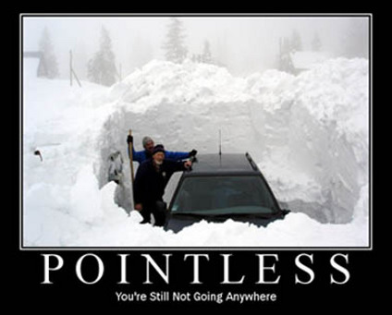
vain
Without success
Notes:
Give student friendly definition
Use the word in other contexts

Slide 13
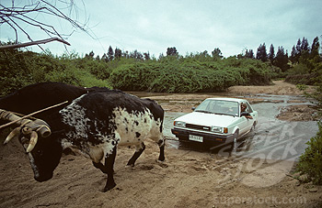
Tell about a time when you tried to do something in vain.
Notes:
Engage the students with the word

Slide 14
Who can use all 3 words in a sentence?
ordinary
vain
envy
Notes:
Read all three words and see if you can use them in one sentence.

Slide 15


Draw a picture to show you know what these words mean.
ordinary
vain
envy
Notes:
Application-
Students need an opportunity to use the words they just learned from the text.

Slide 16
I can use words I learn from a text.
Notes:
Goal-
Revisit the Goal

