Slide 1


Slide 2
swift
gulp
marvel

Slide 3
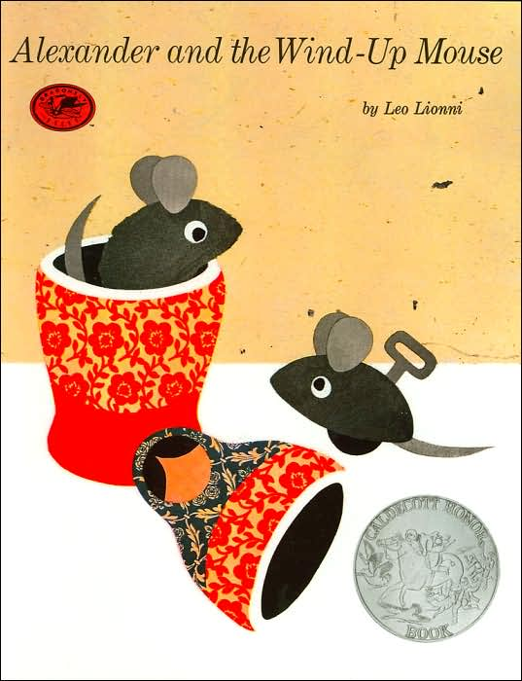

Slide 4
ordinary
envy
vain

Slide 5


Slide 6
sumptuous
quaked
frantically

Slide 7


Slide 8
flashy
nasty
bolted

Slide 9


Slide 10
flapped
midday
agreed

Slide 11


Slide 12
harmony
creep
disgrace

