Slide 1
Describing Art Work
ELA Grade 1 Unit 3
“Life Lessons”

Slide 2
Goal:
I can describe two paintings using specific words, or adjectives.

Slide 3
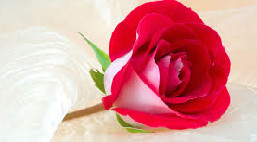
A Rose

Slide 4
Name everything in the picture.
Is this picture close up or far away?
What colors do you see in this picture?

Slide 5
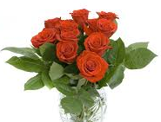
Roses

Slide 6
Name everything in the picture.
Is this picture close up or far away?
What colors do you see in this picture?

Slide 7
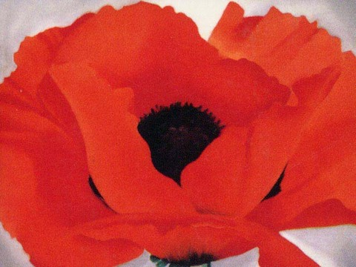
Georgia O’Keeffe, Red Poppy (1927)
Notes:
Georgia O’Keeffe, Red Poppy

Slide 8
Describe this painting by Georgia O’Keeffe
Name everything you see in this painting.
Does the artist show the flower up close or far away?
What colors are in the picture?

Slide 9
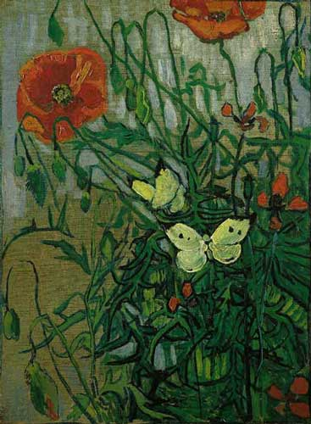
Vincent Van Gogh, Butterflies and Poppies (1890)
Notes:
Vincent Van Gogh, Butterflies and Poppies

Slide 10
Describe this painting by Vincent Van Gogh
Name everything you see in this painting.
Does the artist show the flowers up close or far away?
What colors are in the picture?

Slide 11
Did I Achieve the Goal?
I can describe two paintings using specific words, or adjectives.

Slide 12
Lesson 2
Compare and Contrast
Goal: I can compare two paintings to tell how they are alike and how they are different.

Slide 13
Review the descriptions of the paintings:
Butterflies and Poppies by Vincent Van Gogh
Red Poppy by Georgia O’Keeffe

Slide 14
Are there any words that you used for both paintings? These words can be used to tell how the paintings are alike.

Slide 15
Compare the words you used to describe both paintings.
Are there some words that you used for one painting, but not for the other?
These are words that can describe how the paintings are different.

