Slide 1
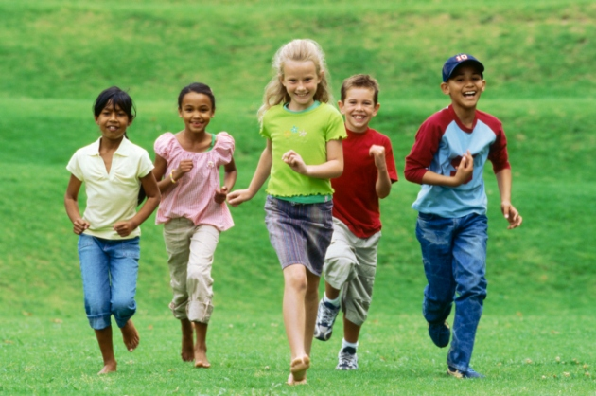

Slide 2
I can compare the experiences of characters in a story.
1 2 3 4

Slide 3
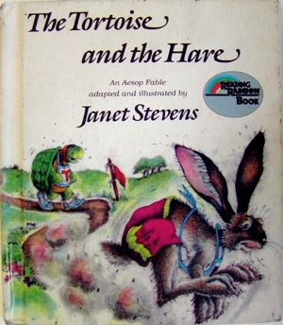
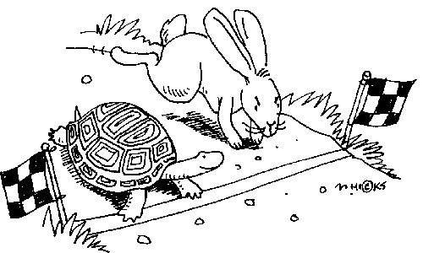

Slide 4
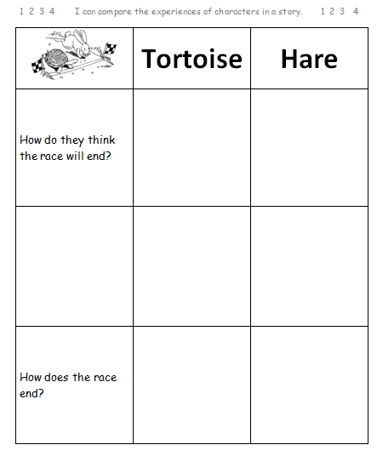
Comparing
I find the items to compare.
I choose the features to compare.

Slide 5
Listen to the race portion of The Tortoise and the Hare. (click on the book for the video- fast forward 3:51- 8:12)

Slide 6
Comparing
I find the items to compare.
I choose the features to compare.
I tell how the items are the same or different.

Slide 7
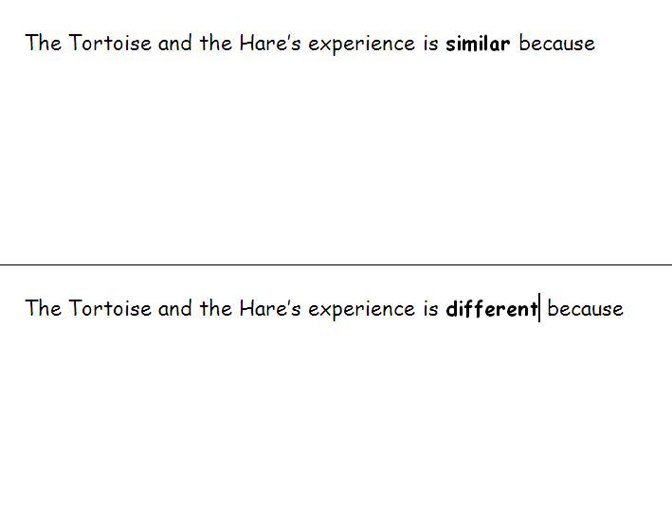

Slide 8
I can compare the experiences of characters in a story.
1 2 3 4

