Slide 1

1st Grade Text Talk
Unit 2

Slide 2
I can use words I learn from a text.
Notes:
Goal-
Students need to engage with the goal- read it, repeat it, write it, etc.

Slide 3
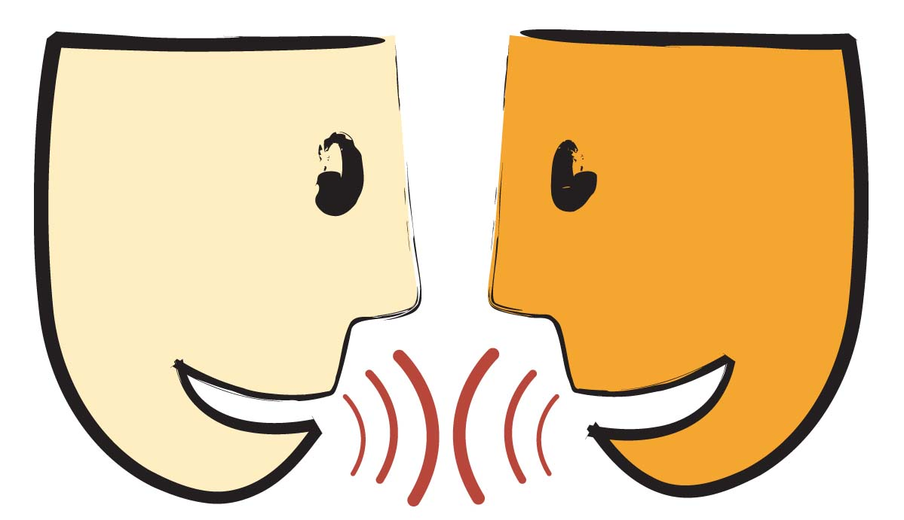
Tell your partner about a new word you learned last week.
Notes:
Access Prior Knowledge- (APK)
Turn and Talk

Slide 4
Notes:
New Information-
Read the book- provide a brief explanation of any words that may be new or unfamiliar to the students.

Slide 5
aquaintance
Notes:
Contextualize the word- Find it in the text
Say the word together

Slide 6
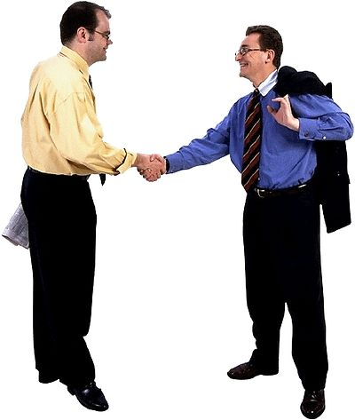
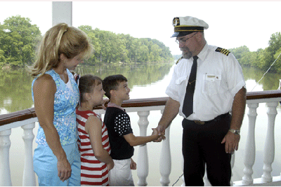
aquaintance
A person that you know, but not that well.
Notes:
Give student friendly definition
Use the word in other contexts

Slide 7

Thumbs up if this is an example of people that are aquaintances. Thumbs down if not.
Two students—one is a first grader and the other is a 3rd grader. They have only met once before.
Your very best friend.
Your family.
The checker at the grocery store.
Notes:
Engage the students with the word

Slide 8
hazy
Notes:
Contextualize the word- Find it in the text
Say the word together

Slide 9
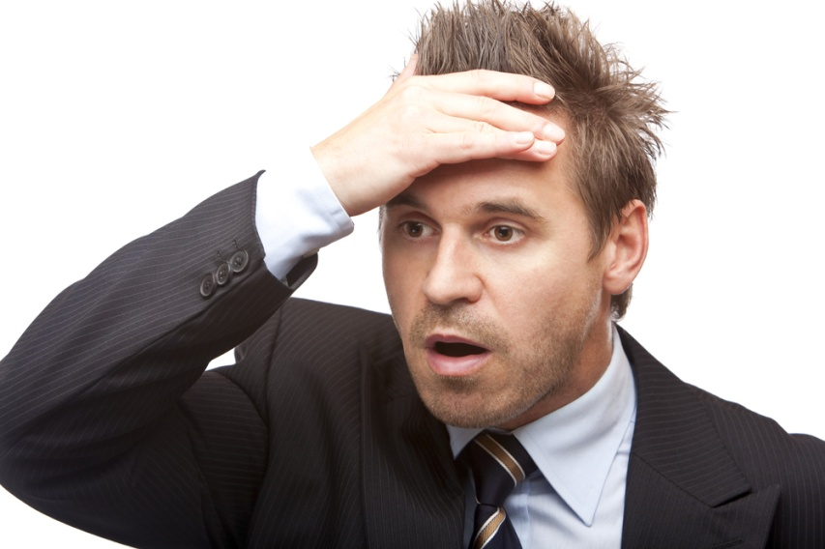
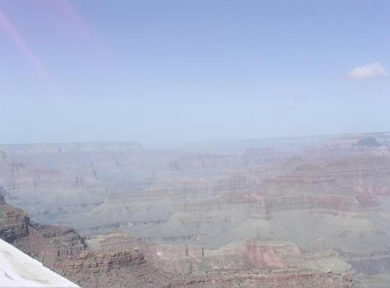

hazy
?
Air that is not clear.
A memory that is not clear.
?
Touch the picture to watch a video of morning
haze moving into the Grand Canyon
Notes:
Give student friendly definition
Use the word in other contexts

Slide 10


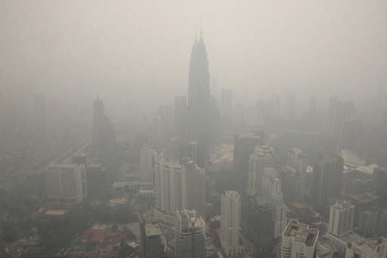
Which pictures are hazy?
Notes:
Engage the students with the word

Slide 11
solemnly
Notes:
Contextualize the word- Find it in the text
Say the word together

Slide 12
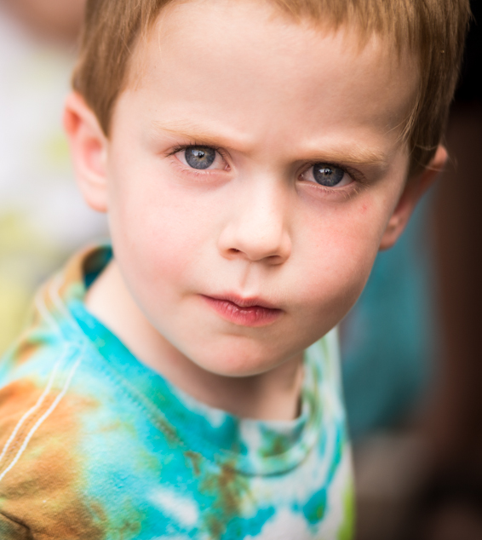
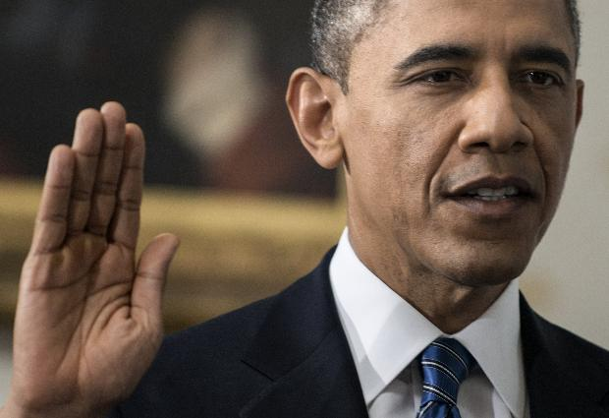
solemnly
to be serious
“I solemnly swear…”
Notes:
Give student friendly definition
Use the word in other contexts

Slide 13
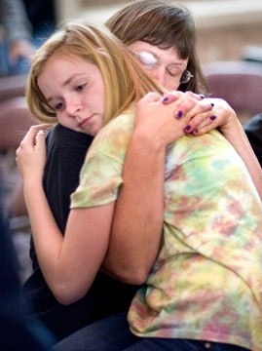
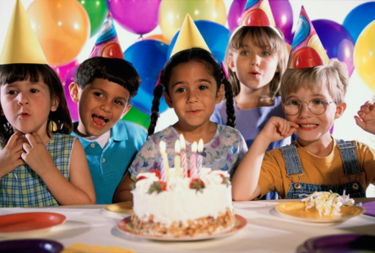
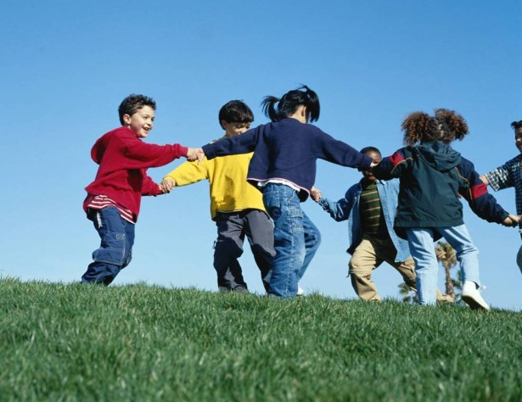
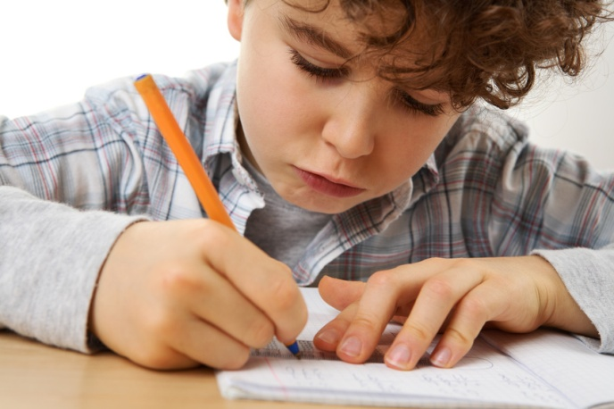
Which pictures show people that are behaving
solemnly?
Notes:
Engage the students with the word

Slide 14
Who can use all 3 words in a sentence?
aquaintance
hazy
solemnly
Notes:
Read all three words and see if you can use them in one sentence.

Slide 15


Draw a picture to show you know what these words mean.
aquaintance
hazy
solemnly
Notes:
Application-
Students need an opportunity to use the words they just learned from the text.

Slide 16
I can use words I learn from a text.
Notes:
Goal-
Revisit the Goal

